Slide 1
15 Days in Nepal!
By: Mehavi Patel

Slide 2
Flight Itinerary
January 30th, 2010
ATL – ORD : Flight # AA 2030 – Leaves @ 4:15pm ; Arrives @ 5:30pm
ORD – DEL : Flight # AA 292 – Leaves @ 7:15pm ; Arrives @ 9:45pm
DEL – KTM : Flight # 9W 264 – Leaves @ 7:45am; Arrives @9:30am
February 14th, 2010
KTM – DEL : Flight # 9W 261 – Leaves @ 3:45pm ; Arrives @ 5:15pm
DEL – ORD : Flight # AA 293 - Leaves @ 12:55 am ; Arrives @ 5:15am
ORD – ATL : Flight # AA 2441 – Leaves @ 7:10am ; Arrives @ 10:15
~~~ ATL = Atlanta ~~~ ORD = Chicago ~~~ DEL = Delhi ~~~ KTM = Kathmandu ~~~
Source : Orbitz.com

Slide 3
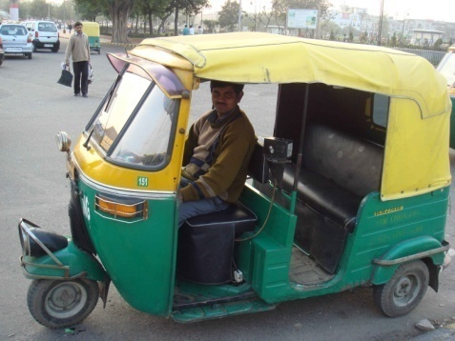
Transportation
The main way (and cheapest) is by taking a public bus. You can even take a taxi or a rickshaw .Tempos, which are sturdier versions of rickshaws and mini buses ( these are usually for 4- 6 people each and they take the same routes as local buses. If you really want to fit in , you can even rent a bicycle/ motorcycle from Thamel. And of course you have the free way to taking your feet – walking.

Slide 4
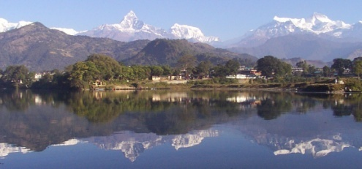
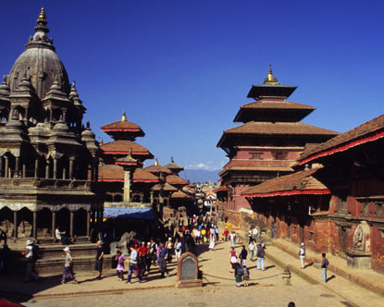
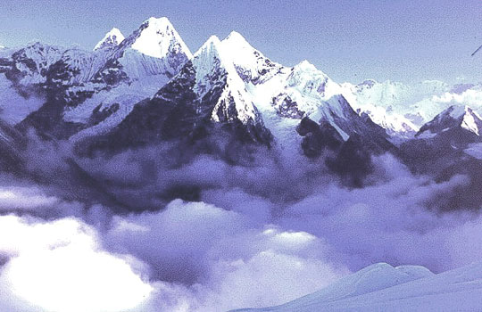
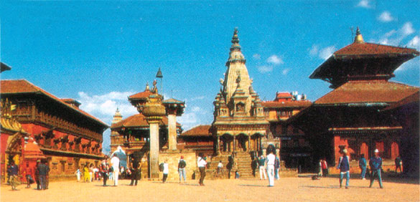
Cities to see….
Kathmandu----- 5 days
Pokhara----- 5 days
Bhaktapur----- 5 days

Slide 5
Kathmandu!!!

Slide 6
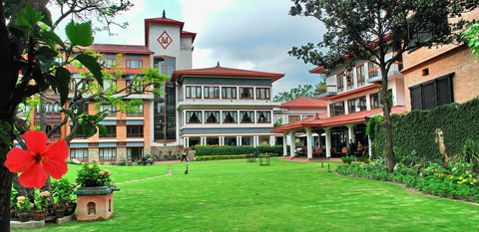
Kathmandu Accommodation
Hotel Malla
-Peaceful Oasis In the Heart of Kathmandu
Location: Between the Royal Palace And Thamel
Description: It offers along with staying a well equipped business center, extensive meeting and conference facilities, a health club with the latest work out equipment, sauna, massage, steambath and jacuzzi.
Average Rating : 4.5/5
Cost : $130 (Single Deluxe)

Slide 7
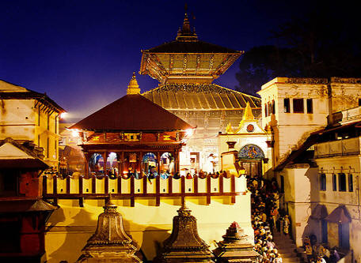
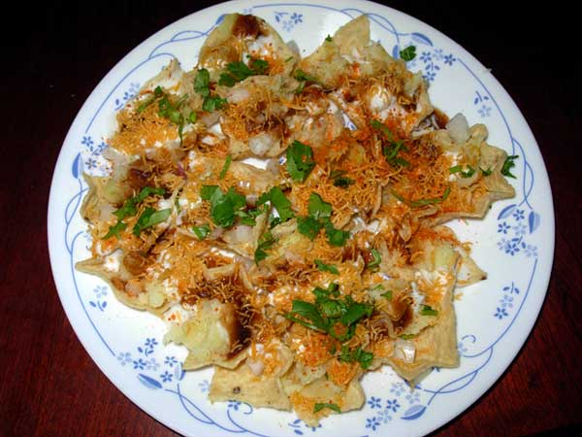
Kathmandu Day 1
Pashupati - when lord Shiva came to Pashupati to escape from his boredom, he became famous as the lord of animals (Pashupati) many Nepalese visit this temple.
Restaurant:
- Kathmandu Restaurant --- Chaat Paapry

Slide 8
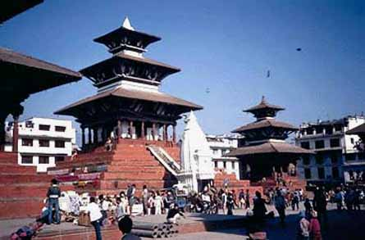
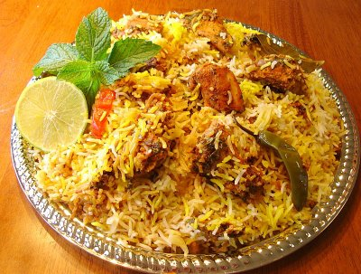
Kathmandu Day 2
Kathmandu Durbar Square- it is a durbar of history and arts. It also has a museum that shows the history of Nepal Kings/Rulers. Here you can also see tons of courtyards that have secret passages. Also this place has come of Nepal’s oldest temples. Also you can see Sundari Chok (Beautiful courtyard).
Restaurant:
- Bristol’s Kathmandu Restaurant --- Vegetable Biryani

Slide 9
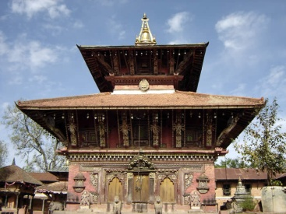
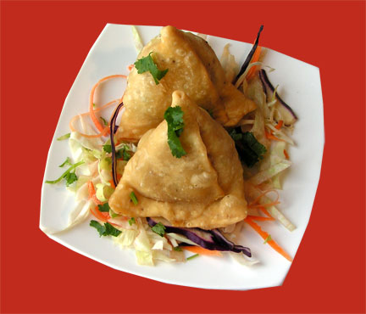
Kathmandu Day 3
Changu Narayan – This temple is completely devoted to Lord Vishnu(the creator).It is believed that this temple is the most ancient. Prayers here are most often answered.
Restaurarnt:
- Bhojan Griha --- Samosa Chaat

Slide 10
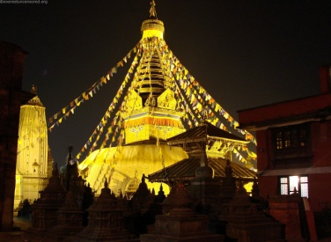
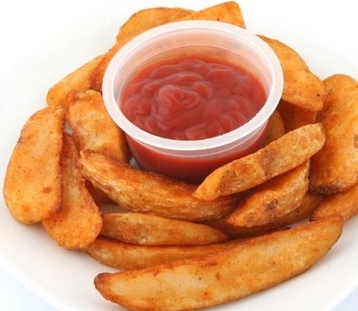
Kathmandu Day 4
Swayambhu- The history of Kathmandu begins at this temple. This valley was a lake, but later when Bodhisattva Manjusri cut a gorge in a southern hill and drained the waters to worship a lotus that he admired during his travel to the region, it lead men to settle on the bed of the lake and named this land Kathmandu Valley. If one visits this place they learn about the religious harmony.
Restaurant:
- Aqua Java Zing --- Cajun Spiced Baked Potatoes

Slide 11
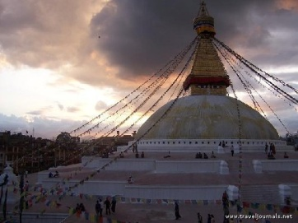
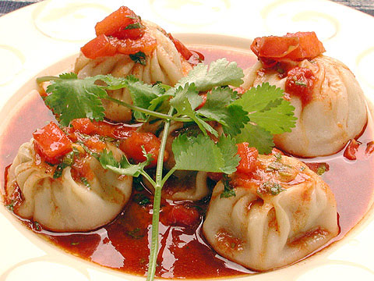
Kathmandu Day 5
Bouddhanath Stupa- one of Nepal's largest stupas, it is the home to Tibetan Buddhists in Nepal. It has many Stupas in nearby, which make it a popular tourist site.
Restaurant:
- Dwarika’s --- Samaya Bajee & Momo

Slide 12
Pokhara!!!

Slide 13
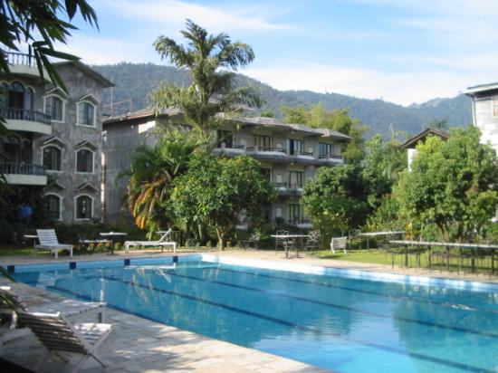
Pokhara Accomodation
Hotel Barahi
Location : Beside Lake Phewa (AKA Fewa)
Description : All rooms include a private balcony from which guests can enjoy spectacular views of Fishtail Mountain and the Annapurnas. All rooms come with en-suite bathroom (including shower and tub) as well as hot running water 24 hours a day, naturally. We have a 24 hour room service and a laundry service.
Average Rating : 4/5
Cost : $75 (Single Deluxe)

Slide 14
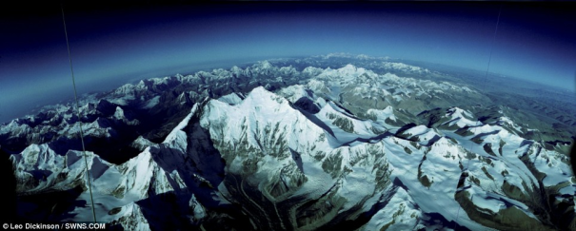
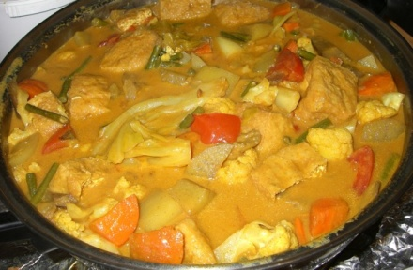
Pokhara Day 1
Mountain Views- See the beautiful scenery using Everest Air. You can see the beautiful side of the Western Himalayas.
Restaurant:
- Yuriko Momo Restaurant --- Daal Bhaat

Slide 15
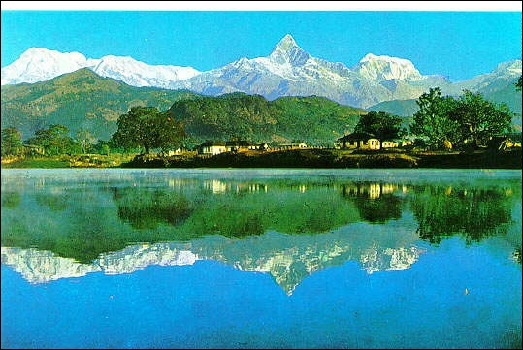
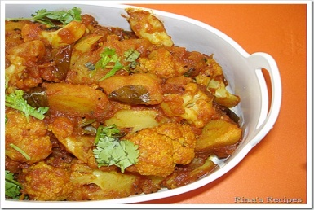
Pokhara Day 2
Phewa Lake- See the 2nd largest lake, and pray at the gorgeous temple at the island in the middle of the lake.
Restaurant:
- Kohinoor Punjabi Restaurant --- Aloo Gobi

Slide 16
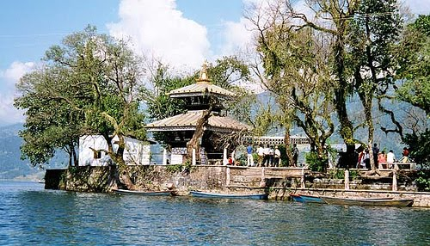
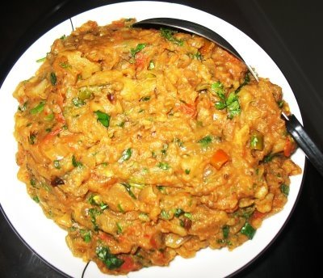
Pokhara Day 3
Barahi Temple: The Barahi Temple is the most important monument in all of Pokhara; this 2-story pagoda has been made for and dedicated to the force of Shakti.
Restaurant:
- Marwadi Sewa Bhojanalaya --- Baingan Bharta

Slide 17
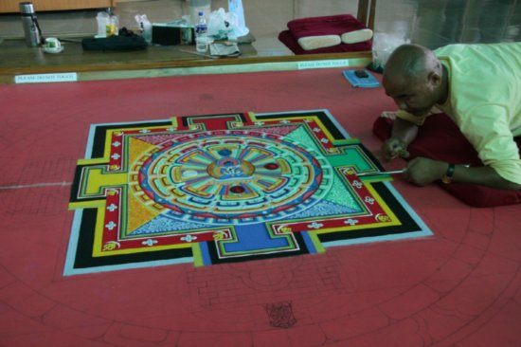
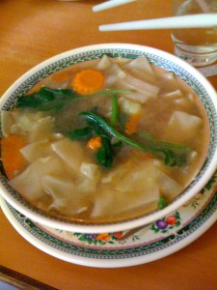
Pokhara Day 4
The Pokhara Museum – At this museum, you can see all the main things that have occurred in Western Nepal up until today. You can learn about the ethnic groups of Thakali, Gurung and Tharu.
Restaurant:
- The Little Tibetan Tea Gardern --- Thenthuk

Slide 18
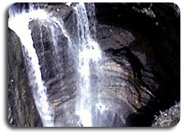
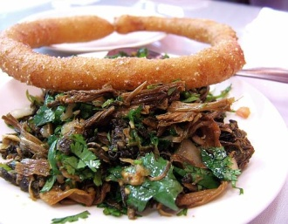
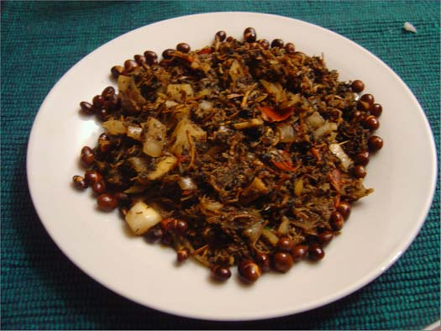
Pokhara Day 5
Devi’s Fall – This is a very beautiful waterfall located 2 kilometers south of the Pokhara Airport. Lagends say that a trekker (David) was washed away and suddenly disappeared into an underground passage below the fall.
Restaurant:
- Once upon a time --- gundruk and dhedo

Slide 19
Bhaktapur!!!

Slide 20
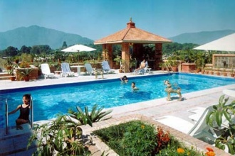
Bhaktapur Accomodation
Planet Bhaktapur Hotel
Location : Jhaukhel VDC, 7 cha, Bhaktapur, Nepal (30 minutes away from Kathmandu Airport)
Description : RESTAURANT "LA BELLA Nepal" TV room, LIBROTECA, INTERNET pedal, PHONE, FAX.
SOCCER CAMP
Indoor and outdoor garden
Big terrace with 360 ° swivel on the Kathmandu Valley
HELP DESK (Francis and friends of Staff) for advice and arrange excursions or tours, tours of Nepal ... etc ...
Reception 24 hours a day, every day and night.
Average Rating : 4.8/5
Cost : $39.00 ( Single Room)

Slide 21
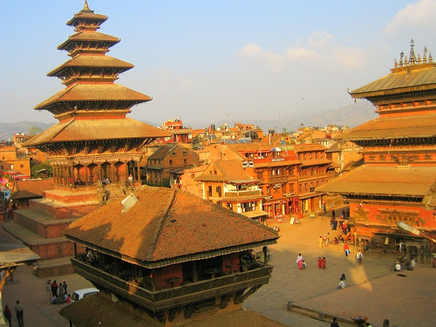
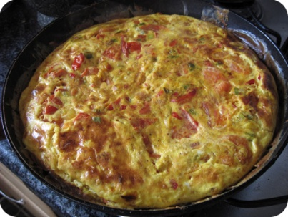
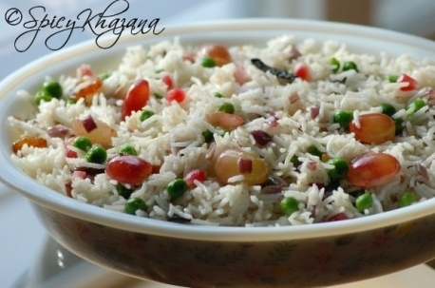
Bhaktapur Day 1
Bhaktapur Durbar Square – A popular tourist spot here is the 55 window palace. This place is very old and seeing its ancient monuments is a pleasure many tourists never forget.
Restaurant:
- Palace Restaruant --- Masala Omlette,Kashmere Pulao, Sugarcane Juice

Slide 22
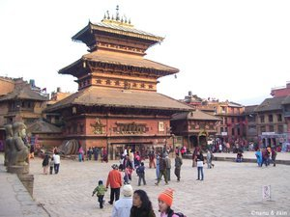
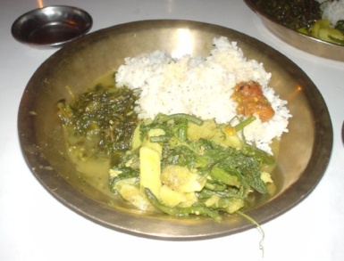
Bhaktapur Day 2
Taumadhi Square – this is Nepal’s tallest pagoda (5-story). This temple is in the name of Goddess Laxmi.
Restaurant:
- Pagoda Restaurant --- Daal bhatt Takri

Slide 23
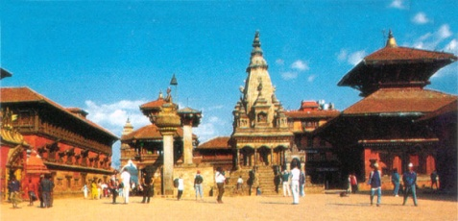
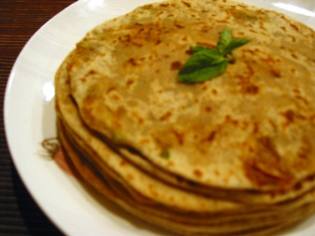
Bhaktapur Day 3
The National Art Gallery – has ancient paintings from Buddhist & Hindu schools.
Restaurant:
- New Chenn ---Plain Paratha

Slide 24
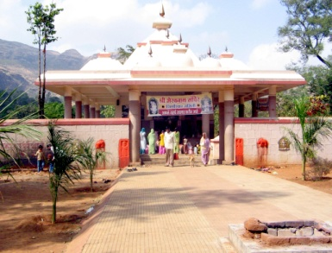
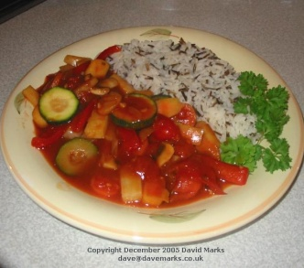
Bhaktapur Day 4
Bhairavnath Temple – This temple is often visited as it is dedicated to the god of terror Bhairav.
Restaurants:
- Big Bell Guest House --- Sweet & Sour Vegetables with Rice

Slide 25
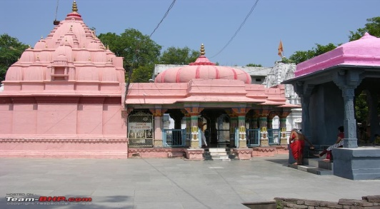
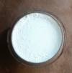
Bhaktapur Day 5
Dattatraya Temple – It is said that this temple was to have been made from a single tree trunk. And right next to it one can see a carved peacock window.
Restaurants:
- Sunny Restaurant --- Juju Dhao (the king of Kurds meal)

Slide 26
Bibliography
KATHMANDU RESTAURANT - The Finest Indian and Nepalese Cuisine in Toronto ! ::. Web. 30 Jan. 2010. <http://www.kathmandurestaurant.ca/menu.asp>.
"Aqua Java Zing." Nepal Travel, Trekking, Tours Information and provides tips on traveling through Bhutan and Tibet. Web. 30 Jan. 2010. <http://www.visitnepal.com/aquajava/>.
"Bhojan Griha - The Exceptional Cuisine and information about Local Nepalese Food, Cuisine, Eating, Dining." Nepal Travel, Trekking, Tours Information and provides tips on traveling through Bhutan and Tibet. Web. 30 Jan. 2010. <http://www.visitnepal.com/restaurants/bhojan_griha.php>.
"Krishnarpan Menu." Dwarikas Hotel, Nepal Hotels, Kathmandu Hotels, Hotels in Nepal, Luxury Hotels in Nepal, Deluxe Hotels in Nepal, 5 Star Hotels Nepal, Five Star Hotels Nepal, Heritage Hotels Nepal. Web. 30 Jan. 2010. <http://www.dwarikas.com/krishnarpan_9cmenu.html>.
"Nepal Restaurants and information about Local Nepalese Food, Cuisine, Eating, Dining." Nepal Travel, Trekking, Tours Information and provides tips on traveling through Bhutan and Tibet. Web. 30 Jan. 2010. <http://www.visitnepal.com/restaurants/>.
"The New Menu at Bristol's Kathmandu Restaurant." Kathmandu Nepalese and Indian Curry Restaurant in Bristol. Web. 30 Jan. 2010. <http://www.kathmandu-curry.com/menu290905.php>.
Print.
"Restaurants & Bars - Dwarikas Hotel, Nepal Hotels, Kathmandu Hotels, Hotels in Nepal, Luxury Hotels in Nepal, Deluxe Hotels in Nepal, 5 Star Hotels Nepal, Five Star Hotels Nepal, Heritage Hotels Nepal." Dwarikas Hotel, Nepal Hotels, Kathmandu Hotels, Hotels in Nepal, Luxury Hotels in Nepal, Deluxe Hotels in Nepal, 5 Star Hotels Nepal, Five Star Hotels Nepal, Heritage Hotels Nepal. Web. 30 Jan. 2010. <http://www.dwarikas.com/restaurantsnepal.html>.
"Sunny Restaurant Restaurants in Bhaktapur - Lonely Planet Travel Information." Lonely Planet Travel Guides and Travel Information. Web. 30 Jan. 2010. <http://www.lonelyplanet.com/nepal/around-the-kathmandu-valley/bhaktapur/restaurants/449937>.
WelCome to Palace Restaurant, Bhaktapur Durbar Square : located in front of National Art Gallery, in the heart of Bhaktapur Durbar Square. We are specialised for fresh, hygienic and Delicious foods like Nepali sets,Typical Newar Sets, Chinese, Indian and Continental etc. Web. 30 Jan. 2010. <http://palacerestaurantbkt.com/menu2.htm>.
"Bhaktapur nepal info guide, bhaktapur nepal general info, bhaktapur nepal info, bhaktapur nepal general information, bhaktapur nepal information, bhaktapur nepal data bank, bhaktapur nepal travel guide, bhaktapur nepal tourist guide, bhaktapur nepal travel agent, bhaktapur nepal tour operator, bhaktapur nepal car tours, bhaktapur nepal coach tours, bhaktapur nepal packages, bhaktapur nepal tour packages, bhaktapur nepal accommodation guide, bhaktapur nepal hotel guide, bhaktapur nepal tourism,bhaktapur nepal tourist office, bhaktapur nepal tourism board, bhaktapur nepal tourist." Nepal travel,nepal travel guide,Nepal tourism, travel nepal, travel to nepal, travel in nepal, travel india nepal, nepal tibet travel, nepal and travel, nepal travel tip, travel tibet nepal tour. Web. 28 Jan. 2010. <http://www.nepaltravelinfo.com/bhaktapur1.htm>.
"Nepal Home Page Travel Guide: Restaurants." Web. 27 Jan. 2010. <http://www.nepalhomepage.com/travel/restaurants.html>.
"Places to See: Pokhara." Friendship Nepal Tours & Travels - Nepal, Tours in Nepal, Nepal Tours, Travel Nepal, Nepal Travel, Nepal Tour, Tour Nepal, Tour to Nepal, Tour in Nepal, Tour Package, Nepal Trekking, Trekking Nepal, Nepal Map, Picture of Nepal, Trekking in Nepal, Visit Nepal, Nepal Trip, Trip to Nepal, Travel in Nepal. Web. 27 Jan. 2010. <http://www.friendshipnepal.com/sightseeing_places/places_pokhara.php>.
"Places to visit in bhaktapur, bhaktapur durbar square, taumadhi square, Dattatreya Square, pottery square, Nyatapola Temple, national art gallery, bhairab temple, surya binayak, kamal binayak temple, hahuman ghat, nava durga temple, jitpur sudal, nagarkot,thimi, changu narayan temple, temples of bhaktapur, nepal bhaktapur city, places to stay, nepal bhaktapur pictures, about bhaktapur, hotels in bhaktapur, bhaktapur temples, shopping in bhaktapur, bhaktapur thankas, restaurants in bhaktapur, lodges in bhaktapur, bhaktapur hospital, bhaktapur police, taxi to bhaktapur, tradition of bhaktapur, culture of bhaktapur, bhaktapur dance, bhaktaur people, bus to bhaktapur, how to go to bhaktapur, bhaktapur trekking, bhaktapur travel, nagarkot hotels, hotels in nagarkot, nagarkot view, sun rise sun set in nagarkot, information about bhaktapur, bhaktapur places to see, nepal trekking, trekking in nepal, nepal trek, nepal hike, annapurna trek, everest trek, trek to nepal, helambu trek, nepal hiking, hiking in nepal, trekking in nepal." ::Bhaktapur Online ::.- about bhaktapur, hotels in bhaktapur, bhaktapur temples, shopping in bhaktapur, bhaktapur thankas, restaurants in bhaktapur, lodges in bhaktapur, bhaktapur hospital, bhaktapur police, taxi to bhaktapur, tradition of bhaktapur, culture of bhaktapur, bhaktapur dance, bhaktaur people, bus to bhaktapur, how to go to bhaktapur, bhaktapur trekking, bhaktapur travel, nagarkot hotels, hotels in nagarkot, nagarkot view, sun rise sun set in nagarkot, information about bhaktapur, bhaktapur places to see, nepal trekking, trekking in nepal, nepal trek, nepal hike, annapurna trek, everest trek, trek to nepal, helambu trek, nepal hiking, hiking in nepal, trekking in nepal. Web. 28 Jan. 2010. <http://www.bhaktapuronline.com/places%20to%20visit.htm>.
"Sightseeing places in Nepal, Places to see in, Nagarkot, Pokhara, Dhulikhel, Kritipur, Daman, Nuwakot, Gurkha, Chitwan." Nepal Guide & Travel Information - A Travel Destination in Nepal, Virtual Guide of Nepal. Web. 27 Jan. 2010. <http://www.thamel.info/outside_kathmandu.php>.
Hotel Barahi ! Pokhara, Nepal ! Web. 02 Feb. 2010. <http://www.barahi.com/>.
"Tariffs - Hotel Barahi." Hotel Barahi ! Pokhara, Nepal ! Web. 02 Feb. 2010. <http://www.barahi.com/tariffs/index.htm>.
"Welcome to The Malla Hotel | The Hotel Malla." Welcome to The Malla Hotel | Welcome to Nepal. Web. 02 Feb. 2010. <http://www.hotelmalla.com/hotel>.
"Welcome to The Malla Hotel | The Malla Hotel Accommodation." Welcome to The Malla Hotel | Welcome to Nepal. Web. 02 Feb. 2010. <http://www.hotelmalla.com/accomodation>.

Slide 27
Hope You Enjoyed Your Stay In Nepal
Come Again Soon
Your Tour Guide: Mehavi Patel

