Slide 1


Egypt
By: Shine Lee

Slide 2

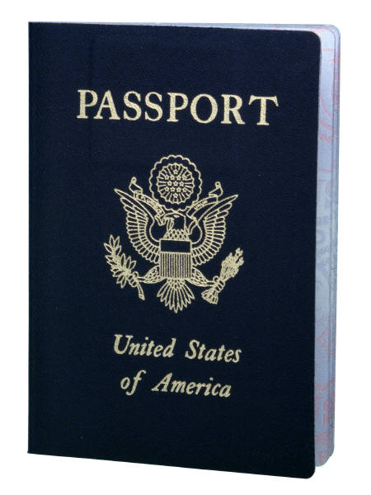

What kind of paperwork do you need to enter Egypt?
You need a passport and a visa to get into Egypt.
It is a $15 fee for a 30-day visa.

Slide 3
Unsafe places in Egypt
If you were traveling to Egypt, you should know what places are safe to visit, and places that are dangerous. Egypt is a pretty safe country, but you should avoid dark and deserted places, and especially highways. In Egypt, there has been many accidents in the highways, whether someone was crossing the road, or someone was driving unsafely.
There are a couple of safety concerns in Egypt. First of all, you should always travel in groups when visiting Egypt. Next, if you were a woman, you probably shouldn’t be traveling at night by yourself. Also, if it’s dark outside and you have to drive for an hour (or hours) on the highway, you should hire someone (who drives carefully) to drive you. So, remember these things when traveling to Egypt and you will be safe!

Slide 4


How far is it?
From Suwanee, GA, to Cairo, Egypt it is…
6,339 miles!
Wow, that’s far!
Georgia

Slide 5
What about Egypt’s currency?
Egypt’s currency is called Egyptian pounds.
$10 in the U.S. would be about $57.06 in Egypt!

Slide 6


What time is it?
*It is... 6:00 p.m.*
If it’s noon in Atlanta, what time is it in Egypt?

Slide 7



Independence for Egypt
Egypt gained its independence on February 28th, 1922!

Slide 8


What’s Egypt's International Country Code?
The international country code of Egypt is .eg.

Slide 9

Egypt’s International Soccer Rank
Soccer is a popular sport played around the world, and almost all countries have an international rank.
(The best rank is 1, and the worst rank is 202.)
Egypt’s International rank in soccer is...9!

Slide 10

Population of Egypt
1998: 66,050,004 people
Today: 78,866,635 people

Slide 11
Population Density
1998: 66 people per/sq kilometer.
Today: 82.3 people per/sq kilometer
Egypt

Slide 12

Per Capita Income
Egypt’s per capita income in 1998 was $1,146 per/person.
Today, it is $5,400 per/person.

Slide 13
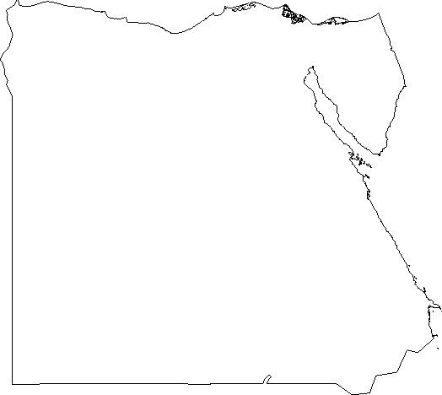
How big is it?
Compared to Mexico, how big is Egypt?
It is slightly more than 3 times the size of Mexico.
x3 =
Egypt
Mexico

Slide 14
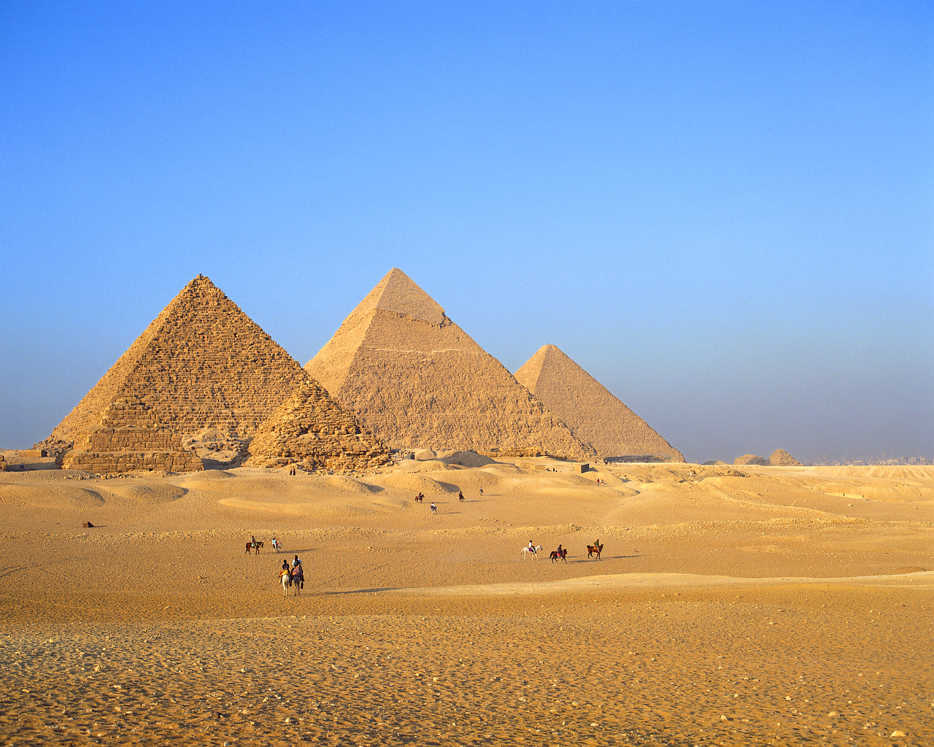
Area of Egypt
Egypt is approximately…
385,229 sq. miles or 997,739 sq. kilometers.

Slide 15

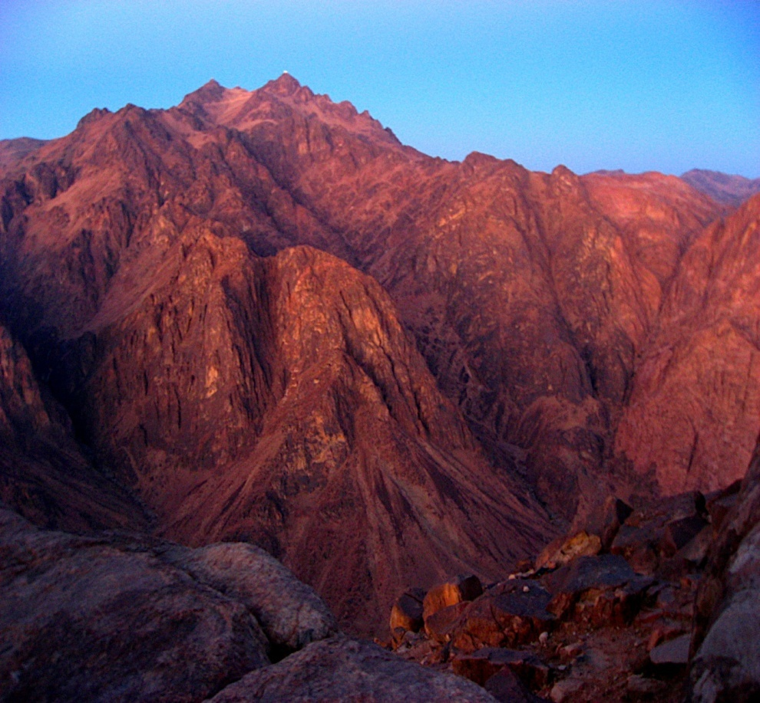
The Highest Point in Egypt
The highest point in Egypt is on Mount Catherine.
This mountain is 2,629 m high.

Slide 16

Egypt’s natural resources
Natural resources found in Egypt:
Petroleum
Natural gas
Iron ore
Limestone
Lead
Zinc
Etc.

Slide 17
What’s the fertility rate?
The fertility rates of Egypt from today and 1998:
Fertility Rate: How many children born per woman.
1998- 3.41 children born per/women.
Today-3.01 children born per/women.

Slide 18

Infant Mortality Rate of Egypt
Today and from 1998:
1998: 69.23 deaths/1000 live births
Today: 27.26 deaths/1000 live births
Births…
Deaths…

Slide 19

What is the life expectancy?
How long are the people of Egypt expected to live?
1998- 62.1 years
Today- 72.12 years

Slide 20

Literacy rates of Egypt
Literacy rate- people over the age of 15 that can read and write.
1998: 51.4%
Today:71.4%

Slide 21
Major ethnic groups
Egyptian: 99.6%
Other: .4%

Slide 22


Major Religions
Islam(Mostly Sunni): 90%
Coptic: 9%
Christian: 1%

Slide 23
Bibliographies:
“Blank Outline Map of Egypt.” Drawing. 2005. 9/12/10. www.aneki.com
Bureau of consular affairs. “Egypt.” August 12th, 2009. Online. 8/25/10. www.http://travel.state.gov
David Degnan. “What does the eagle mean on the Egyptian flag?” June 6th, 2010. Online. 9/12/10. www.answerbag.co.uk
“Egypt.” 1997-2004. Online. 9/3/10. www.egyptiancastle.com
“Egypt Life expectancy at birth.” 2010. Online. 9/3/10. www.indexmundi.com
Diane Stamate Latos. “Egyptian pounds.” 8/30/10. www.fotolia.com
“FIFA/Coca-Cola World ranking.” 1994-2010. Online. 8/29/10. www.fifa.com
Google. “Egypt poverty and wealth.” Online. 9/3/10. www.nationsencyclopedia.com
Google. “People in Egypt.” Online. 9/3/10. www.world66.com
“Health and safety.” 2000-2010. Online. 9/11/10. www.frommers.com
“Mount Catherine.” Photo. June 12, 2009. 9/6/10. www.picasaweb.google.com
“Population Density of Modern Egypt.” 2010. Online. 9/3/10. www.trueknowledge.com
“The World Factbook.” Updated bi-weekly. Online. 8/29/10. www.cia.gov
“What does each color of the Egyptian flag represent?” June 13, 2010. Online. 9/12/10. www.chacha.com
Clip Art

