Slide 1
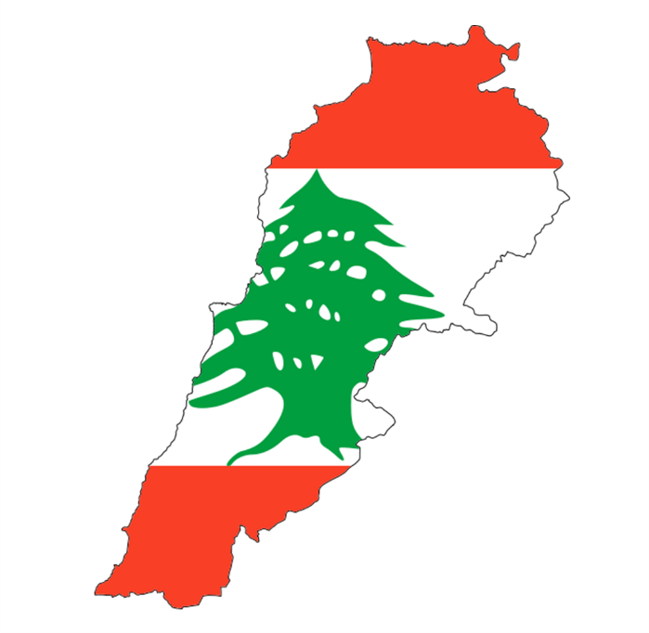
Lebanon Culture
By: Abby Boone

Slide 2
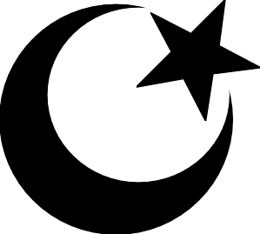
Religion
Lebanon’s main religion is Islamic, but Christianity is a close second.
In the past, Lebanon’s religion was mainly Islamic, but had more Christians than it does now.
The Islamic section of Lebanon is exactly half Shia and half Sunni.
Most Catholics in Lebanon are Maronite Catholic.
Lebanon’s least popular religion is Judaism.

Slide 3
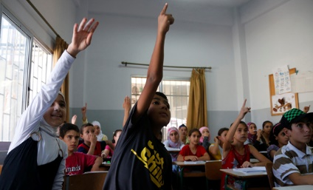
Education
Lebanese children start elementary school later than American children.
Lebanon’s highest ranking university is the University of Beirut.
The highest grade you can receive at a Lebanese school (any school except college) would be considered a failing grade in the U.S.A.
In 1987, only half of a decade of elementary school education was required for all Lebanese children.
Lebanon’s literacy rate is lower than the United States’, but it is higher than most countries’ literacy rate.

Slide 4
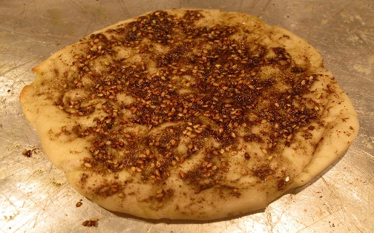
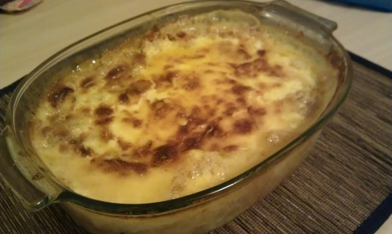
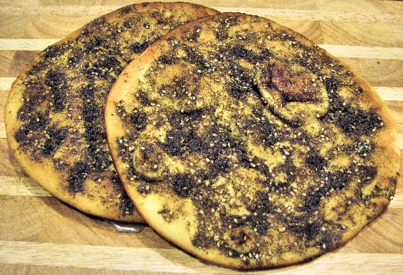
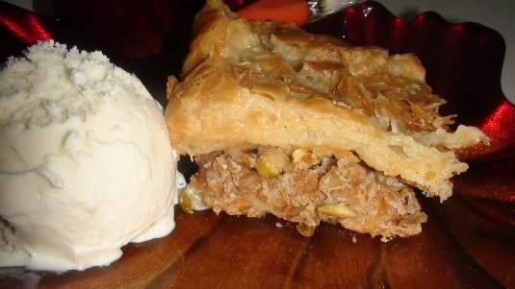
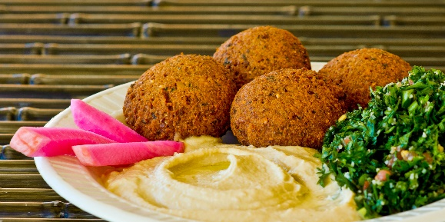
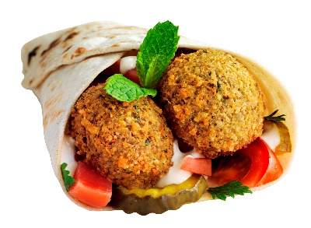
Food
Hummus is a popular food in Lebanon. t is spread on almost anything, including burgers and pita bread. It is different from the United States’ hummus because it is common for hummus to be spread on baked potatoes and their hummus usually has lots of garlic in it.
Manakeesh is also a popular food in Lebanon. Manakeesh is a round bread sprinkled with cheese, ground meat, or herbs. This dish is usually served during breakfast or lunch. Different types come from different places, ranging from vendors to fancy restaurants.
Grilled halloumi is a chewy food made of goat and sheep milk. Unlike other cheeses, no bacteria is used while processing.
Falafel is more of a snack dish. Made up of chickpeas and herbs, this dish is both delicious and healthy.
Umm Ali is a popular dessert dish in Lebanon. It is bread pudding cooked in milk and cream. Different versions are made with croissant pieces, raisins, condensed milk, and vanilla.
The food shown at right is manakeesh.
The food shown at left is Umm Ali.
The food shown below is falafel.

Slide 5
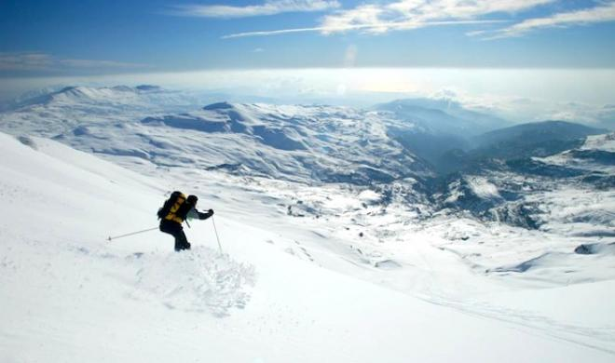
Entertainment
The Wax Museum in Byblos was founded in 1970. It contains statues and scenes showing the Phoenicians’ way of life, culture, civilization, and tradition, and it describes Lebanese history and traditions.
Skiing is a popular thing to do while at Lebanon. Skiing is the most popular winter sport, and Lebanon is known for the ski slopes.
If you ever visit Lebanon, be sure to go shopping. Lebanon has amazing pottery pieces and glassware, as well as brass and copper goods that have attractive handwork designs.
Folk dances were popular in the early 21st century, and they still are.
There is a Town Hall Theatre in Lebanon that seats hundreds of people. It has plays and musicals year-round.

Slide 6
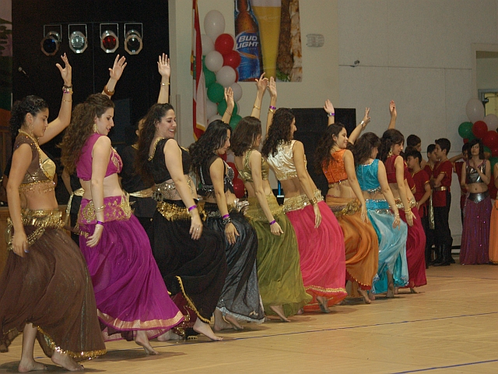
Clothing
Women in Lebanon wear the western dress, and some Muslim women wear the hijab, a long-sleeved coat or dress, and a scarf (usually white) that covers the hair.
Traditional Lebanese clothing from the past is worn only by performers at dance festivals.
At festivals, men wear the shirwal, which is baggy black pants, and they wear high black boots, white blousy shirt, dark vests, and a fez.
Women wear long dresses with embroidered designs on them and tall hats with long white veils at festivals.
An old fashion trend of the past in Lebanon (for girls) was colorful dresses with medium to long sleeves and sparkly objects (such as fake jewels) on them. These dresses are usually only worn at celebrations and festivals nowadays.

Slide 7
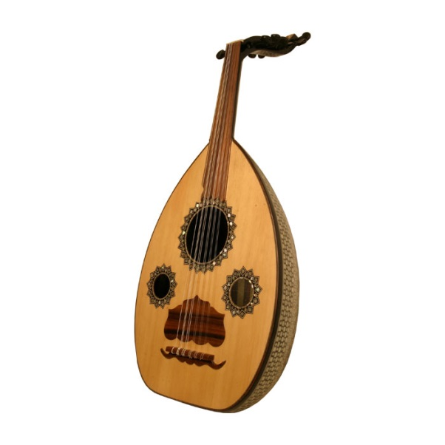
Music
Paul Anka wrote and recorded popular songs starting in the mid-1900s, including ‘Diana,” “She’s a Lady,” and “My Way.”
Lebanon’s national anthem was adopted in 1927. The title is “All Of Us, For Our Country.”
The mijwiz, which means “double” in Arabic, is a popular instrument in Lebanon. It is a type of reed clarinet.
Fayrouz sang many songs in Lebanon, and she is known for singing traditional songs.
The oud is one of the most popular Arabian musical instruments. It is small and has a very short neck and the body is egg-shaped.
The Oud

Slide 8
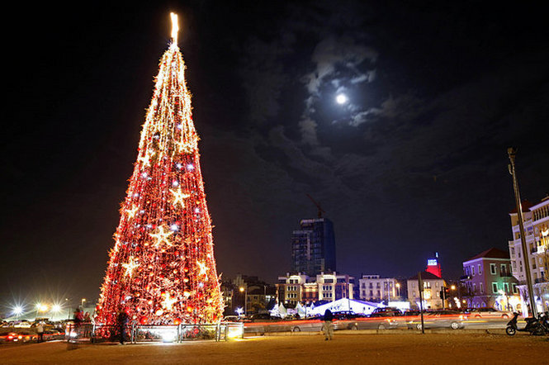
Celebrations
Lebanon’s National Independence Day is celebrated on November 22. In Beirut, Lebanon’s capital city, a parade is held every year, celebrating Lebanon’s independence.
Lebanese weddings can last for multiple days. There is eating and dancing, and there are two parties: one at the bride’s house and one at the groom’s house.
A few weeks before Christmas, people plant seeds on a piece of cotton and water them every day. The seeds grow a few centimeters tall and are used later.
Lebanese people decorate Christmas trees with orange peels cut into different shapes.
On Easter, Cristian and Muslim children play a game with colored eggs. One child taps his/her egg against another’s. The child whose egg doesn’t crack while cracking everyone else’s eggs wins.

Slide 9
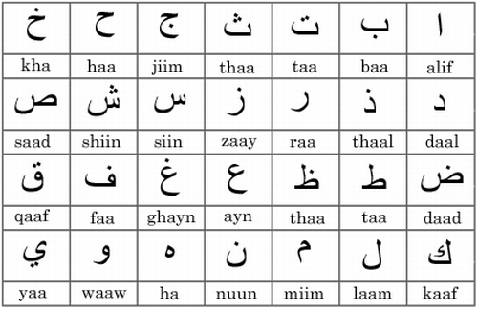
Language
Lebanon speaks Arabic, but Lebanese Arabic is their dialect.
Although Arabic and Lebanese Arabic are two different languages, they have many words in common.
Lebanon’s characters look like symbols to people that speak only English. The symbols are very similar to Arabic symbols.
Lebanon has many dialects, including Northern Lebanese, Central-Mountain Lebanese, and Southern Lebanese.
Although Arabic and Lebanese Arabic are similar, learning Arabic will not make you able to speak Lebanese Arabic.
The image at the left shows the Lebanese alphabet. Below the characters are the names of the characters.

Slide 10
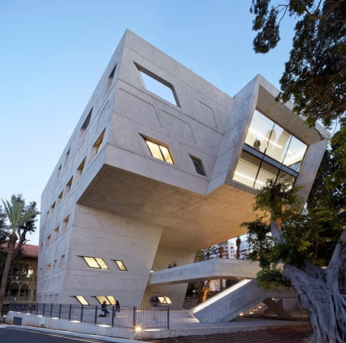
Architecture
Old architecture in Lebanon had slanted roofs, were usually two stories tall, and were made of brick or stone.
Now, buildings in Lebanon are made of brick and stone, plus stucco, metal, and glass, too. More buildings in Lebanon now have flat roofs than they did years ago.
Famous Lebanese buildings have odd shapes, such as the Issam Fares Institute, shown below.
4. The simplest type of flat-roofed house in Lebanon is called the Closed Rectangular House. It has a single square or rectangular space with a low door, ventilation openings below the roof, and a few small windows. It is called “closed” because there usually aren’t any other openings in the house.
5. Most old buildings aren’t still in Lebanon today because of all of the wars Lebanon had. The space where those buildings once stood is now being occupied by new buildings.

Slide 11
Mass Media
Lebanon’s radio stations include Jaras Scoop FM, Sawt El Ghad, Aghani Aghani, and Radio Sawa Lebanon.
Some TV channels on Lebanon include MTV Lebanon, Al Hiwar, Al Quds al Arabi, and LBC Drama.
Movies in Lebanon include West Beirut, Caramel, Void, and The Kite.
Popular types of television shows in Lebanon are entertainment, news, and religious shows.
TV Charity is a Christian TV channel based in Keserwan. Al Jadeed is a privately owned Arab TV station in Beirut, Lebanon.
The logo at right is the logo for the TV channel Aghani Aghani.

Slide 12
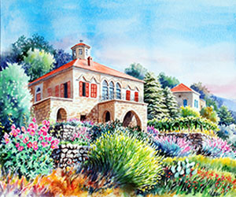
Art
Many of Lebanon’s famous paintings have at least one building in them. They believe that buildings are important to their culture.
The famous painting shown below is by Michel Rouhana.
3. Pierre Karam is a well-known sculptor who graduated in 1992 and created a workshop where he started to “officially” sculpt. He later became an art teacher.
4. Lebanon painters usually add French touches to their paintings because franch artists influence them.
5. Traditional pottery-making and crafts are encouraged in Lebanon. Sometimes the works of art are donated to charity when nobody buys them.

