Slide 1
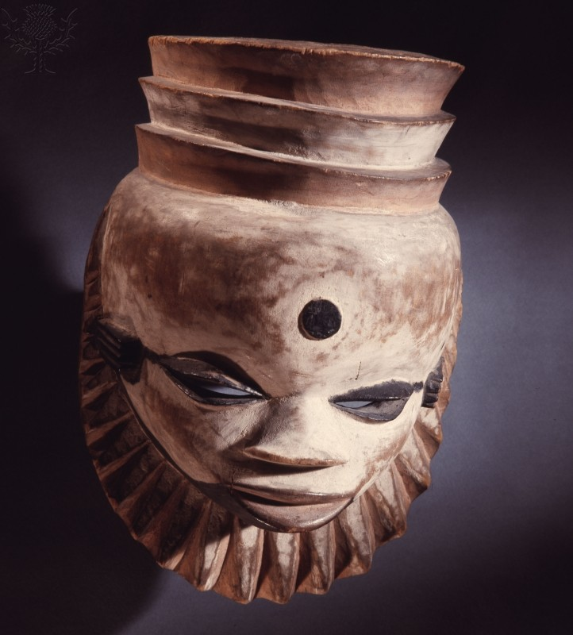
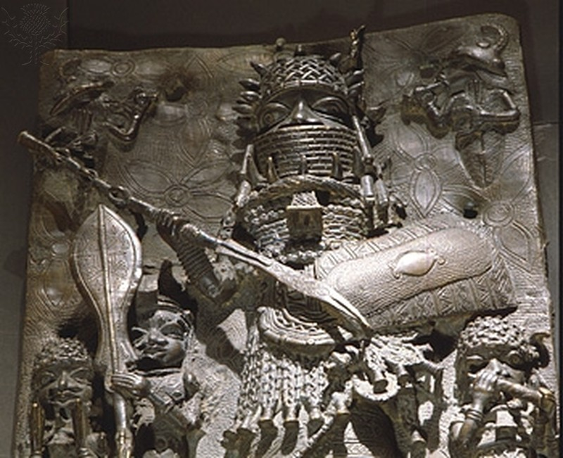
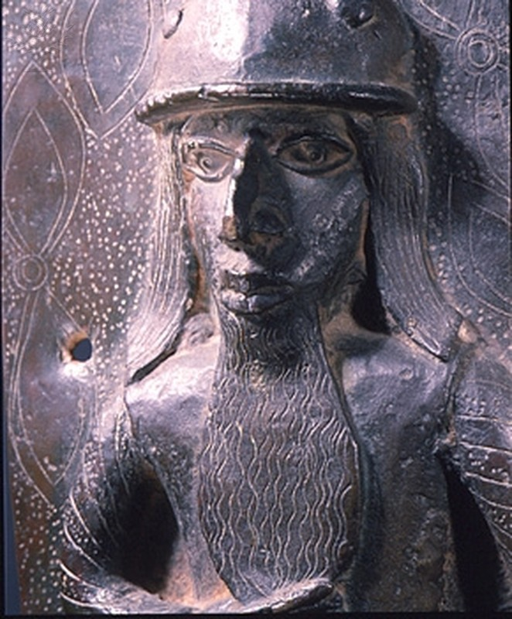
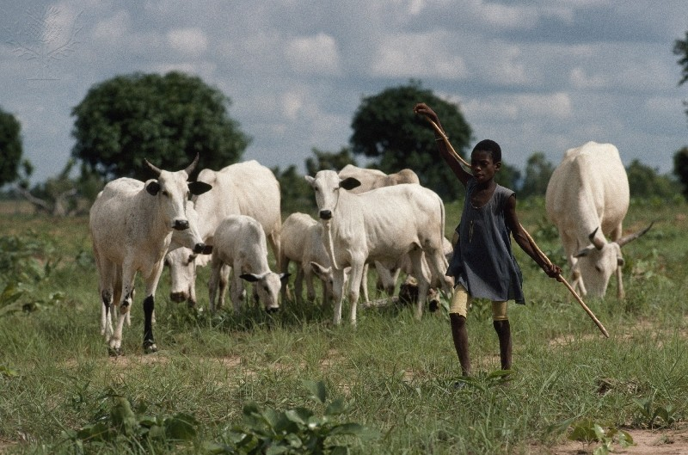
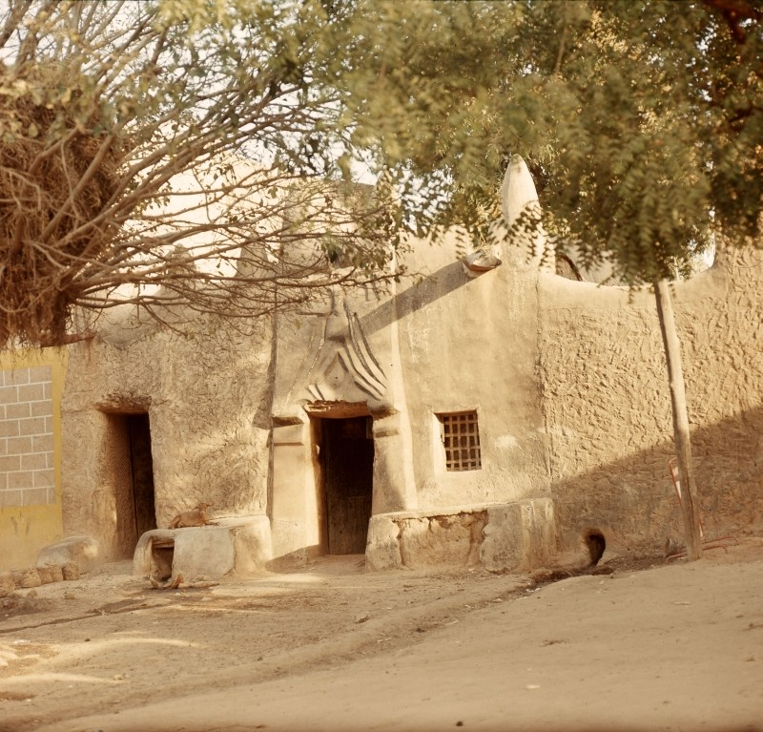
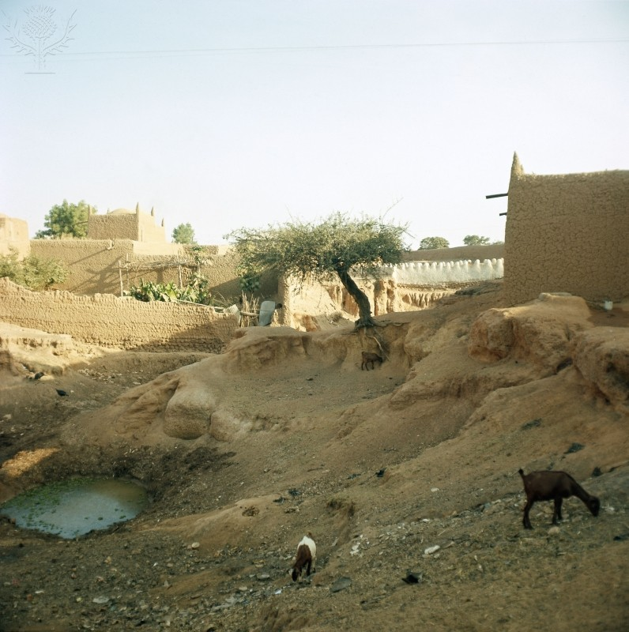
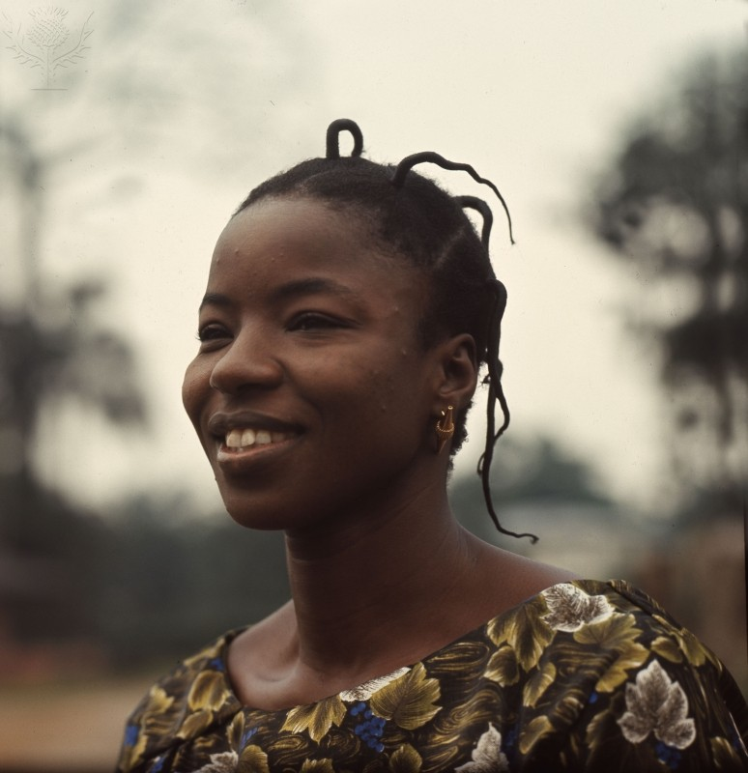
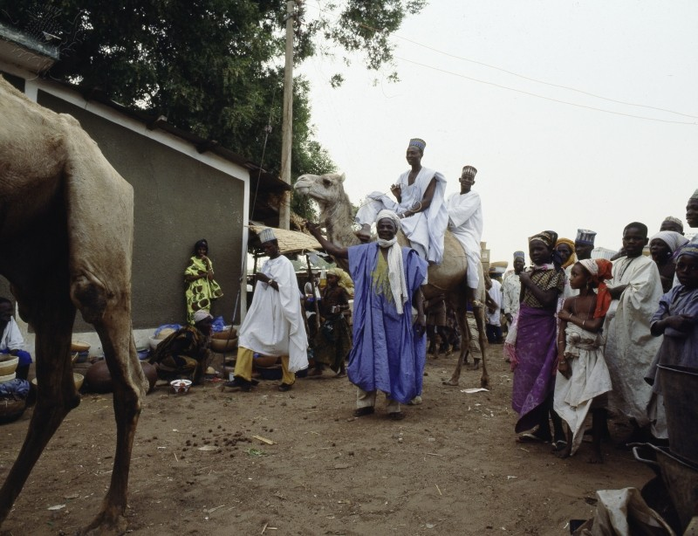
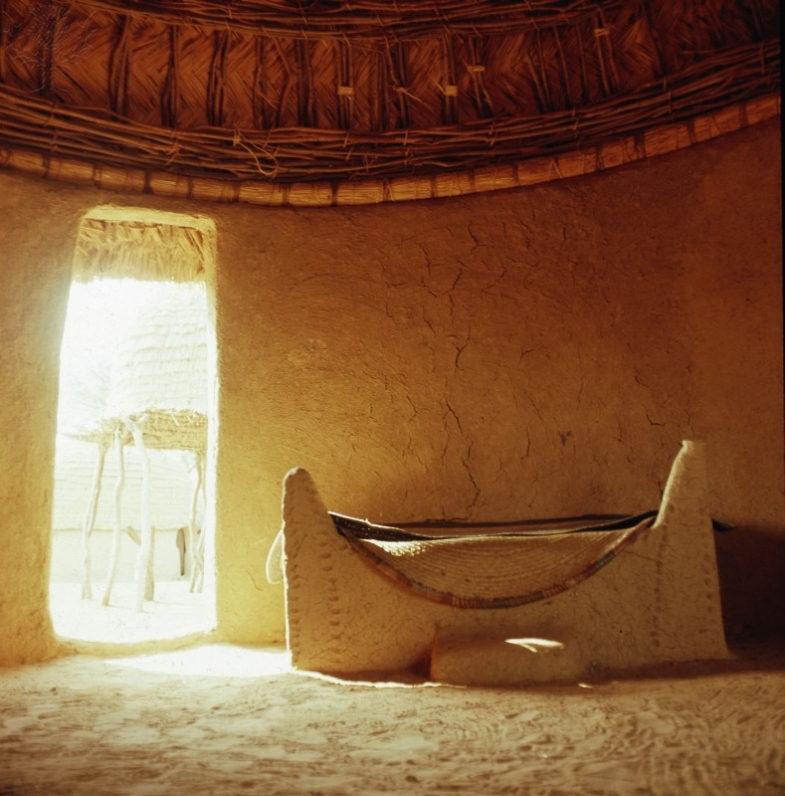
Nigerian Culture
By: Elizabeth Chang

Slide 2
Religion
There were some religions in Nigeria that coexisted. They have helped emphasize regional and ethnic characteristics. In 1990, all of the different religions that were in Nigeria were practiced in each important city. Islam was mostly in the north, though, and Christianity and Protestantism were mostly in Yoruba areas. Catholicism was predominant in the Igbo and very similar areas. As a result of missionaries, the practice of Christianity had increased in Nigeria, around 1963, and there was a small decrease in the practice of Indigenous beliefs. Missionaries spread their beliefs and religion to Nigerians, causing some of them to convert to Christianity. Although Indigenous beliefs had been a huge part in Nigeria’s religion and had greatly influenced their culture, many had then started switching to Christianity and Islam.
In Nigeria today, the overall population are mostly Muslim, with the Sunni branch being the majority, and Christianity is the second most popular religion. Traditional African religions are hardly evident in the nation at all. There is a lot of tension between the Christians and Muslims in Nigeria, with much violence.

Slide 3
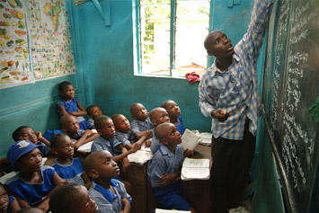
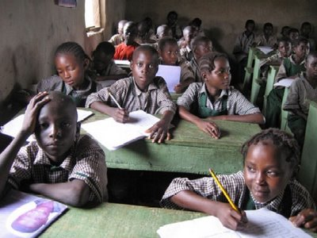
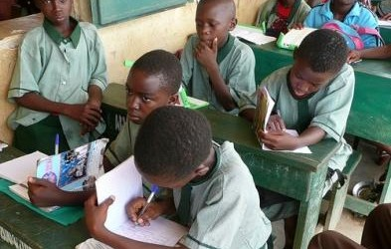
Education
Nigeria’s growing population has put increased pressure on the resources, infrastructure, and the already overstretched public services. Much of the country’s population is made up of children under the age of fifteen, causing there to be a burden on their education.
Some children in Nigeria do not attend any primary school. The lowest school attendance rate in the country is in Northern Nigeria, mostly for girls. Though there has been a great increase in net enrollment rates, the amount of children who are still not going to primary school is very high.
Quality education and improved learning achievements have become a problem because of increased enrollment rates. There are not enough resources since there are so many students in the schools in Nigeria. It is often that teachers will have up to one hundred students, or students will have to be taught outside of the school building because there are not enough classrooms.
The Nigerian Government has been attempting to resolve this issue by applying the Basic Education scheme. In 2004, the Universal Basic Education Act was passed. This served as the government’s plan to decrease illiteracy and to provide convenience to basic education to all children in Nigeria.
A problem with girls’ education is also occurring throughout Nigeria. Girls are given less of an opportunity to attend school and receive an education, particularly in the north of the country.

Slide 4
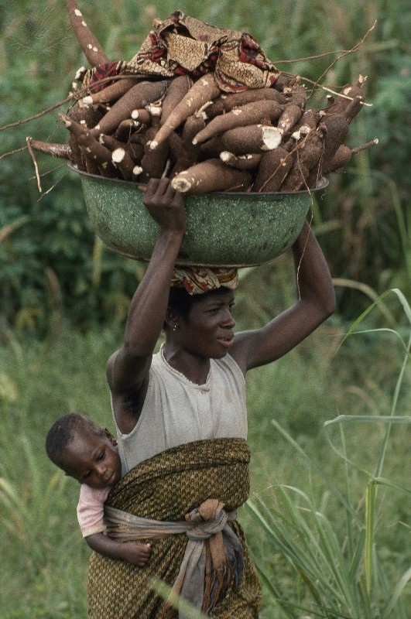
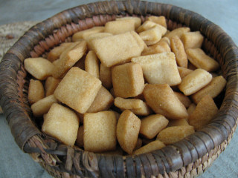
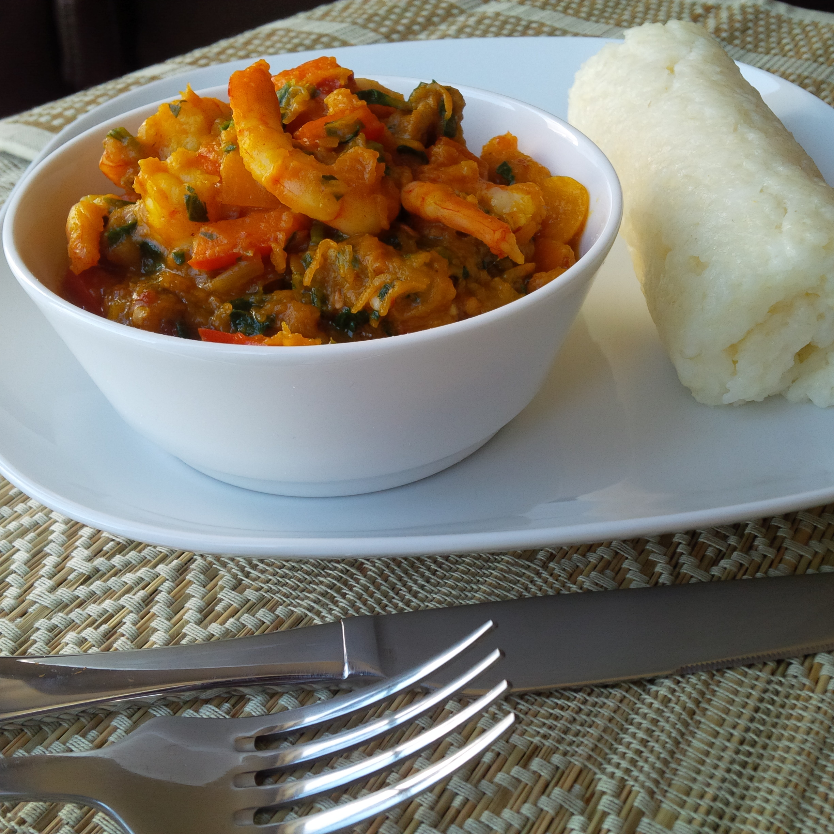
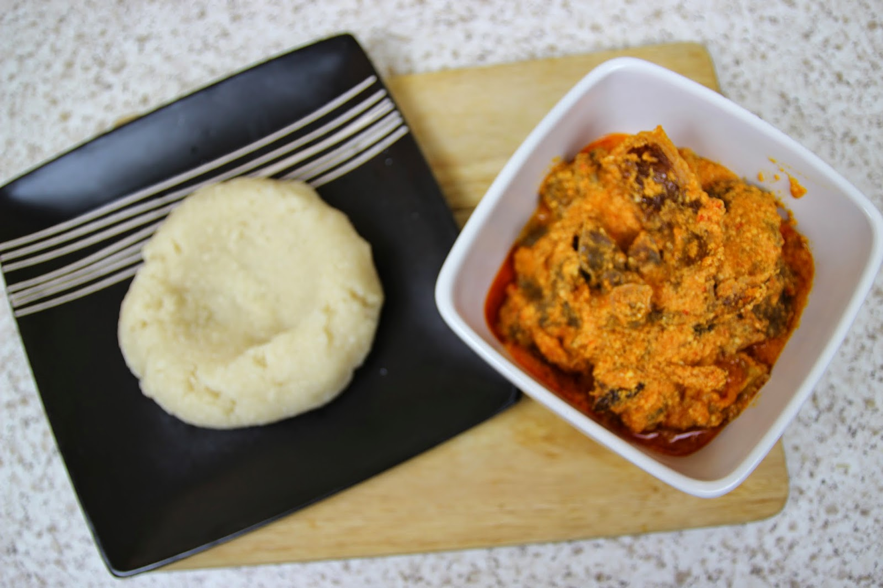
Food in Nigeria
Trade had a huge impact on the flavors of food in Africa. Before trading had occurred, rice, millet, and lentils had been main staples. The first Europeans able to reach Nigeria were the Portuguese, during the slave trade in the 1400s. They introduced Western Africa, including Nigeria, to cassava. The British, Dutch, and other Europeans later on fought for authority over the trade. Beans, maize and cassava were just a few of the many food staples brought to Western Africa by European traders and explorers.
Nigeria has a large diversity of ethnic groups, resulting in a variety of different foods. One common breakfast dish, though, is Akara, which is made from soaked pealed black eye beans, blended into a thick paste and fried. Another common breakfast item includes Fura de Nunu, which is pasteurized milk that is served with either millet or corn flour. It is popular in Northern Nigeria, but is eaten all over the country.
The big meal in Nigeria is normally lunch. One common lunch item is Eba. This is made from grated fried cassava and eaten with any kind of soup. Miya Kuka is also a Nigerian lunch item. Dinner in Nigeria is usually a lighter meal than lunch. Often eaten dinner items include potato porridge, yam porridge, jollof rice, rice and stew, rice and beans, plantain porridge, and yam, plantain, and pepper soup.
Snacking is common between meals. Popular snacks are suya, fried plantain chips, kilishi, chin chin, ground nut, and roasted corn or maize.

Slide 5
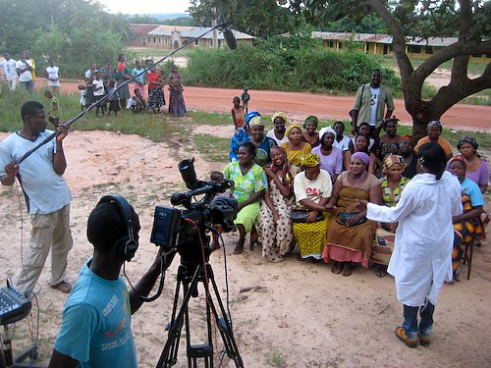
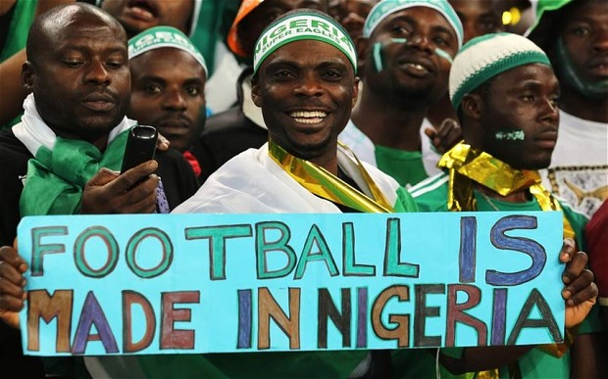
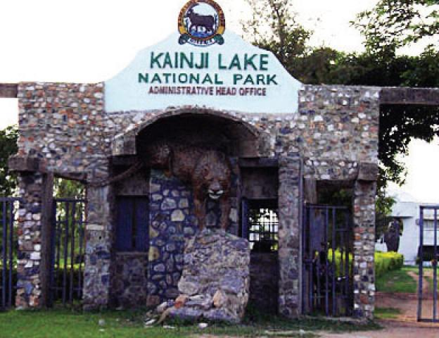
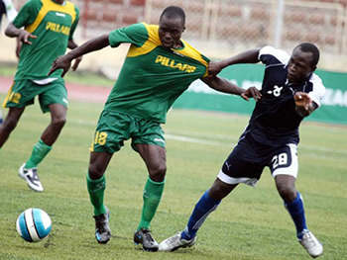
Entertainment
In the 1960s, Nollywood was created. Many historical filmmakers in Nigeria started the Nigerian movie industry in a country that relied on Hollywood for their entertainment.
Football(soccer) is the most popular sport in Nigeria, and many Nigerians enjoy this activity. They made Olympic football history in the 1996 Olympics in Atlanta. They became the first African and non-European and South American team to win the gold medal in football.
Chappal Waddi, the highest mountain in Nigeria, is a way to entertain people in Nigeria. They can climb up the mountain range and see the beautiful scenery.
The Kainji Lake National park is found in the Kwara state and founded in 1979. The Zurgurma Game Reserve and Borgu Game Reserve is in this area. People can visit this place for entertainment.
Traditional dances in Nigeria are a part of their entertainment, and art and music are too.

Slide 6
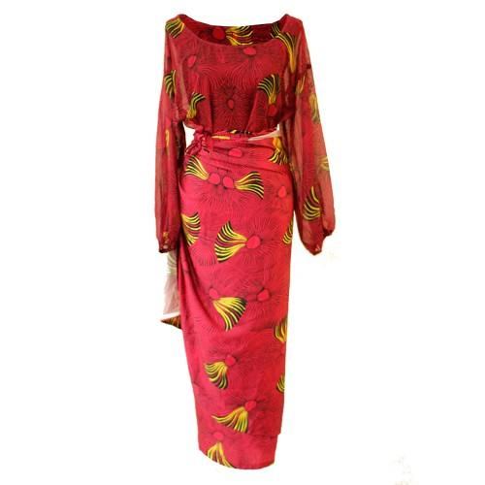
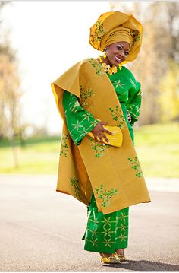
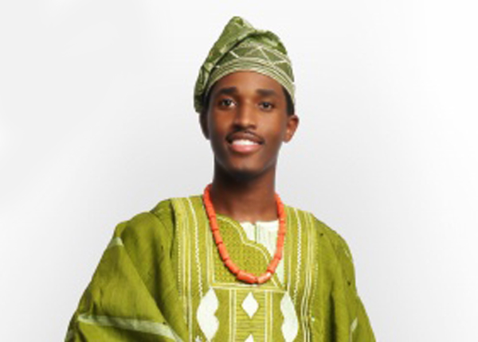
Clothing
Since there are so many ethnic groups in Nigeria, the types of clothing varies, depending on what their culture is. Many centuries ago, the one cause for the Igbo to wear clothing was for modesty, not for style or to show status. They wore traditional clothes, including wraps for women to wear for everyday life and some for formal occasions. Expensive cloth that was imported was used to design these formal wraps. Men had normally worn shirts, cotton wrappers, and sandals for everyday wear. Better material was used to make the wraps that men would wear for formal occasions. Traditional attire is still worn in Nigeria today.
In Nigeria, the clothing is very unique to their culture. Today, women in Nigeria wear dresses, including kaba, buba, iro, gele, and iborun or ipele. Men in Nigeria wear clothes, including buba, fila, agbada, sokoto, and abeti-aja. Dresses in the country are made from materials, like jacquard, ankara, adire, and lace. Clothes in the country range from a very traditional attire to western clothing. Clothing plays an important role in the ceremonies performed in Nigeria.

Slide 7
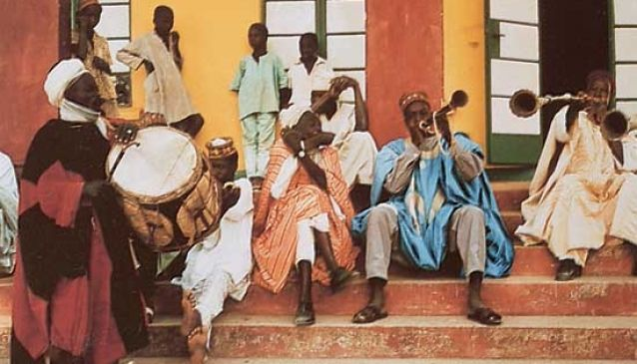
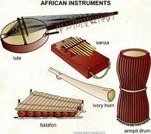
Music
Folk music in Nigeria is influenced by the 250 ethnic groups in the country. Traditional music in Nigeria is usually performed to mark a ritual, like a funeral or a wedding. Work songs are a typical type of traditional music in Nigeria, and is commonly used by workers in river canoes, fields, and other jobs.
Traditional instruments include xylophones. In the early development of Nigerian music, woodwinds and brass instruments were a major part in the music.
Some popular music in Nigeria during the 1920s was palm-wine music and highlife. Apala was also a style of music that was derived from traditional Yoruba music. The evolution of new styles of music happened in the 20th century, including Yo-pop, waka music, and Afrobeat.

Slide 8
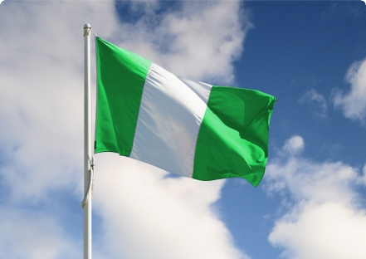
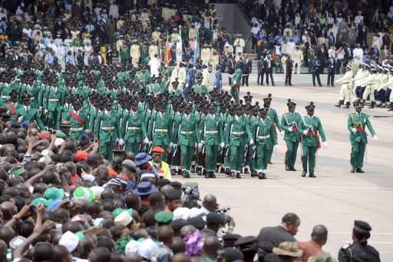
Celebrations
There are many celebrations that take place in Nigeria, including public national holidays. The festivals celebrated in the country are influenced by both Islam and Christianity. The first important national holiday in Nigeria is New Year’s Day, on January 1st. Many Nigerians celebrate their festivals with brilliance and pizzazz. They host New Year’s parties where they eat, drink, dance, and observe the special holiday. Everyone makes the best of this significant holiday, pledging to be a better person in the coming year and to be more positive. They make vows to end feuds with their rivals and to forget about their conflicts with their enemies. Also, on New Year’s Day, Nigerians celebrate by having masquerade parties, where they dress up and dance on the streets, filled with cheer. Another public holiday celebrated in Nigeria is Independence Day, on October 1st. On this day, the president of Nigeria announces a live speech on the radio and on TV to mark the initiation of Independence Day celebrations. To honor the country, they have a ceremony where they raise the Nigerian flag. The armed forces perform traditional dances after the president makes his speech. Allegiance is given to the people who fought for Nigeria’s independence from the colonial rule of Britain.
Next, another celebration in Nigeria are birthdays. The 1st, 5th, 10th, and 15th birthdays are very important events in Nigeria. Huge parties with many guests take place in the country on these certain birthdays. They also have feasts on their birthdays. They serve jollof rice, which is rice with tomatoes, onions, red peppers, and cassava.

Slide 9
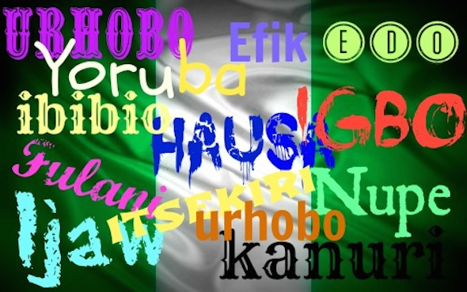
Language
Several languages are spoken in Nigeria, but the official language of the country is English. They speak Pidgin English or “Broken English.” Another language spoken in Nigeria is Yoruba, which is spoken by the Yoruba people. This language has both human and non-human nouns. For example tani is for human nouns (‘who?’), and kini is for non-human nouns (‘what?’). There are over fifteen different dialects in the Yoruba language and standard Yoruba is the written form of the language and the basic type learned in school.
In the north of Nigeria, native Hausa speakers are found. The language is now written in Latin through Quranic schools. Next, the Igbo people speak the language Igbo, written in Roman script. It is a language with different tones, like Yoruba and Chinese, with high and low as the two main tones. Igbo is not usually written or read, but is mostly just spoken. There are many Igbo dialects, and some of them are not commonly comprehensible.

Slide 10
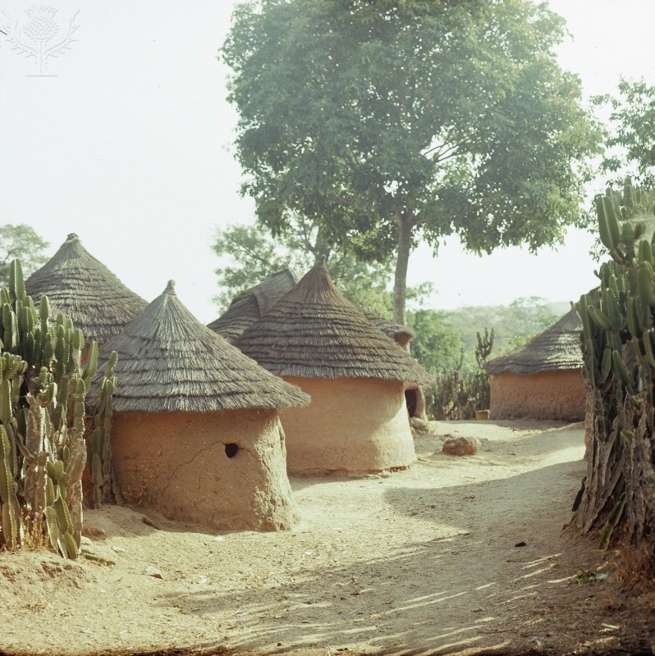
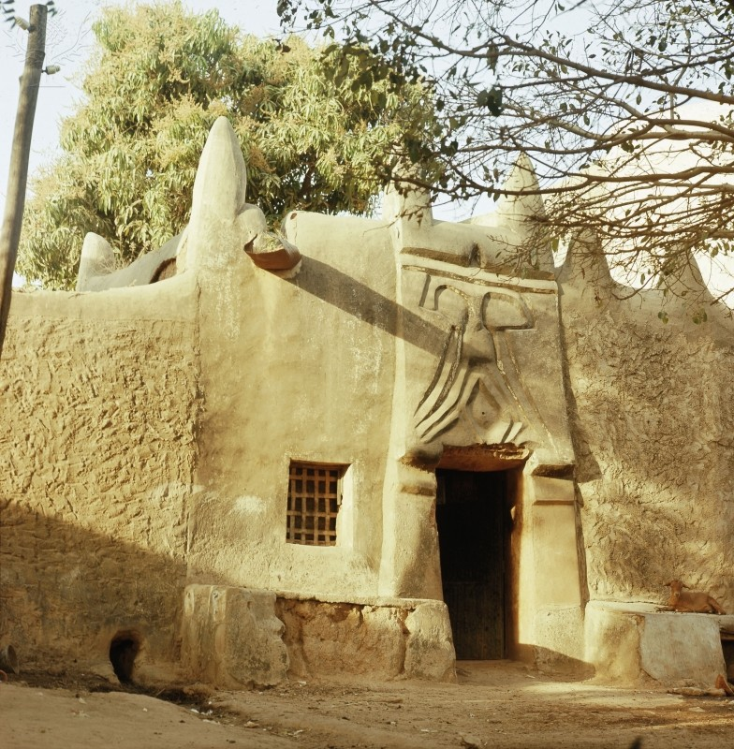
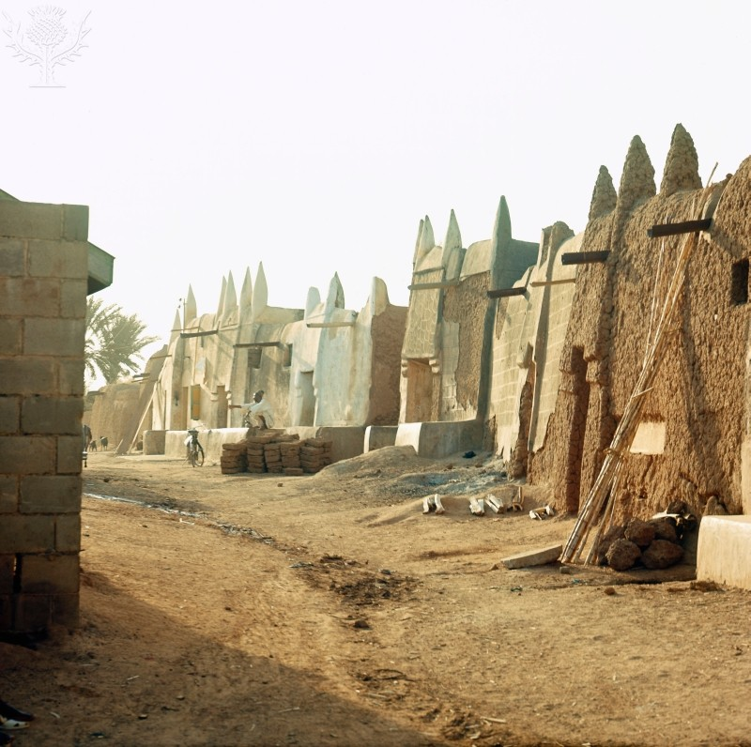
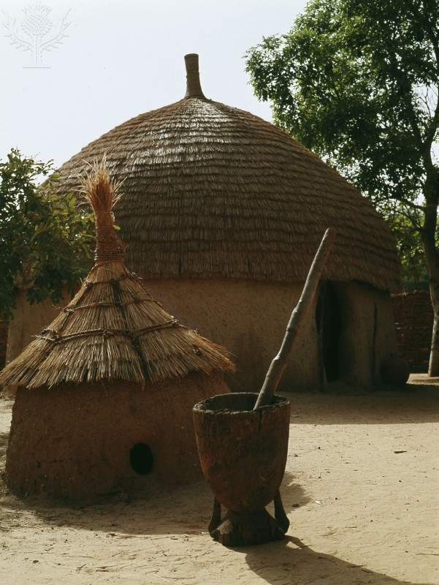
Architecture
Many traditional buildings and monuments significant to the history of Nigeria that were built during the pre-colonial and colonial era have basically disappeared from our landscape. We now have to cope with modern architecture of many descriptions and styles. Before imported building goods and modern European architecture was brought to Nigeria, traditional societies would build their houses to meet their cultural, religious, and social needs. Primary materials used to build were grass, palm, wood, stone, and mud.
Today, there is a wide variety of architecture in the cities of Nigeria. Lagos and other Nigerian cities have Westernized and modern areas. One of the most expensive cities in Nigeria is Abuja, the capital, and it has many hotels and luxury villas, mansions, and apartments. The outskirts of Nigerian cities are slums that have makeshift churches, huts, bars, and schools.

Slide 11
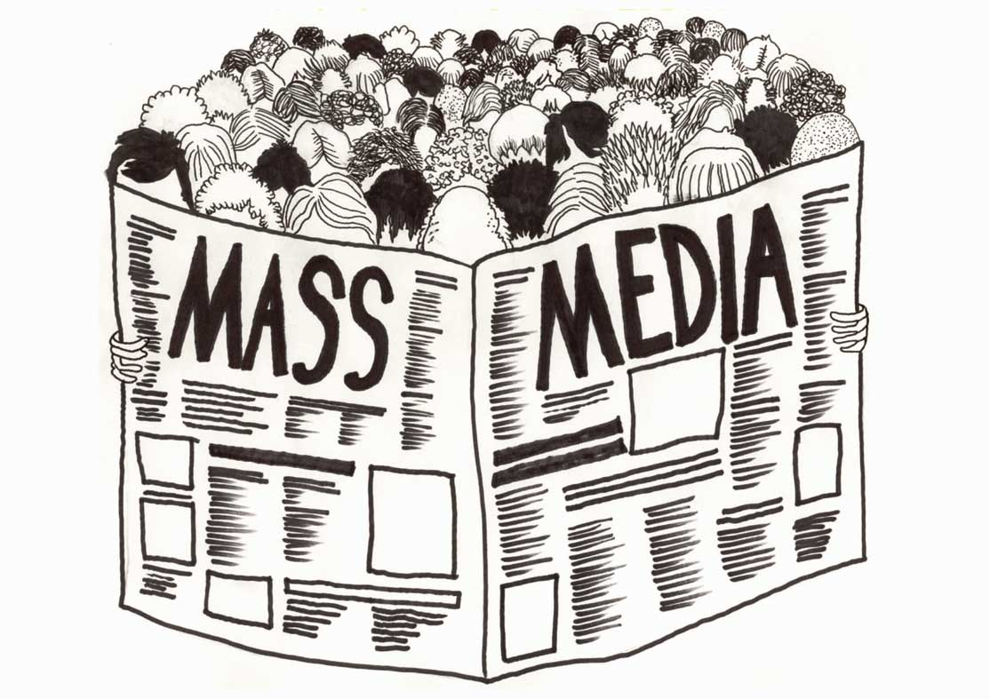
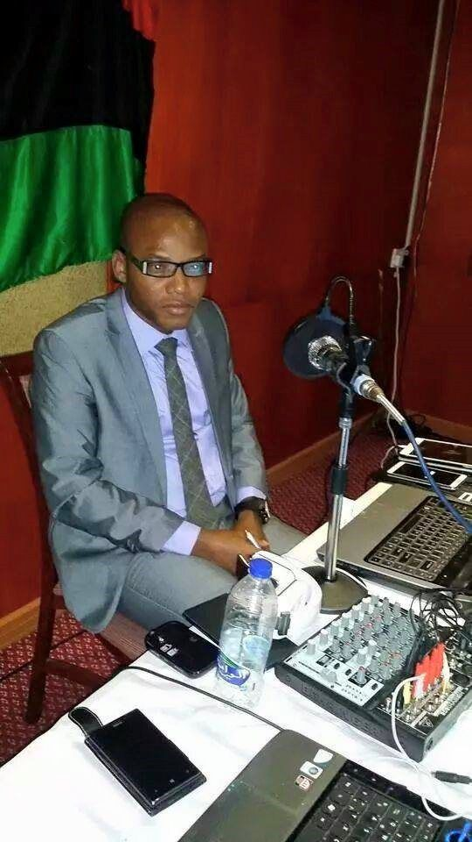
Mass Media
There are many radio stations in Nigeria that are both private and state owned. Over 30 privately owned radio stations are all over the country, giving news, sports, and information to people. Nigerians use the radio as the main way for them to get information since it is very easy to access in the cities and the villages and also since almost all of the programs are in local languages.
Nigeria was the first African country to host a television station in the 1950s, and since that time, they have continued on to be the largest TV station network in the continent. Most of the privately owned television stations are in the commercial city of Lagos. The city of Lagos holds the highest amount of TV stations in a city in Africa, with ten television stations.
Another type of mass media in Nigeria is the newspapers. In 1880, the Lagos Times was first published, which began a tradition of diverse and active debate of mass media. From 1920 to 1936, the Lagos Daily ran. There are over 50 newspapers in the country today, and many newspapers and magazines are produced in Lagos alone.

Slide 12
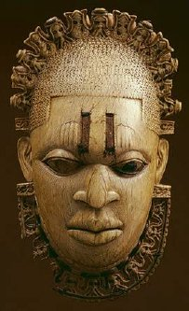
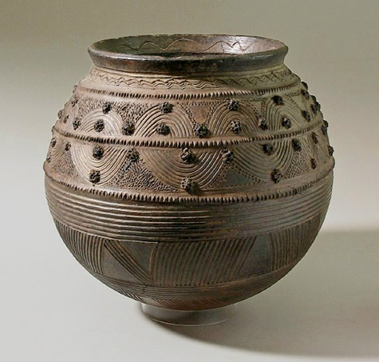
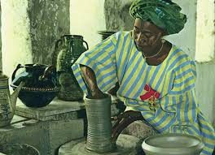
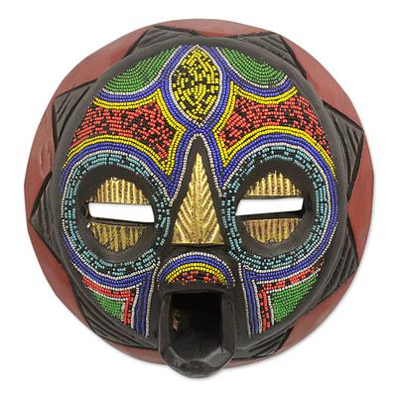
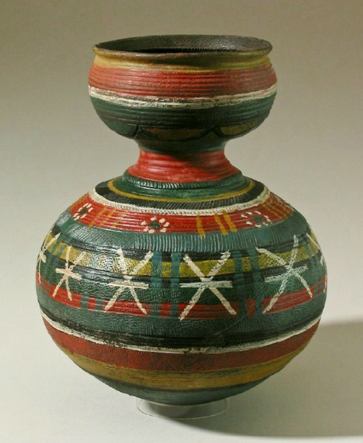
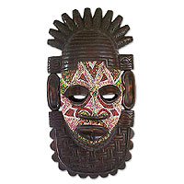
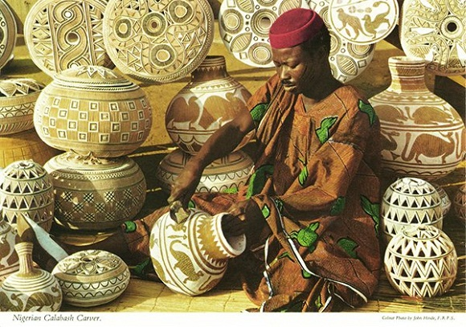
art
The artistic tradition of Nigeria dates back thousands of years. The early art of the country had a spiritual or religious significance, but most of the traditional crafts and art developed over time to include practical and decorative items.
Sculptures in Nigeria that archaeologists found date all the way back to at least 500 B.C. Bronze, ceramic, brass, and terra cotta are some of the materials that figurines and sculptures found in Nigeria have been made from. In the southwestern part of the country, bronze casting was found.
The Yoruba people in Nigeria are animists, and large wooden masks are a part of their faith. They are painted and are worn to funerals and other ceremonial events to alleviate the spirits.
Pottery has been a part of Nigeria’s culture and history for a long time. In Nigeria, potters are usually women and is a technique that is passed down through families. Important centers of traditional pottery today are found in Abuja, Ilorin, and Suleja. A lot of the pottery pieces are large vessels with detailed carvings.

