Slide 1

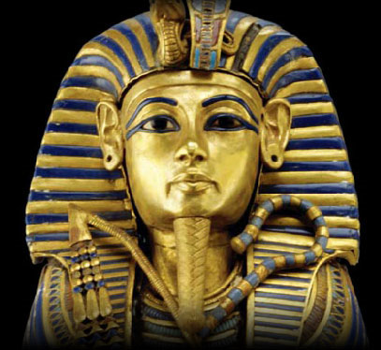
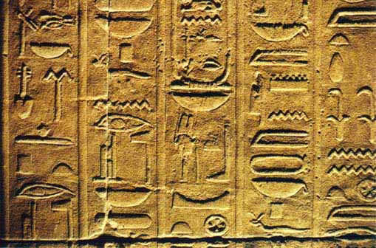

All About Egypt
By: Shine Lee

Slide 2
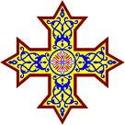
What’s their religion?
From the time Egyptians started living in Egypt, up to today, Egypt has gone through some major religion eras. These eras are the Egyptian era, the Christian era, and the Islamic era.
During the Egyptian era, the Egyptians worshipped and believed in many Egyptian gods. The Gods that they worshipped during that time were: Re, the Sun God, Anubis, the Death god, Hathor, the Goddess of love, birth, death, and many more.
But, as centuries passed, the Christian era slowly overtook the Era of the Egyptians. As a result, Egypt was a Christian nation for more than a century. Today, many Coptic Christians are found in Egypt.
The Islamic Era began when Arabs took over Egypt in 639 AD and spread their Islamic religion throughout the country. In Egypt today, most Egyptians are Sunni Muslims.

Slide 3

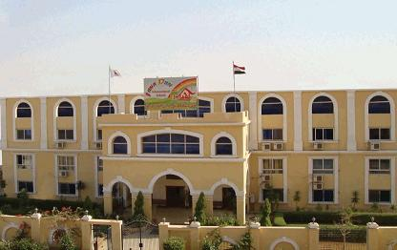
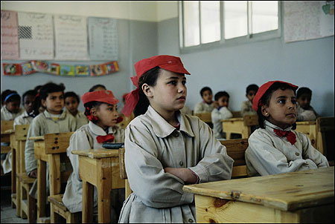
Education
Egypt’s education system has become better over the years. There are many levels in the education system. These levels are: primary school, intermediate school, and secondary school (which includes General schools and Technical schools).
The students that go to the schools in Egypt are provided with textbooks for each of their subjects, by the government. They also take exams that determine if they are ready to step up a level.
Even though the government helps provide supplies for schools, the system is having trouble because of the rapidly increasing population in Egypt. As a result, there are too many students in each class, so middle-class Egyptians send their children to private schools. In these private schools, the teachers teach many things, including French and Arabic.
Also, there are certain uniforms that the students that attend the schools must wear. The boys usually wear white shirts and trousers, and the girls wear white shirts and ankle-length skirts.

Slide 4

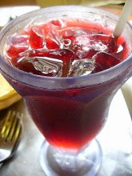
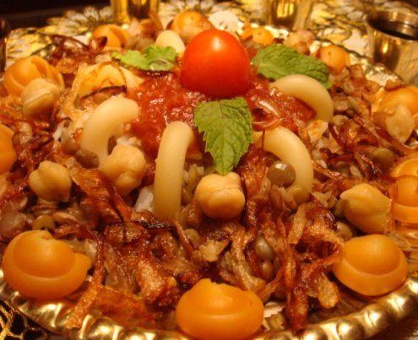
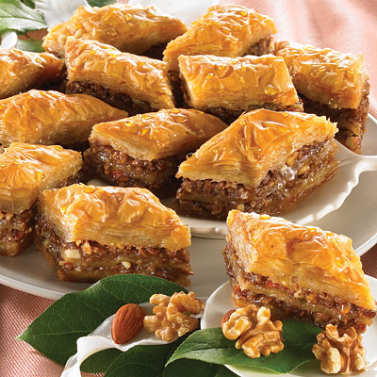
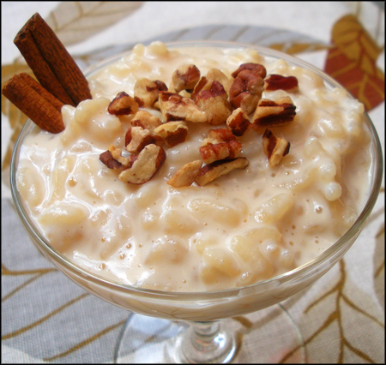
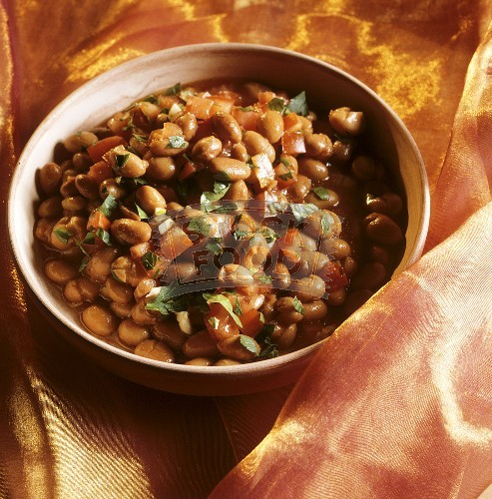
Amazing Foods of Egypt
In Egypt, meals usually consist mainly of bread and rice, but there are also many other varieties of exquisite foods. Also, foods differ between rural places, and cities. Typically, city foods have a wider range of foods than rural areas.
A lot of delicious foods are sold right in the streets of Egypt. Almost every corner of a block has a stall selling food. The most popular breakfast sold in the streets is a flat, round bread stuffed with foul, a bean dish.
Other savory foods sold on the streets include Falafel and Shawarma. Falafel is a deep-fried meal of chickpeas, vegetables, and spices mixed together. Shawarma is a marinated chicken or lamb cutlet that is slowly cooked on a Shawarma machine (a shawarma machine consists of a skewer rotating over a charcoal fire).
A popular main course that is cooked by both the rich and the poor is Koushari. It is made of lentils, macaroni, and rice. Riz Bi Laban, or rice pudding, is a popular dessert in Egypt. Also, many people like to drink something called Karkadeh, made of hibiscus leaves.
Pastries are something that Egyptians really love to eat. Baklava and Halvah are similar pastries that everyone enjoys. Baklava is a pastry with thin sheets of dough, filled with nuts, and sweetened with honey. Halvah is basically the same except, it is made with rice flour.
So, these are some of the wonderful foods of Egypt.

Slide 5

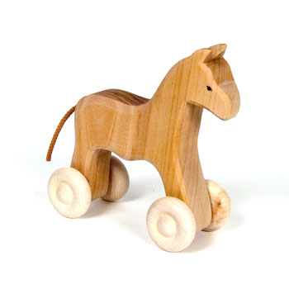


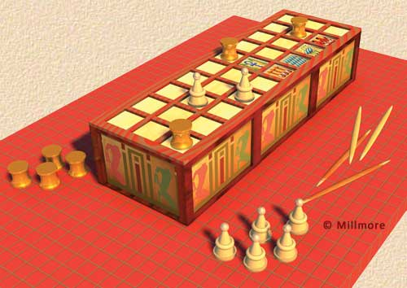
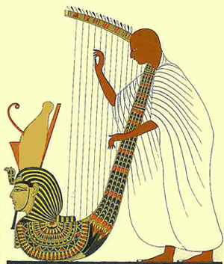
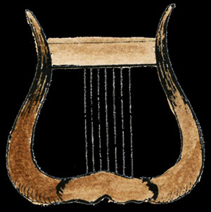
Entertainment
Ancient Egyptians:
When the Ancient Egyptians were alive, they had many great ways to have fun and entertainment. The men would go hunting for hippos and crocodiles, for fun and sport. The children played with toys such as wooden horses with wheels, dolls, and other things.
The Egyptians especially loved music. They played the lute, harp, and lyre in their free time. They also played board games such as: Senet and Hounds & Jackals.
Senet

Slide 6
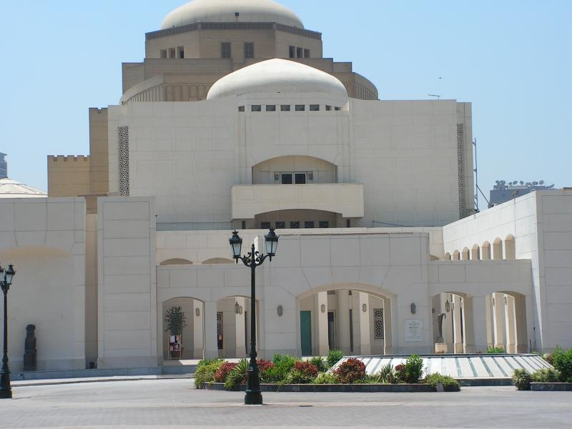
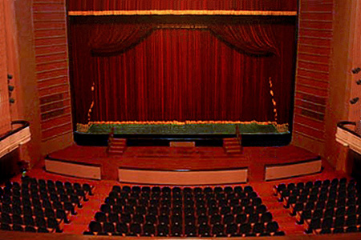
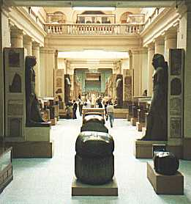
Entertainment continued…
Modern Egyptians:
Today, the people of Egypt do different things for entertainment. They go to many places such as live discos, opera houses, museums, theaters, malls, and karaoke clubs, to have fun.
Most of the museums and theaters are based on the cultural diversity of Egypt. So, now you know that the ancient Egyptians had different ways to have fun than the modern Egyptians.
Cairo Opera House
Egyptian Museum

Slide 7

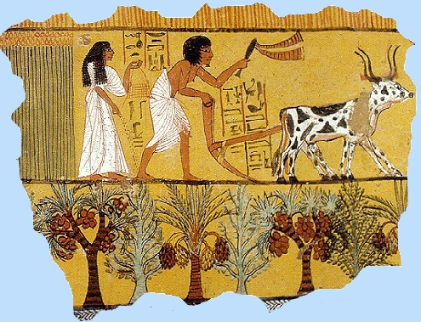
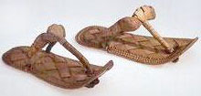
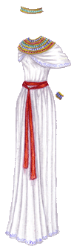
What do they wear?
The clothing styles in Egypt, in the past and present are very different.
During the Ancient Egyptians time, because the weather was always warm, both men and women wore linen clothing (clothing that is light and keeps you cool). Men wore linen skirts called Kilts, and women wore long dresses with straps on the shoulders. While they worked, men wore loin cloths, and women wore short skirts. For special occasions, they wore blue and green eyeshadow, and jewelry (if they could afford it). They were usually barefoot, but occasionally wore leather or straw sandals. The rich wore long, transparent robes, and leather sandals with straps. Wealthy women also wore long colorful dresses.
Today, Egyptian men wear loose shirts (such as T-shirts and polos) and trousers. Some men wear lengthy robes, but most don’t. The women wear loose skirts, and shirts with elbow-long sleeves. Some women in small cities wear long dresses, and veils to cover their hair.

Slide 8
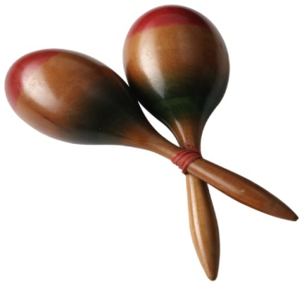

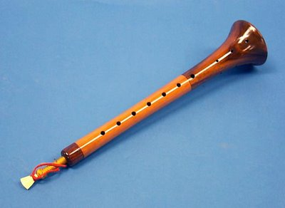
Egypt’s Music
The Ancient Egyptians loved music very much. It was an important part of their life. Most of the Egyptian musicians were women. They played instruments such as harps, lyres, lutes, drums, rattles, etc. Musicians usually performed at private parties or religious parties. Because they didn’t have any way to record their music, we don’t know what their music sounded like.
In Egypt today, there are many styles of music to listen to. These styles include Classic Arabic music, the Egyptian’s own style of pop, Egyptian country music, and lots more. Classic Arabic music was written a long time ago, and it is old-fashioned, while the pop music is fast and joyful.
Instruments such as drums and flutes are mixed with techno beats, to make the music sound better.
Another cool instrument that the Egyptians play today is, the mizmar (sounds similar to bagpipes).
Mizmar

Slide 9
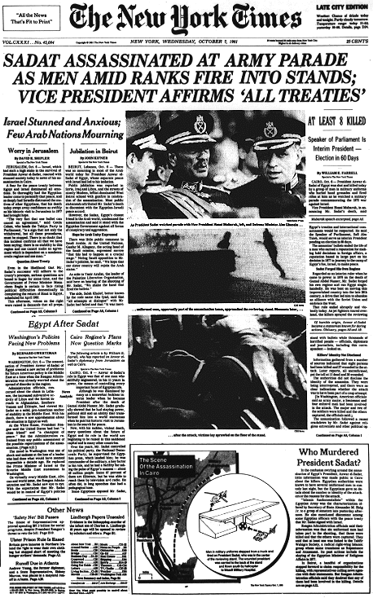
Celebrations: National Holidays
There are many different holidays and celebrations in Egypt. Some of the most important national holidays for the Egyptians are, National Day, Armed Forces Day, and New Year’s Day. On National day, July 23rd, there are many special reports on television and in the news. Schools and other places arrange public or private events to celebrate the Egyptian revolution.
New Year’s Day is a special holiday where the Egyptians give gifts to one another. The children receive sweets that they enjoy very much. Also, the adults visit old friends and relatives on this day.
During Armed Forces Day, huge parades were held, until President Sadat was murdered at one. Today, there are no more military parades, because of this tragic event.

Slide 10
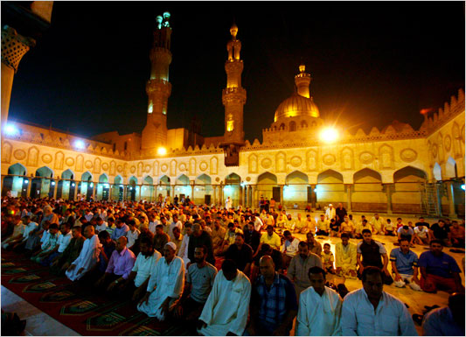

Celebrations continued: Religious Holidays
Many people also celebrate religious holidays. The Muslims that live in Egypt celebrate holidays such as Ramadan and Eid Al-Fitr. During Ramadan, the Muslims would fast from sunrise to sunset. They would eat and drink before sleeping, and before the sun rose. Eid Al-Fitr was the celebration of the end of Ramadan. After Ramadan ended, vast feasts would be held at mosques. These were some of the celebrations that were held in Egypt.

Slide 11
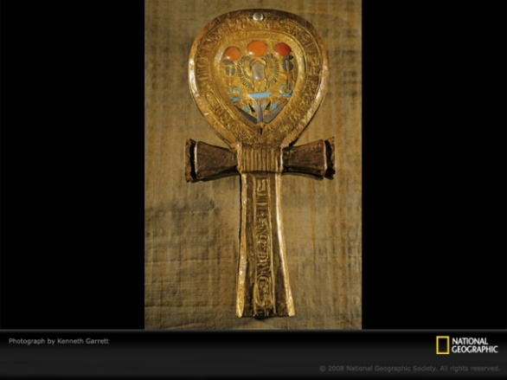
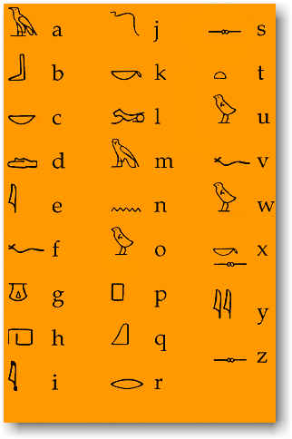
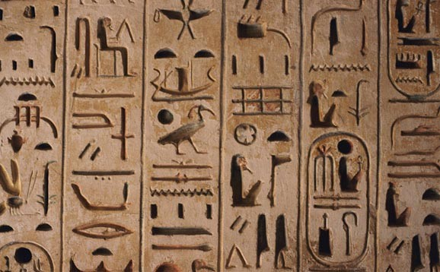

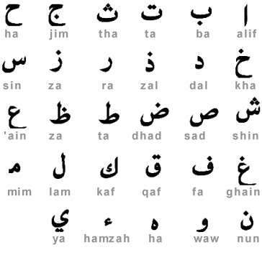
What’s their language?
Symbol for Life
Long ago, in Egypt, the ancient Egyptian’s alphabet was in the form of hieroglyphs. The Egyptians would call the hieroglyphs “Words of the Gods.”
Because the hieroglyph vocabulary size was so big, the language was very hard to understand and master.
The Egyptians would write things using pens made of reeds, and ink made of soot and water. They would write it down on papyrus, a paper-like material from the papyrus plant.
Today, the language of Egypt is Arabic. It is written and read from right to left.

Slide 12
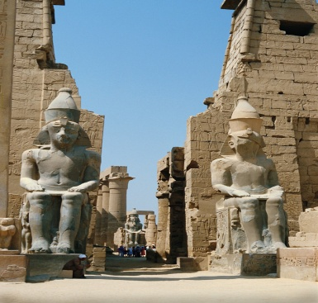
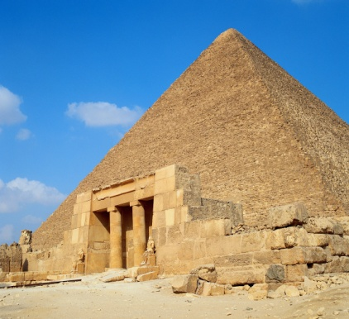
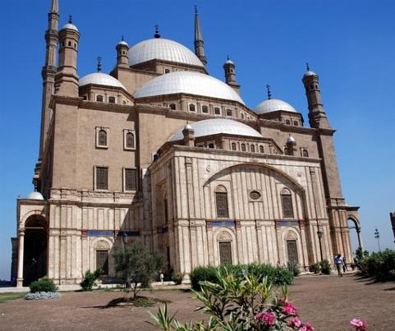
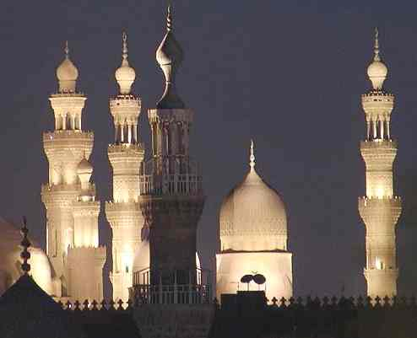
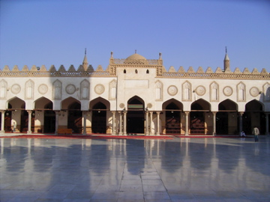
Architecture of Egypt
During the time of the Ancient Egyptians, most of their buildings and architecture were made of stone. An example of one of the famous structures the Egyptians built is, the Great Pyramids. This famous landmark was built by the Ancient Egyptian slaves. The slaves were instructed by the pharaoh, to build a pyramid. So, they had to use a special technique, to drag blocks of stone (that each weighed tons), and assemble them.
In all, the Ancient Egyptians built many famous and grand architectural structures. Some are: The Great Pyramids, the Sphinx of Giza, and more.
Today, in modern Egypt, the architectural styles are slowly becoming eco-friendly. The construction materials are selected to blend in with the ecosystem, without damaging anything.
Also, because of the Islamic influence, there are many mosques in Egypt. The mosques are wonderful tourist attractions for everyone.

Slide 13


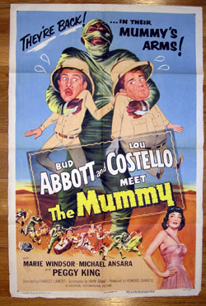
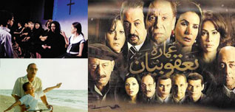
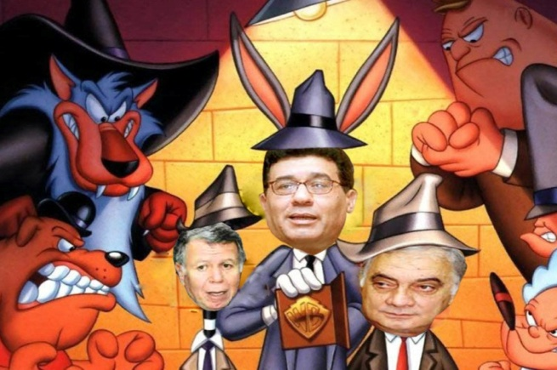
Mass Media
Egypt has many popular Radio Stations, movies, shows, and TV programs that are big influences in the Arab world. The film industry in Egypt supplies many Television programs to Arab countries. The mass media is so popular that Egypt might just become the new, “Hollywood of the East.”
Radio Broadcasting Systems are also big in Egypt.
One well-known broadcasting network is, the Egypt Radio Television Union, or ERTU for short. This is because it has many: radio networks, Satellite TV channels, and more.
Everyone loves to watch the Egyptian movies, and the hilarious shows.

Slide 14
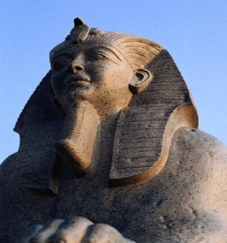
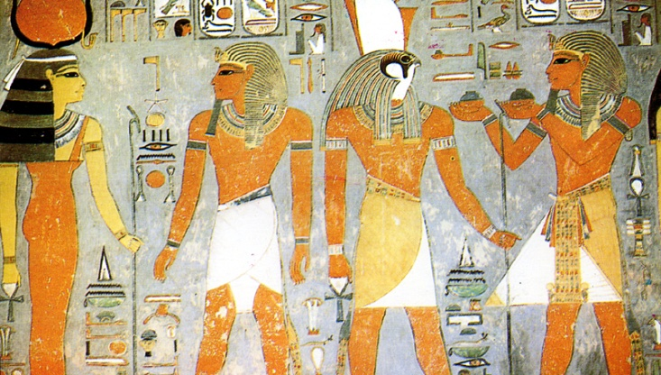
Other Cultural Features
Egyptians today and in the past have many cultural features, including arts and sculptures.
The arts of the Ancient Egyptians had lots of influence from the Gods they worshipped. Many of their paintings had a picture of a god (or gods), the pharaoh, or the workers/slaves. They also made statues of their Gods or pharaohs.

Slide 15
☺Bibliographies:☺
Asfour, Khaleh. “View from Cairo-new architecture in Egypt.” August, 2001. Online. 10/24/10. www.findarticles.com
Bobbie, Kalman. “Egypt, the culture.” Canada: Crabtree Publishing Company, 2008 copyright.
Carr, Karen. “Egyptian Clothing.” January 19th, 2009. Online. 10/16/10. www.historyforkids.org
Carr, Karen. “Egyptian Music.” January 21st, 2009. Online. 10/17/10. www.historyforkids.org
Egypt: Art and Architecture. Online. 10/17/10. www2.sptimes.com
“Egypt daily life: Entertainment.” Online. 10/14/10. www2.sptimes.com
“Egypt Mosques.” Online. 10/24/10. www.mapsofworld.com
Green, Jen. “Focus on Egypt.” US edition: World Almanac Library. 2007 copyright.
Map XL Inc. “Egypt Entertainment.” Online. 10/16/10. www.mapsofworld.com
Pateman, Robert. “Cultures of the World: Egypt.” NY: Marshall Cavendish Benchmark. 2003 copyright.
O’Connell, Abigail. “What types of clothing do Egyptians wear today?” Sep. 23rd, 2010. Online. 10/16/10. www.ehow.com

