Slide 1
What is Diwali?
By: Mehavi Patel

Slide 2
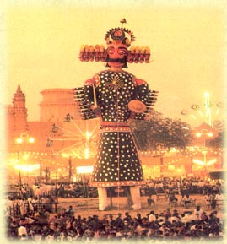
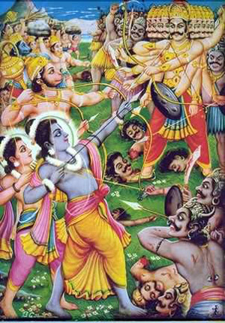
Dusshehra
Holiday exactly twenty days before Diwali; the exact date that Ram destroyed the demon Ravan. On this day people make a huge “Ravan” and destroy him, as Ram did.
Plum-Ucci, Carol. Celebrate Diwali (Celebrate Holidays). New York: Enslow, 2007. Print.

Slide 3
Deepavali
Another word for Diwali meaning “an array of lights”. Diwali can be referred to as either one.
Plum-Ucci, Carol. Celebrate Diwali (Celebrate Holidays). New York: Enslow, 2007. Print.

Slide 4
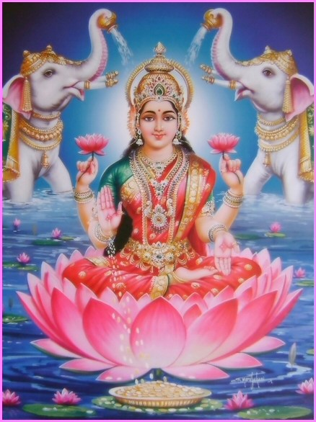
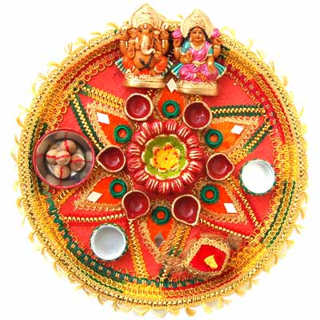
Puja
Rituals of worship that honor the Hindu deities.
Plum-Ucci, Carol. Celebrate Diwali (Celebrate Holidays). New York: Enslow, 2007. Print.

Slide 5
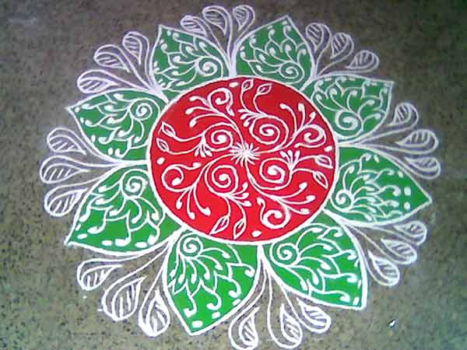
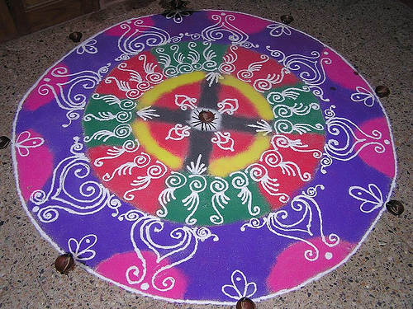
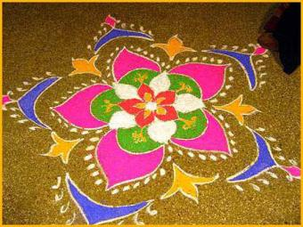
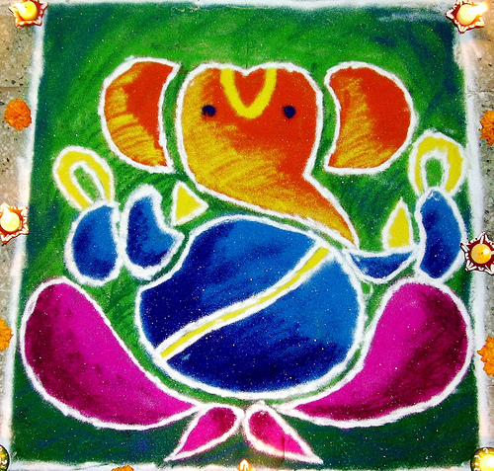
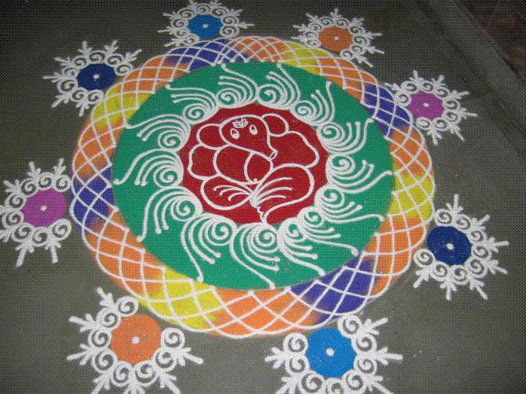
Rangoli
A powder used to make colorful designs on houses and sidewalks(these are made by hand). They are really made just
to make the house look more
attractive.
Plum-Ucci, Carol. Celebrate Diwali (Celebrate Holidays). New York: Enslow, 2007. Print.

Slide 6
Diyas
Clay lamps traditionally used as lights for Diwali (sometimes also referred to as Deepavali).
Plum-Ucci, Carol. Celebrate Diwali (Celebrate Holidays). New York: Enslow, 2007. Print.

Slide 7
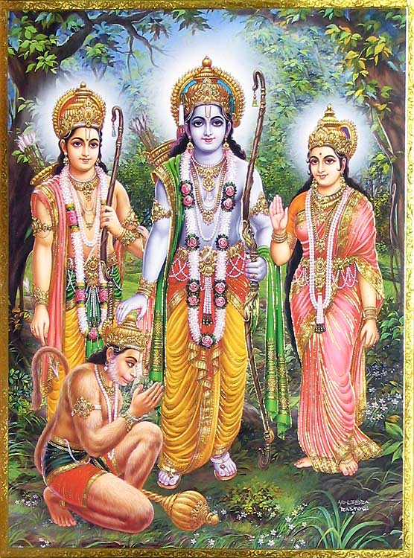
How Diwali Began
Ram & Sita lived in the royal capital (Ayodhya). Ever since they got married, Ayodhya began to prosper. Ram’s father, King Dashrath, wished to make Ram the heir to his throne, as Ram was the eldest of his sons. The people of Ayodhaya loved Ram and celebrated the anticipation of his crowing with great pomp. But one of Dashrath’s wives, Kaikeyi, wanted her son, Bharat to be king. She had got the King to promise that he would grant her any wish. And Dashrath never went back on his word. Kaikeyi told him to make Bharat king, and Ram to be a hermit in the woods for 14 years. Dashrath told Ram this and ram said he would go. Sita came along with him( even though Ram didn’t like this). For safety, they took Ram’s favorite Brother, Lakshman. Then one day, Ram & Sita were sitting under a tree, and then a giantess named Surpanaka came along. She fell in love with Ram and tried to get him to leave Sita. Ram simply laughed and rejected her. Surpanaka started to envy Sita & tried to kill her. But then Lakshman came to the rescue! He cut off Surpanaka’s nose and ears. Then Surpanaka decided to go to her brother Ravan, the demon King, to kidnap Sita. Ravan managed to kidnap her and keep her trapped as a prisoner in his palace. Ravan fell in love with Sita and did everything he could to take her from Ram. Meanwhile, Ram and Lakshman looked for Sita everywhere; they fought many demons and evil spirits. Then Hanuman, a god, became a loyal friend and with great leaps, he located Sita. Hanuman then ordered a tribe of servants to make a bridge( it was made in 5 days). Then a war took place. Ram won Sita back, and they returned to Ayodhya in a chariot. The people of Ayodhya lit candles & oil lamps to symbolize that good wins over evil. This happiness then created the holiday of Diwali! We still celebrate Diwali today!
Plum-Ucci, Carol. Celebrate Diwali (Celebrate Holidays). New York: Enslow, 2007. Print.

Slide 8
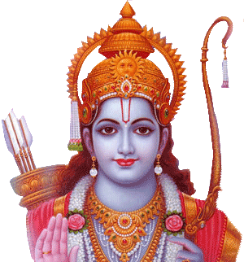
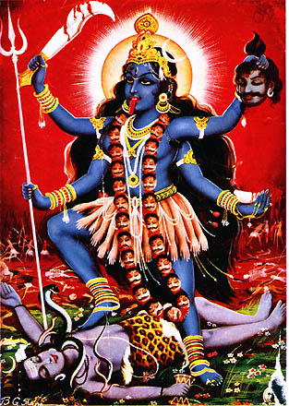
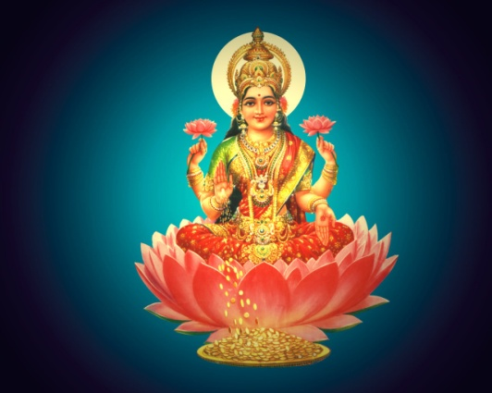
Special Welcoming
Many parts of India welcomes a different god.
North India welcomes Ram and his return to Ayodhya after defeating Ravan
Gujarat welcomes Lakshmi, the goddess of wealth
Bengal welcomes Kali, another goddess
Plum-Ucci, Carol. Celebrate Diwali (Celebrate Holidays). New York: Enslow, 2007. Print

Slide 9
Not only a Hindu Holiday
Not only Hindus celebrate Diwali.
The Diwali Season is also significant to Sikhs. In 1620, the sixth Guru, Hargobind Singh, successfully released 52 Hindu princes, who had been imprisoned under false accusations. To welcome their Guru, Sikhs on this day light many diyas at the golden temple of Amritsar. Sikhs still follow this tradition today; it means just as much to them.
Jains also celebrate Diwali. Mahavir Tirthankar, Jainism's founder, also attained nirvana on Diwali.
"10 Reasons to Celebrate Diwali." About Hinduism - What You Need to Know About Hinduism. Web. 19 Nov. 2009. <http://hinduism.about.com/cs/diwali/a/aa102003a.htm>.

Slide 10
Diwali Facts to Know
Diwali always falls on a night when a moon does not rise (new moon) and there is darkness everywhere.
Light is considered the symbol of hope and energy and indicates the win of good over evil.
By spreading light everywhere, we try to destroy the reign of darkness on the night of Diwali.
Everyone decorates their premises with diyas, lights, etc to make their surroundings filled with light and happiness.
Plum-Ucci, Carol. Celebrate Diwali (Celebrate Holidays). New York: Enslow, 2007. Print.

Slide 11
Timeline
4th December 7424 BC- Birth of Sri Ram
7405 BC – Ram marries Sita
7404 BC – Ram goes to exile
7391 BC – Ravan kidnaps Sita after about 5-6 months
7391-7390 BC – Ram invades Lanka Defeat of Raakshas(Ravan’s) nation
7359-60 BC – Death of Sri Ram
"Vedic Timeline - FRDB Archives." FRDB - Powered by vBulletin. Web. 19 Nov. 2009. <http://www.freeratio.org/thearchives/showthread.php?t=152200>.

Slide 12
Hindu Deities
Ganesha (Also worshiped as the god of knowledge, wisdom, and wealth) | The son of Shiva and Parvati(also gods) Lord of success and destroys evils and obstacles
Shiva (also known by: Mahadeva, Pashupati, Vishwanath, Bhole Nath ) | The most powerful and fascinating
Krishna | The great exponent of the Gita, the ninth and most complete avatar of Vishnu Blue skinned
Ram (the perfect avatar of Vishnu) | Most popular symbol of chivalry and virtue Embodiment of truth and morality The ideal son and husband The ideal king
Hanuman( also worshipped as a symbol of strength , perseverance, and devotion) | Aided Ram in his expedition against evil forces Believed to be the avatar of Lord Shiva In times of trouble, many chant his name
Vishnu (Popularly worshipped as Lord Vankateshwara in Southern India) | Peace-loving deity of the Hindu trinity Preserver/ sustainer of life Vishnu’s earthly incarnations have 10 major avatars
Lakshmi ( also known as Goddess of wealth and prosperity) | Means “good luck” to Hindus The word Lakshmi is derived from the Sanskrit word “Laksya”, meaning “aim” or “gold” Household Goddess of many families and favorite of women
Durga | Also known as Bhavani, Sherawali, Amba, Chandika, Gauri, Parvati, and Vaishno Devi
Kali | Dark Goddess Is the fearful and ferocious form of Mother Durga Depicted as being born from the brow of Durga, in one of her battles with the evil forces
Saraswati (also known as Goddess of wisdom, art, music, knowledge, and learning) | Represents the free flow of wisdom and consciousness Mother of the Vedas Daughter of Lord Shiva and goddess Durga
http://hinduism.about.com/od/godsgoddesses/tp/deities.htm

Slide 13
Map of Sri Ram’s(AKA Rama’s) Bridge
http://www.hinduismnet.com/images/rama_setu_bridge.jpg

Slide 14
My View Of Diwali…
I feel that Diwali is the one of the most important holidays that I celebrate. This holiday eliminates all my worries, and lightens up one’s life. It also brings hope for the new year.(also in the Diwali Season). This holiday teaches me more about my religion than all the other holidays I celebrate. I have read and heard many stories about Ram & Sita, but by watching plays, acts etc on Diwali, I know about what really happened while they were in exile.

Slide 15
Major Cause and Effect
Because Ram defeated Ravan, he was able to get Sita back and return to Ayodhya, and the holiday of Diwali was created.

Slide 16
MLA Bibliography
"10 Reasons to Celebrate Diwali." About Hinduism - What You Need to Know About Hinduism. Web. 19 Nov. 2009. <http://hinduism.about.com/cs/diwali/a/aa102003a.htm>.
"Diwali (Deepavali): Hindu Festival of Lights - ReligionFacts." Religion, World Religions, Comparative Religion - Just the facts on the world's religions. Web. 19 Nov. 2009. <http://www.religionfacts.com/hinduism/holidays/diwali.htm>.
Plum-Ucci, Carol. Celebrate Diwali (Celebrate Holidays). New York: Enslow, 2007. Print.
"Vedic Timeline - FRDB Archives." FRDB - Powered by vBulletin. Web. 19 Nov. 2009. <http://www.freeratio.org/thearchives/showthread.php?t=152200>.
"Top 10 Hindu Deities." About Hinduism - What You Need to Know About Hinduism. Web. 22 Nov. 2009. <http://hinduism.about.com/od/godsgoddesses/tp/deities.htm>.

