Slide 1







Land
&
Government
Water
Features
EGYPT
Inventions
Economy
Climate
By: Shine Lee

Slide 2
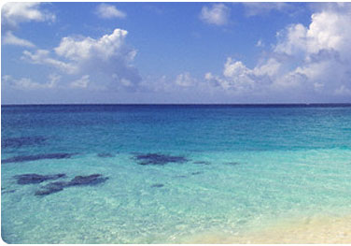
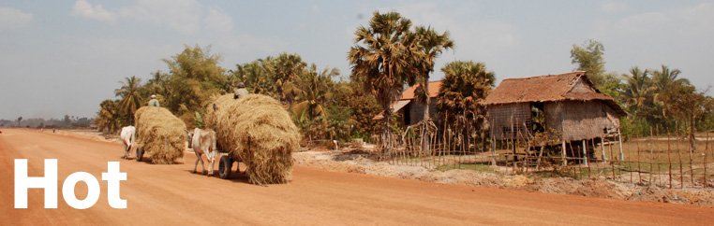
What is the climate like?
Egypt usually has a hot and dry climate, because of it’s arid region. But, the climate also varies based on the location, whether it’s on the coast (Upper Egypt), lower Egypt, or in between.
On the coast of Egypt, the climate is cool and warm, while in lower Egypt, it’s hot! But, in areas between upper and lower Egypt (like Cairo), there is a moderate climate annually.
During the summer, it gets especially hot in the months of May-August.
In the winter, there is a warm and lovely climate for traveling.
Coastal climate
Hot & Dry Climate

Slide 3
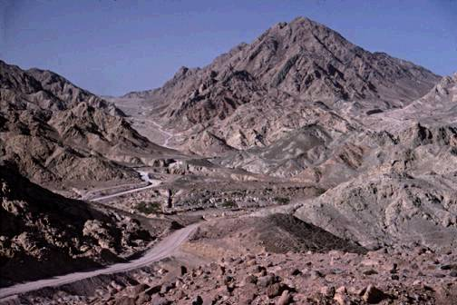
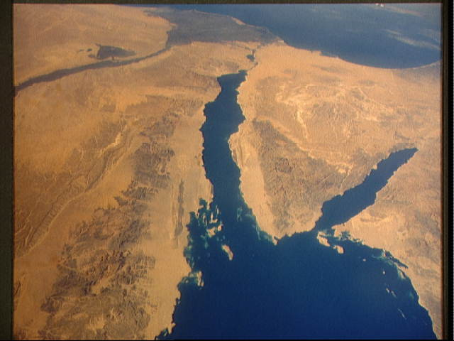
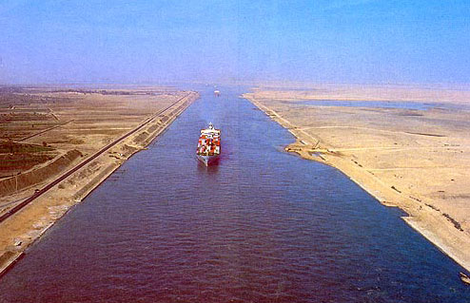

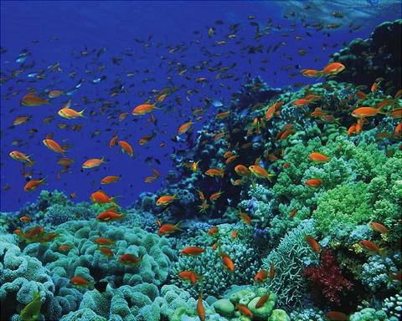
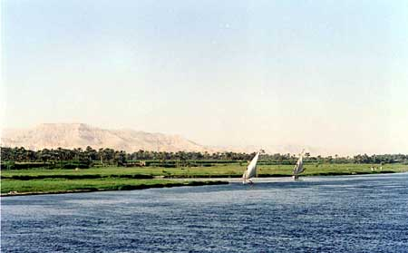
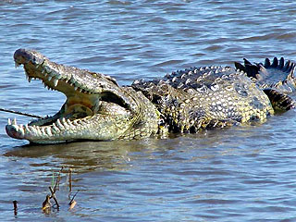
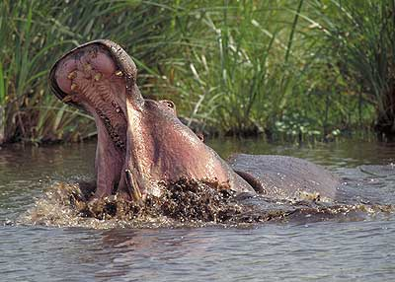
Land & Water Features
Egypt has several land and water features that are each special, and unique in their own way. These features include the Sinai Peninsula, Mtn. Catherine, Red Sea, Nile River, and the Suez Canal.
The Sinai Peninsula is a triangular peninsula that links Africa and Asia together.
Next, is Mtn. Catherine, which is the highest point in Egypt, and has great views.
The Red Sea is a body of water that borders the East coast of Egypt, and it is a big trade route in Africa and Asia.
After that is the Nile River, which is the longest river in the world. The Nile has many animals living there such as birds, hippos, and crocodiles.
Last but not least, is the Suez Canal, which is a man-made canal that creates a shortcut from the Red Sea, to the Mediterranean Sea.

Slide 4

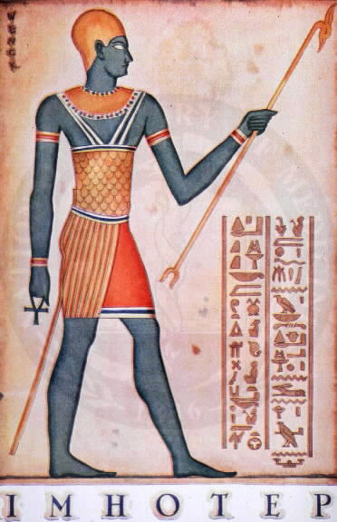
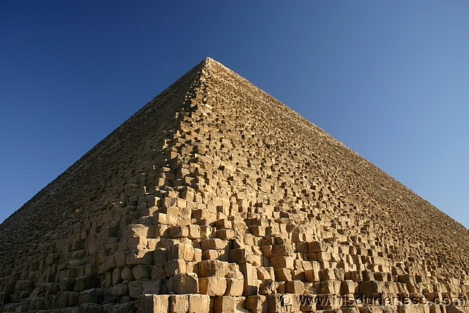
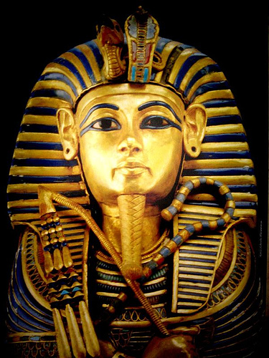
Government of Egypt:
(Past)
During the time of the Ancient Egyptians, the supreme ruler was the pharaoh. The pharaoh owned most of the power of Egypt.
The second most powerful person in Egypt was the Vizier, or now known as the prime minister. The vizier was a very rich person that was in charge of many things appointed to them by the pharaoh. Some things that the vizier was responsible for were: taxes, food supply and distribution, and the building of important monuments.
(A famous Egyptian vizier was Imhotep. He created the idea of step pyramids.)
So, the people who governed Egypt were the pharaoh, the vizier, and important nobles and officials.

Slide 5
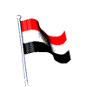
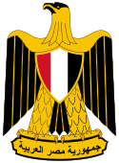
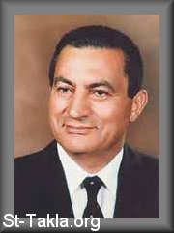
Government today
Today, the government of Egypt is very different from the government of the past. Because of British influence, Egypt has a Parliamentary system of government. There are also some branches of government known as the Executive, Legislative, and the Judicial branch.
In the Executive branch, the Head of State is the president. Currently, the president of Egypt is Mohamed Hosni Mubarak. He was once vice president, until the last president, Sadat, got murdered.
The Legislative branch is made up of The People’s Assembly & the Consultative Council.
Last but not least, is the Judicial branch. In this branch, laws are interpreted, or made. Most of the laws are based on Islam or the national law.

Slide 6

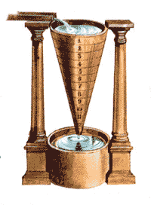
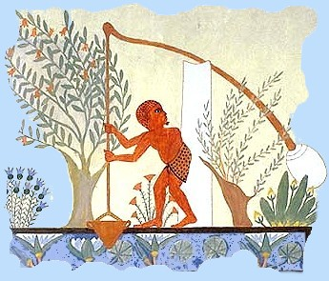

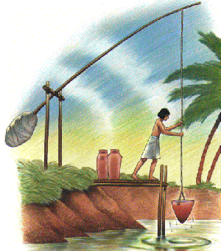
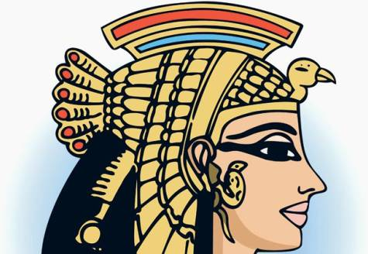
Inventions of Egypt
There were many great and helpful inventions that were created by the Ancient Egyptians. These inventions were:
The Water clock, Paper, the Shaduf, and Egyptian makeup.
A water clock is a stone pot, that has long, slanted sides. At the bottom, there is a tiny hole that drips out water at steady rates to tell time.
Paper was made from papyrus plants that were weaved together. First, the papyrus stalk was cut into thin slices, then it was washed in water to get rid of the sugary taste. After that, it was pounded to take out the water, and lastly, it was woven together.
A Shaduf is a simple machine that was used to irrigate farmland for crops. It is basically a long pole balanced on a crossbeam, and on one end, there is a bucket and a rope, on the other end is something heavy. Farmers would pull the rope and the bucket would lower into the Nile River, then they would pull it back up, and turn it around to water the land.
Last of all, Egyptian makeup was popular at the time. Everyone, whether they were rich or poor, would wear eye makeup (called Kohl). It was made from a mixture of Galena, which is a mineral made of sulfur and lead, and soot.
So, these were some of the inventions of the Ancient Egyptians.
Eye makeup
(Kohl)

Slide 7


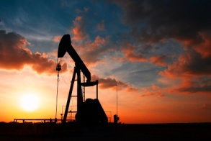
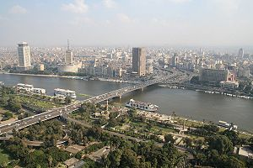
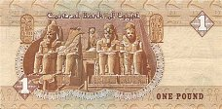
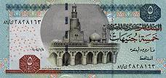
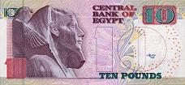
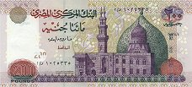
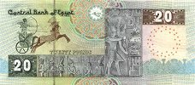


Egypt’s economy
In the ancient times, Egypt was considered as an ancient command economy.
Even though Egypt had a command system, the government did not tell the Egyptian farmers what to produce. Instead, they placed taxes on the goods produced, collected taxes from the people, and did other things.
Today, Egypt has a mixed economy (market plus command). Like the USA, both the people and the government have power (power is shared).
The economy of Egypt depends on tourism, oil, and exports such as: cotton, rice, beans, etc
Egypt’s economy has been improving over the years, and it’s growing stronger even today.

Slide 8

Bibliographies:
“Ancient Egyptian Government.” Jan. 16, 2009. Online. 11/11/10. www.king-tut.org.uk
Barrow, Mandy. “Ancient Egyptian Farming.” Online. 11/10/10. www.woodlands-junior.kent.sch.uk
Blakemore, Sarah. “The Egyptian Government.” Nov. 17, 2009. Online. 11/7/10. www.suite101.com
Bureau of Near Eastern Affairs. “Economy.” Nov.10, 2010. Online. 11/13/10. www.state.gov
Dunn, Jimmy. "Historical Papyrus.”Feb. 30, 2005. Online.11/7/10. www.touregypt.net
"Early Clocks." A Walk Through Time. 2002. Online.11/13/10. physics.nist.gov
“Egypt Climate.” 2010. Online. 11/3/10. www.asiarooms.com
Illes, Judith. "Ancient Egyptian Eye-Makeup." 1996.Online. 11/13/10.www.touregypt.net
“Land.” Online. 11/3/10. www.infoplease.com
“The Ancient Egyptian Economy.” April 2010. Online. 11/13/10. www.reshafim.org.il

