Slide 1
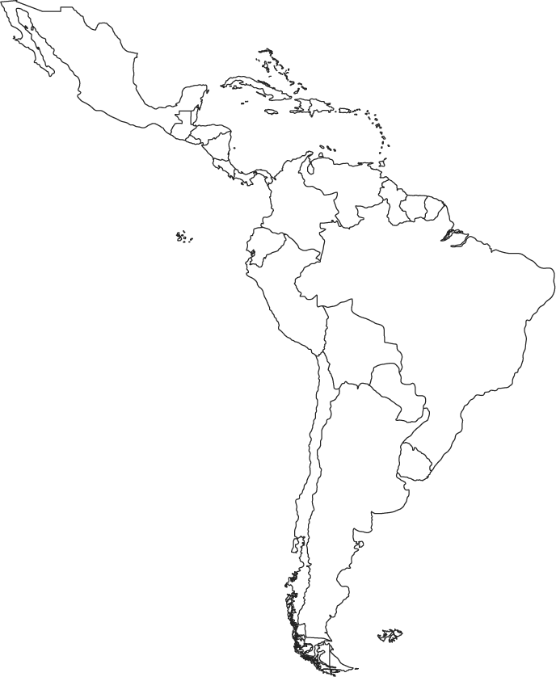
LATIN AMERICA MAP REVIEW

Slide 2
MEXICO
COUNTRY

Slide 3
GUATEMALA
COUNTRY

Slide 4
BELIZE
COUNTRY

Slide 5
HONDURAS
COUNTRY

Slide 6
EL SALVADOR
COUNTRY

Slide 7
NICARAGUA
COUNTRY

Slide 8
COSTA RICA
COUNTRY

Slide 9
PANAMA
COUNTRY

Slide 10
CUBA
COUNTRY

Slide 11
JAMAICA
COUNTRY

Slide 12
HAITI
COUNTRY

Slide 13
COUNTRY
DOMINICAN REP.

Slide 14
COLOMBIA
COUNTRY

Slide 15
VENEZUELA
COUNTRY

Slide 16
GUYANA
COUNTRY

Slide 17
SURINAME
COUNTRY

Slide 18
FRENCH GUIANA
COUNTRY

Slide 19
BRAZIL
COUNTRY

Slide 20
URAGUAY
COUNTRY

Slide 21
ARGENTINA
COUNTRY

Slide 22
PARAGUAY
COUNTRY

Slide 23
BOLIVIA
COUNTRY

Slide 24
CHILE
COUNTRY

Slide 25
PERU
COUNTRY

Slide 26
ECUADOR
COUNTRY

Slide 27
MEXICO CITY
CAPITAL

Slide 28
BOGOTA
CAPITAL

Slide 29
GUATEMALA CITY
CAPITAL

Slide 30
BELMOPAN
CAPITAL

Slide 31
SAN SALVADOR
CAPITAL

Slide 32
TEGUCIGALPA
CAPITAL

Slide 33
MANAGUA
CAPITAL

Slide 34
SAN JOSE
CAPITAL

Slide 35
PANAMA CITY
CAPITAL

Slide 36
HAVANA
CAPITAL

Slide 37
KINGSTON
CAPITAL

Slide 38
PORT-AU-PRINCE
CAPITAL

Slide 39
SANTO DOMINGO
CAPITAL

Slide 40
CARACAS
CAPITAL

Slide 41
GEORGETOWN
CAPITAL

Slide 42
PARAMARIBO
CAPITAL

Slide 43
CAYENNE
CAPITAL

Slide 44
BRASILIA
CAPITAL

Slide 45
MONTEVIDEO
CAPITAL

Slide 46
BUENOS ARIES
CAPITAL

Slide 47
ASUNCION
CAPITAL

Slide 48
LA PAZ
CAPITAL

Slide 49
SURCE
CAPITAL

Slide 50
SANTIAGO
CAPITAL

Slide 51
LIMA
CAPITAL

Slide 52
QUITO
CAPITAL

Slide 53
Rio de Janeiro
CITY

Slide 54
Sao Paulo
CITY

Slide 55
AMAZON
RIVER

Slide 56
Caribbean Sea
Body of Water

Slide 57
Gulf of Mexico
Body of Water

Slide 58
Atlantic Ocean
Body of Water

Slide 59
Pacific Ocean
Body of Water

Slide 60
ANDES
Mountains

