Slide 1
Middle East Map Review

Slide 2
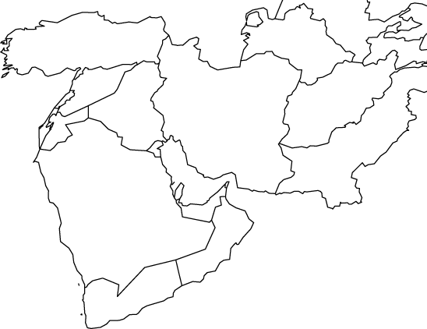
TURKEY
COUNTRY

Slide 3
SYRIA
COUNTRY

Slide 4
CYPRUS
COUNTRY

Slide 5
LEBANON
COUNTRY

Slide 6
ISRAEL
COUNTRY

Slide 7
JORDAN
COUNTRY

Slide 8
EGYPT
COUNTRY

Slide 9
Saudi Arabia
COUNTRY

Slide 10
YEMEN
COUNTRY

Slide 11
OMAN
COUNTRY

Slide 12
United Arab
Emirates
COUNTRY

Slide 13
QATAR
COUNTRY

Slide 14
Kuwait
COUNTRY

Slide 15
IRAQ
COUNTRY

Slide 16
IRAN
COUNTRY

Slide 17
Afghanistan
COUNTRY

Slide 18
ANKARA
Capital

Slide 19
ISTANBUL
CITY

Slide 20
NICOSIA
Capital

Slide 21
Beirut
Capital

Slide 22
DAMASCAS
Capital

Slide 23
JERUSALEM
Capital

Slide 24
AMMAN
Capital

Slide 25
CAIRO
Capital

Slide 26
BAGHDAD
Capital

Slide 27
TEHRAN
Capital

Slide 28
KABUL
Capital

Slide 29
RIYADH
Capital

Slide 30
MECCA
or
MAKKAH
CITY

Slide 31
KUWAIT CITY
Capital

Slide 32
DOHA
Capital

Slide 33
SANNA
Capital

Slide 34
ABU DHABI
Capital

Slide 35
DUBAI
CITY

Slide 36
MUSCAT
Capital

Slide 37
Euphrates
RIVER

Slide 38
Tigris
RIVER

Slide 39
JORDAN
RIVER

Slide 40
NILE
RIVER

Slide 41
Persian Gulf
Body of
Water

Slide 42
Body of
Water
Arabian Sea

Slide 43
Body of
Water
Indian Ocean

Slide 44
Red Sea
Body of
Water

Slide 45
Mediterranean
Sea
Body of
Water

Slide 46
Black Sea
Body of
Water

Slide 47
Caspian Sea
Body of
Water

Slide 48
Strait of
Hormuz
Body of
Water

Slide 49
SUEZ CANAL
Body of
Water

Slide 50
Rub a Khali
Desert (in Arabic)

Slide 51
ARABIAN
Peninsula

Slide 52
Bosporus
Strait

Slide 53
ANATOLIAN
Peninsula

Slide 54
SINAI
Peninsula

