Slide 1
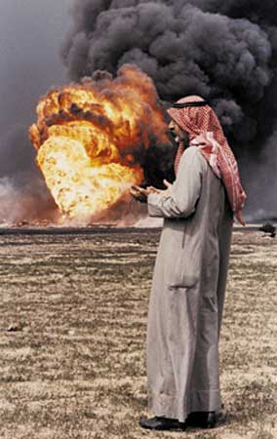
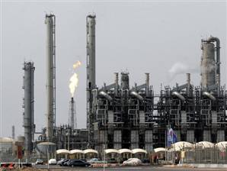
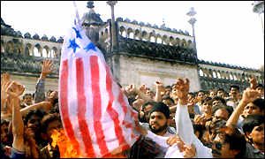
Modern Middle East

Slide 2
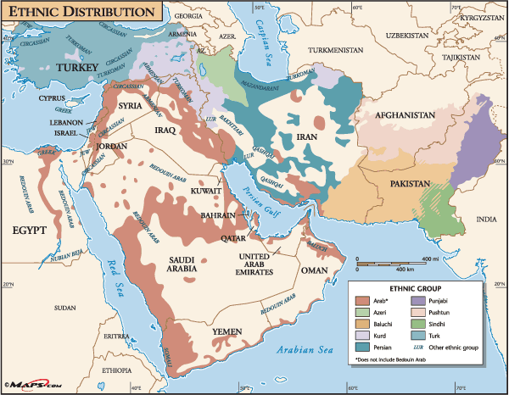
Ethnic Groups
An ethnic group is a group of people who share cultural ideas and beliefs that have been a part of their community for generations.
The characteristics they may have in common could included a language, a religion, a shared history, types of foods, and a set of traditional stories, beliefs, or celebrations.
These things make up a common culture shared by those in a particular ethnic group.

Slide 3
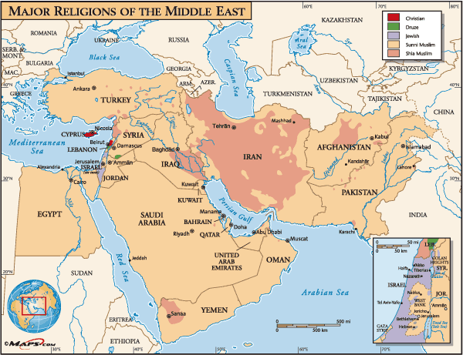
Religion
A religious group shares a belief system in a god or gods, with a specific set of ritual and literature.
People from different ethnic groups may share the same religion; through they may be from very different cultures.
Religion has been important to the history of the Middle East.
Christianity, Islam, and Judaism were started in this region.
People who follow Judaism are called Jews.
Followers of Christianity are called Christians.
Followers of Islam are called Muslims.

Slide 4
Arabs
Southwest Asia is home to many different ethnic groups who share similar religions.
The Arabs of Southwest Asia believe themselves to be descendants of Abraham in the Bible, through his son Ishmael.
They make up the majority of those who live throughout the region known as the Middle East, though there are many differences among them.
Most Arabs practice the religion of Islam and call themselves Muslims.
Most Arabs, whether they are Muslim or Christian, speak the Arabic language.

Slide 5
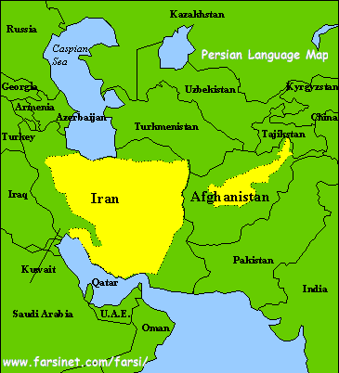
Persians
Persians are those who live in the modern country of Iran.
The Persian people are descended from a different group than those who are Arabs and Jews.
Their ancestors were Indo-Europeans from Central Europe and Southern Russia.
The country of Persia became known as Iran after World War I.
Persians, or Iranians, speak Farsi, a language that uses the Arabic alphabet but is actually a different language.
They practice Islam, but most belong to the Shia group of Muslims.
About 15 percent of Muslims in the world are Shia. The other 85 percent are Sunni Muslims.

Slide 6
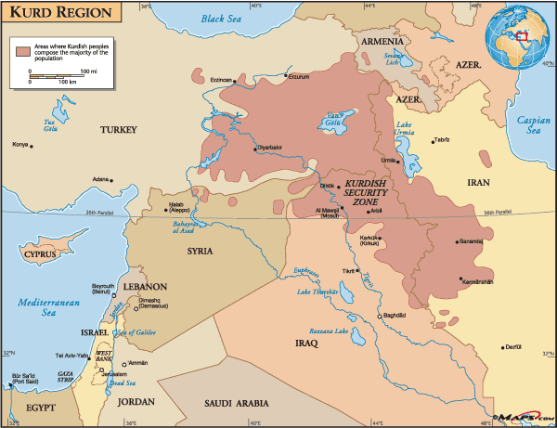
Kurds
The Kurds are an ethnic group the lives in several different countries in the Middle East.
Most Kurds are found in the mountainous areas where Syria, Turkey, Iran, and Iraq come together.
The Kurds see themselves as a distinct ethnic group from others in the area.
They speak their own language, known as Kurdish, and have a separate history, literature, music, and set of traditions.
Many Kurds hope to have a nation o their own some day, a hope that has caused conflict with the countries in which Kurdish people live.
Most Kurds are Sunni Muslim, though there is a small minority who are Shia Muslims.

Slide 7
The Middle East has a common culture which includes the Arabic language and the Islamic religion.
For centuries, kingdoms and empires have battled for control of the region.
Three continents (Europe, Asia, & Africa) meet in the Middle East.
Important trade routes have long passed through the region.
For many years, whoever controlled the Middle East held great influence over much of the world’s economy.

Slide 8

Hammurabi's Code
Hammurabi was a king of Babylon who set up the first written law called Hammurabi’s code
It was a collection of 282 laws with the most famous being and “eye or an eye”
Law was equal depending on your social class

Slide 9
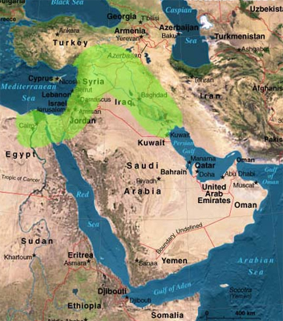
Fertile Crescent
The Fertile Crescent is a crescent-shaped, or curved, area of fertile land along the Tigris and Euphrates River
As the population of the Fertile Crescent increased, wars began to break out among the growing number of city-states, mostly over land and water
Phoenician’s spread their culture and their newly developed alphabet all over the area through trade and conquest since they were excellent sea voyagers

Slide 10

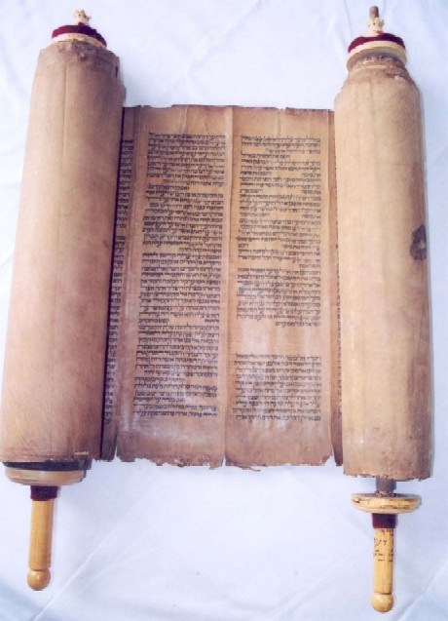
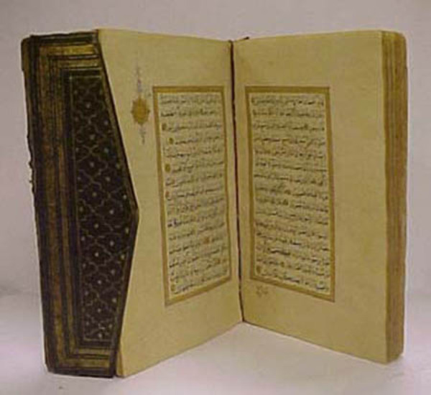
Origins of Judaism, Christianity, and Islam
Section 2 – Religions of the Middle East
The three major religions that originated in Southwest Asia are Judaism, Christianity, and Islam.
All are based on monotheism, a belief in one god.
Each religion has a sacred text, or book, which is at the core of its faith.
Each book is a collection of writings compiled over time.
None was written by the central figure of the faith.
All three faiths trace their ancestry back thousands of years to the prophet Abraham

Slide 11
Origins of Judaism
Judaism is the oldest of the three religions.
It began as a set of beliefs and laws practiced by ancient Hebrew people in Southwest Asia.
Its book is the Hebrew Bible – aka The Torah.
Jews believe that one day a human leader will come as a messenger of God and bring about a golden age.
They call this leader the messiah. In Greek versions of the Bible, messiah is written as christos, the anointed one.

Slide 12
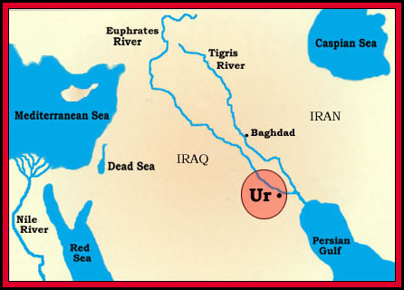
The Bible names Abraham as the father of the Jews.
There is no other evidence of his life.
Scholars place Abraham living sometime between 2000 and 1500 BCE (BC)
The Bible states that Abraham was born in Ur, in present-day Iraq.
He later moved to Canaan, in present-day Israel.
Jews believe Canaan is the Promised Land, which God promised to Abraham and his descendants.

Slide 13
It was said that Abraham’s grandson Jacob had 12 sons.
The twelve tribes of Israel began with Jacob's sons.
Jacob was later called Israel, and his descendants are called Israelites.
Sabbath – The seventh day of the week, Saturday, observed by Jews as a day of worship and rest
Kosher – fit to be eaten, according to Jewish dietary laws
Passover – Jewish festival marking the flight or Exodus of the Israelites from Egypt
Rabbi – teacher of Jewish law; spiritual head of a congregation

Slide 14
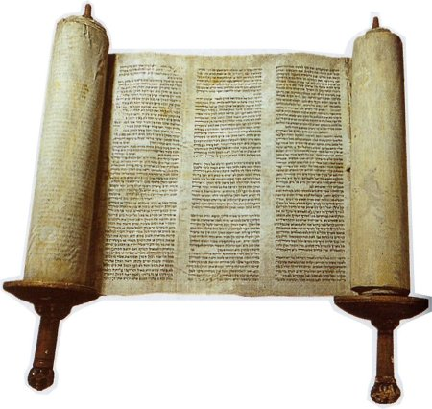
they were the first religion to be monotheistic and it is one of the worlds oldest religion
their holy book is the first five books of the Bible, which they call the Torah - this is what Moses delivered to the Israelites from God
The rest of the Jewish bible – the Christian Old Testament – are the writings of prophets
Prophet – a person thought to be inspired by God
More writings on Jewish law, history, and folklore are collected in the Talmud

Slide 15
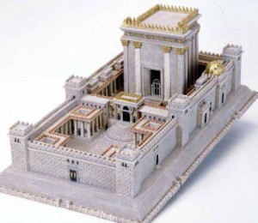
According to the Bible, the First Temple for Jewish worship was built around 900-1000 BCE and destroyed by Babylonians in 586 BCE.
The Jews were then sent out of Canaan, but returned after 50 years in exile.
A Diaspora occurs when a group of people leave their homeland and move to many different locations separately.
All of the world’s Jewish communities today that do not live in present-day Israel are part of the Jewish Diaspora.

Slide 16
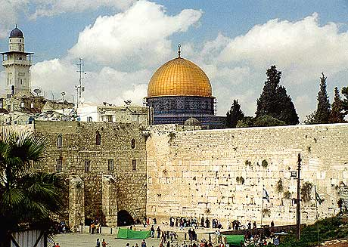
A new temple was finished 70 years later on the site of the First Temple, but was badly plundered by invading Romans about 54 BCE.
King Herod, a Jew, ruled Judea for the Romans.
The second temple was rebuilt in 20 BCE.
When the Romans attacked Jerusalem again in 70 CE(AD), they destroyed Herod’s temple.
Today, the single remaining temple wall, the Western Wall, is a place of prayer for Jewish pilgrims.
Jews moved away from the land again, until the modern state of Israel was formed in the late 1940s.

Slide 17
Origins of Christianity
In 30 CE, a Jew named Jesus began preaching new ideas about Judaism in Roman-controlled Judea.
The later title of Jesus Christ given to Jesus is a reference to the belief by his followers that he is the Jewish messiah.

Slide 18
According to the Christian New Testament, Jesus preached only to his fellow Jews.
His idea was that the old laws of Judaism should be replaced by a simpler system based on love of one's fellow human beings.
He began to grow popular.
Jewish leaders did not want Jesus to threaten their power and asked the Romans to arrest him.
The Romans found him guilty of speaking against Jewish laws and sentenced him to death by crucifixion, or being hung on a cross.
He died in 33 CE, after preaching for only three years.

Slide 19
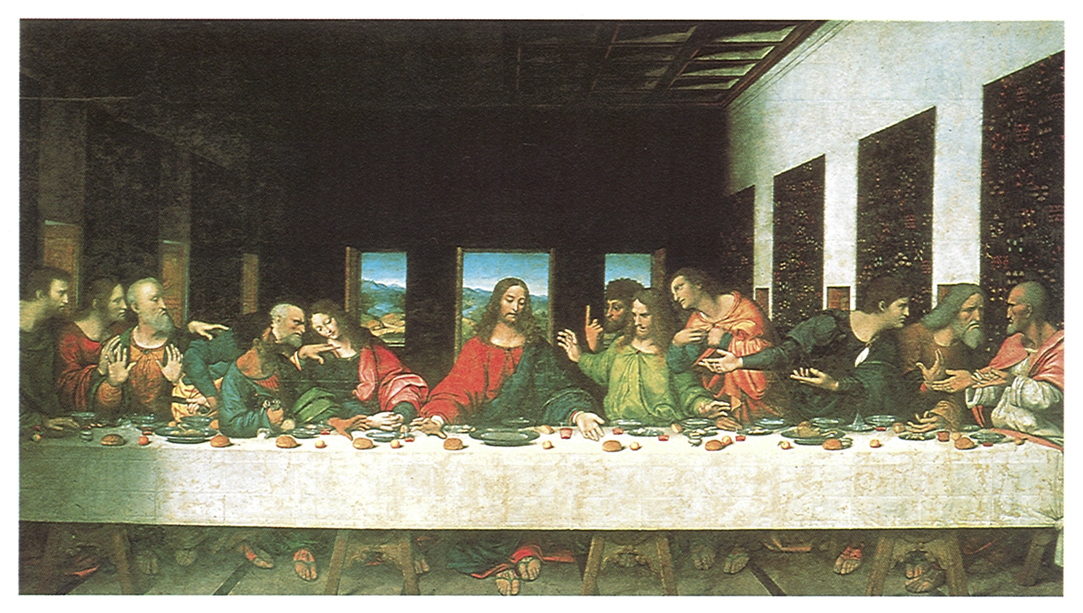
Jesus had 12 close followers, or disciples.
Interestingly, a man who had never met Jesus became the person to spread his message around the world.
Paul of Tarsus had a vision of Jesus after the crucifixion that told him to teach Jesus' ideas to non-Jews. Paul traveled to build churches throughout the ancient world in Ephesus, Corinth, Rome, and other cities.
The New Testament records Paul’s journeys through a series of letters, or epistles, that he wrote.

Slide 20
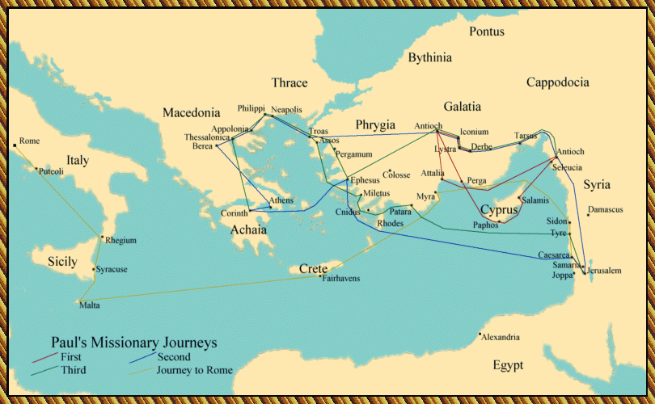

Slide 21
The chapters of Romans, Corinthians, Ephesians, Galatians, and Thessalonians, are all letters written by Paul to the people of the new, non-Jewish churches established in these locations.
Paul taught them how to live their lives in these letters.

Slide 22
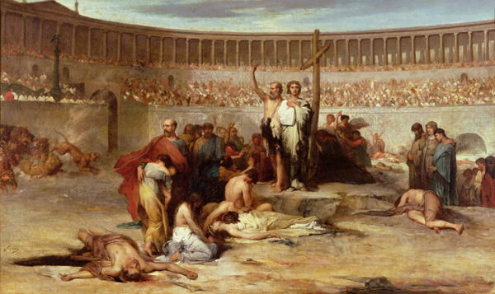
By 100 CE, the growth of Christianity was left to a new generation of people who had never known Jesus and who did not know Jewish laws.
Roman authorities fought the growth of Christianity.
Christians were often arrested and killed.
A number of Roman emperors launched bloody campaigns against the new faith.
Christians were thrown into public arenas to be torn apart by wild animals.
Nero had some lit on fire to serve as human torches.
Most Christians practiced their religion in hiding, but their numbers continued to grow and the religion spread.

Slide 23
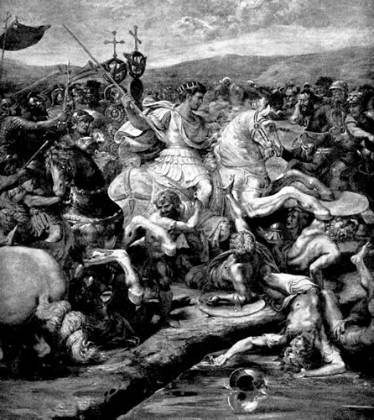
By the early 4th century, Christianity may have reached members of the Roman emperor’s family.
The Roman Emperor Constantine was not a Christian, but he had his soldiers fight an important battle in 313 with a Christian symbol on their shields.
His army won the battle.

Slide 24
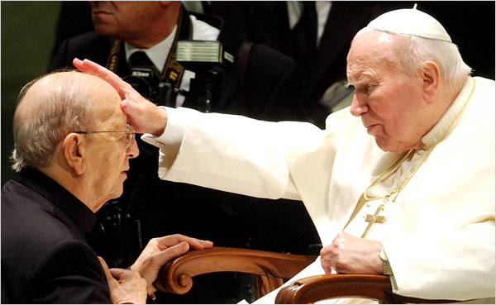
In the nearly 300 years since his death, many different ideas had developed about how to follow Jesus.
In 325 CE, Constantine called a meeting for all the Christen leaders to meet in Nicea.
About 300 men attended the meeting to discuss how Christianity should be practiced.
The council produced the Nicene Creed, the first attempt at a uniform statement of Christian doctrine found in the current New Testament.
When the Christian leaders left this meeting, a new type of Christian church had been formed.
This new church was said to be Catholic, which means universal.

Slide 25

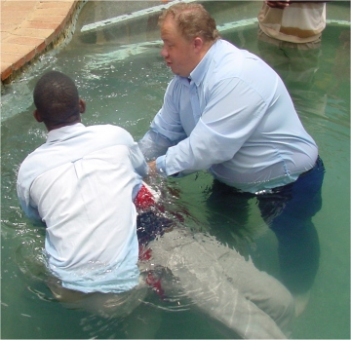
Three main divisions of Christianity: Roman Catholic (headed by a pope in Rome), Eastern Orthodox, and Protestant
Protestant – a Christian that split from the Roman Catholic church in the 16th century
Gospels – The first four books of the New Testament containing the life and teachings of Jesus Christ
Easter – Holiday commemorating the resurrection of Jesus Christ
Resurrection – The rising of Jesus Christ from the dead on the third day after his crucifixion
Eucharist – blessed bread and wine shared in Christian worship; also called Holy Communion
Baptism – ceremony of initiation into the Christian church, usually with water

Slide 26
Origins of Islam
The Prophet Muhammad was an Arab born in 570 CE, in Mecca, which is in present-day Saudi Arabia. He was a merchant known as “al-Amin,” the trustworthy one.
According to Islamic tradition, in 610 CE, while he was praying in a cave, he had a vision of the angle Gabriel, a figure in the Hebrew Bible.
The angle gave him messages from God, called Allah in Arabic.

Slide 27
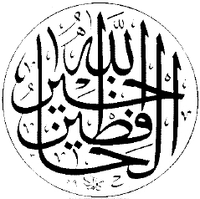
Muhammad taught that Abraham, Moses, and Jesus were each prophets, but that Jews and Christians had misunderstood their teachings.
Many of the poor who heard Muhammad’s message accepted it because he called for social justice and equality.
A great number of powerful leaders and rich merchants, however, rejected Muhammad's message.
They saw him has a threat to their economic security.

Slide 28
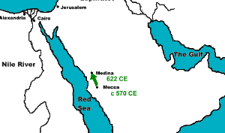
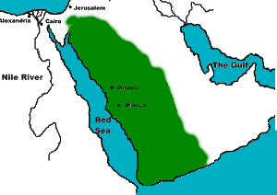
Muhammad spread the messages he received from Allah.
He was forced to flee Mecca for Medina in 622 CE.
This flight is known as the Hijrah.
The Islamic calendar begins at this date.
By the time he died in 632 CE, Islamic control of central Arabia was well underway.

Slide 29
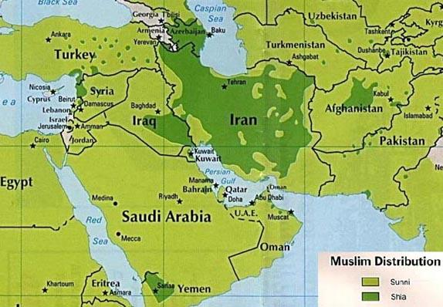
Before 700 CE, Muhammad’s followers were fighting over his successor.
The fight split Muslims into the Shi’a and the Sunni.
The Shi’a comprise 10% - 15% of Islamic followers today and Sunni comprise close to 90%.
Sunni – Orthodox Muslim who accepts the traditional teachings of the Koran and the authority of the descendants of Caliph Ali.
They believe that the Caliph (leader of Islam) does not have to be a blood relative of Muhammad.
Shi’a (Shiite) – A Muslim who rejects the authority of the religious leaders who succeeded Muhammad’s son-in-law Ali & the Caliph must be a blood relative.

Slide 30
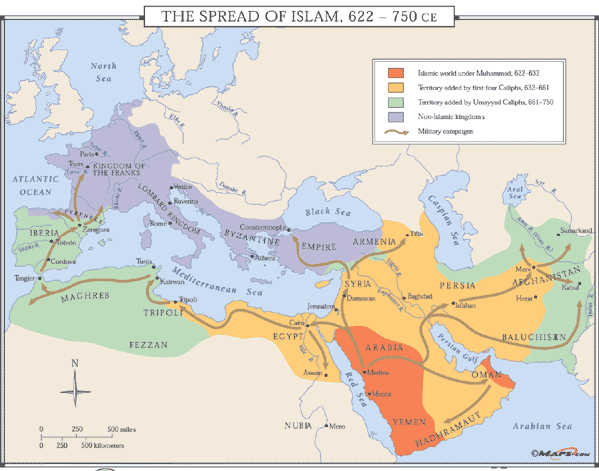
Within a century, Islam spread throughout the Middle East and North Africa.
Muslims even conquered parts of Spain.
Their military campaigns were inspired by a desire to spread Islam, and for some, a desire for wealth and power.
Due to divisions in Christianity, many former Christians in North Africa actually welcomed the new religion.

Slide 31
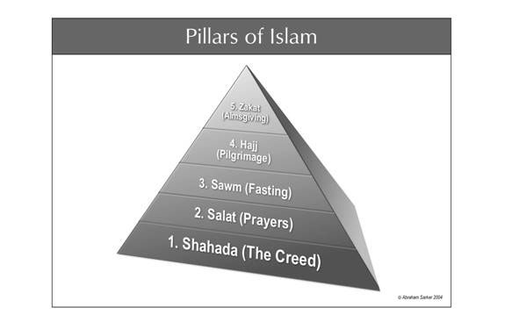
The Five Pillars of Islam is the term for the religion’s five main beliefs.
They are accepted by all Sunnis and Shi’as, but the Shi’as have added several other practices to form the Branched of Religion.
The Five Pillars are:
  Believe in only one God and Muhammad is his messenger (Shahada)
  Pray in the direction of Mecca five times a day (Salat)
  Donate money to the poor ( Zakat)
  Fast during the month of Ramadan (Sawm)
  Make a journey, or hajj, to Mecca at least once.

Slide 32
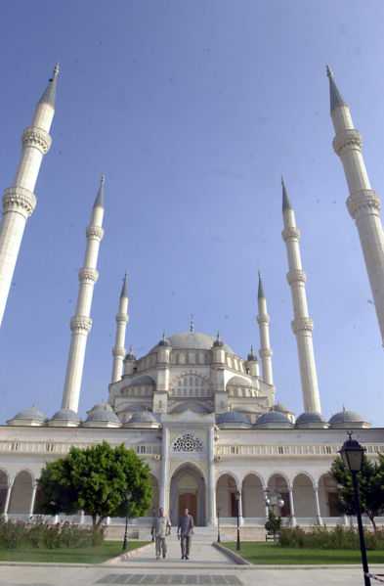
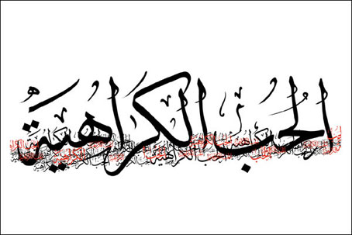
Islam has other rites, including what Muslims are allowed to eat and drink (They don’t eat pork or drink alcohol)
Also, the Qur'an, their scared book, explains a concept called jihad.
Jihad requires believers to meet the enemies of Islam in combat.
Enemies can be attacked by the heart, the tongue, the hand, or the sword.
Muslims pray at a Mosque
Minaret – a high slender tower attached to a mosque
They write in calligraphy
Calligraphy – beautiful or elegant handwriting

Slide 33
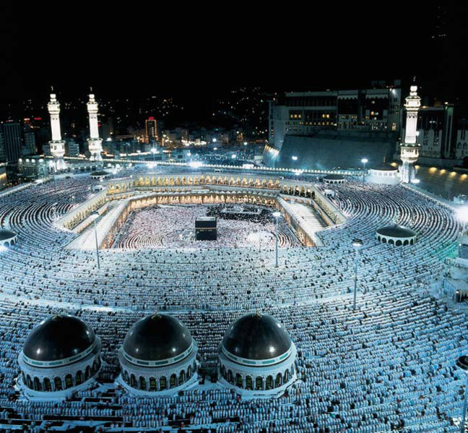
The Great Mosque of Mecca

Slide 34
Section 3 – History
Crusaders
the Christians in Europe wanted to take back the Holy Land from the Muslims, so they sent armies there to do the job
Pope Urban II started the Crusades in 1095, he sent an army to take the land of Jesus, which is modern day Israel
the first crusade was successful, but the Christians slaughtered many Muslims and Jews
at the time, the Islamic civilization was more advanced than Europe’s, so soon the Muslim’s, under general Saladin, eventually drove the Christians out
Saladin called for a jihad or holy war

Slide 35
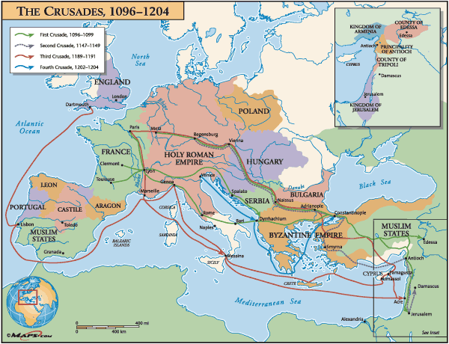

Slide 36
The Ottoman Empire
The Ottoman Empire began in 1299, in Turkey, which is located in southwestern Asia.
It lasted longer than any Muslim empire in history.
The empire grew had later included parts of Asia, the Middle East, Africa, and Europe.
The Turks had been ruled by the Byzantine Empire prior to 1299.
By the 13th century, the Byzantine Empire was in decline.

Slide 37
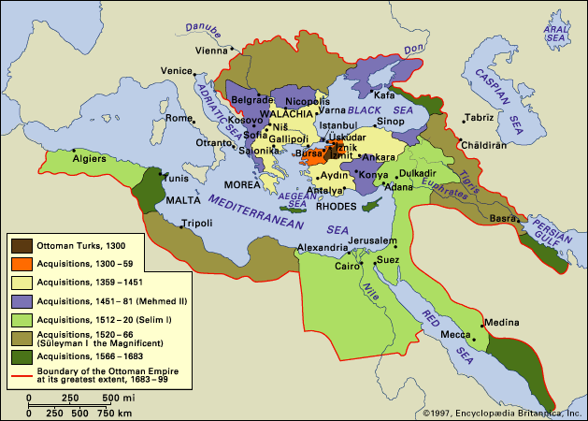

Slide 38
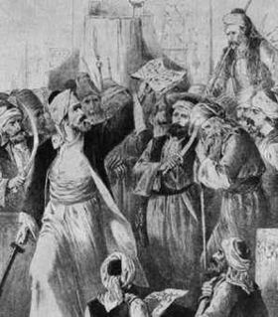
Osman was a Turkish warrior and a Muslim.
He had many followers, called Ottomans.
Through successful military campaigns and the promise of booty (wealth taken after battle). Osman gained soldiers and his domain grew.
In 1299, Osman conquered the last of the Byzantine villages and the Ottoman Empire began.
Osman was the first Ottoman sultan.
A sultan is the ruler of a Muslim state.

Slide 39
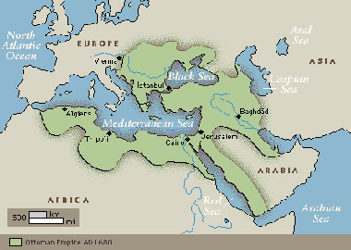
The Ottoman Empire controlled many trade routes.
It had access to the Persian Gulf, the Black Sea, and the Mediterranean Sea.
Europe and Asia were linked by Ottoman trade routes.
This connection helped join these distant cultures.

Slide 40
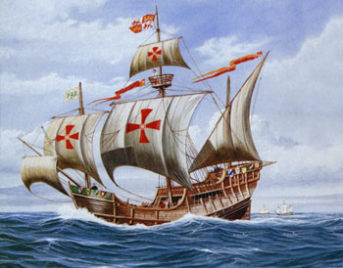
Most countries of Western Europe looked at the Ottoman Empire as a threat.
European Christians feared the spread of Islam.
Many European traders did not want to trade with the Ottomans because of this fear.
All trade routes to the east were under Ottoman control.
Western Europeans began to search for other ways to reach Asia
This search led to the age of exploration, during which the New World was discovered and explored.

Slide 41
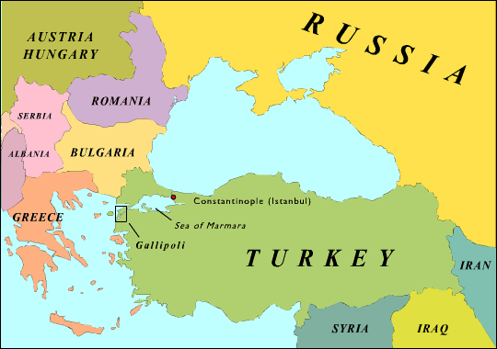
By the 20th century, the Ottoman Empire was weak.
It sided with the Central Powers in World War I, which fought against the Allied powers of England, France, Russia, and the United States.
The Ottoman troops won only one key battle in World War I, the battle of Gallipoli

Slide 42
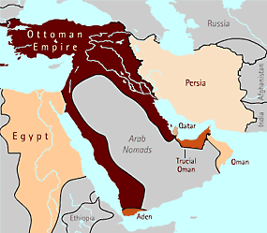
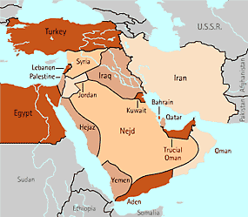
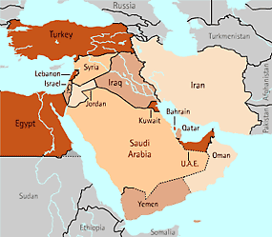
Middle East 1880
Middle East 1920
Middle East Today

Slide 43
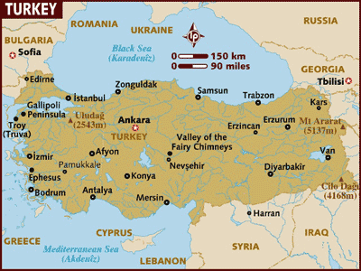
The British took control of Jerusalem and Baghdad from the Ottomans.
Arabia then rose up against Ottoman rule.
By 1918, the Ottoman Empire had ended.
In 1920, after the end of World War I, the Treaty of Sevres split the land of the Ottoman Empire among Allied, or Western, powers.
France was grated mandates over Syria and Lebanon.
The United Kingdom was grated Palestine and Iraq.
The modern Turkish republic was declared on October 29, 1923.
Today, Turkey is the largest Muslim nation in Europe.

Slide 44
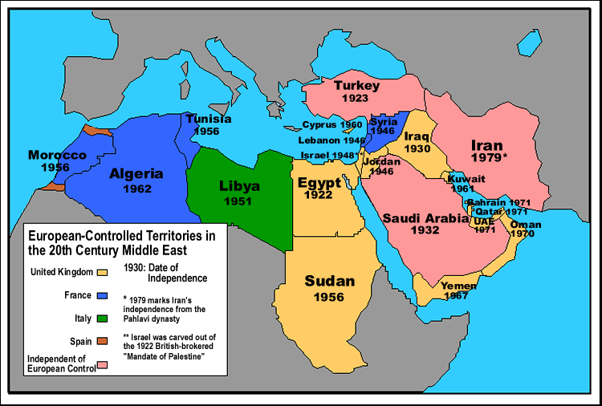
End of Section 1

Slide 45
The State of Israel
Section 4 – Creation of Israel
The modern state of Israel was established in 1948.
Many beliefs and events led to its creation including Zionism, anti-Semitism, and the Holocaust.

Slide 46
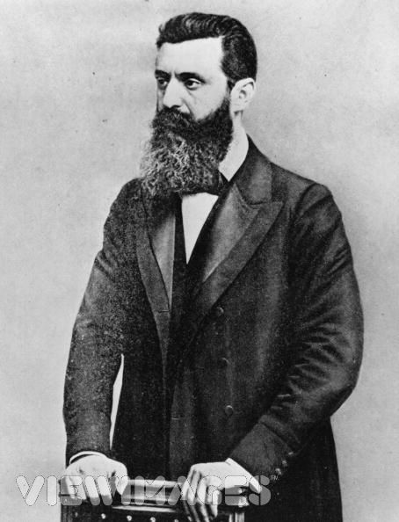
Zionism is a Jewish movement that began in Europe in the late 19th century.
Its goal was to establish a Jewish homeland in Palestine.
Theodor Herzl started the movement and also led the first Zionist Congress in 1897.
After World War I, the movement grew in popularity.
In 1917, Britain issued the Balfour Declaration, which stated that Britain would work toward the establishment of a national home for the Jewish people in Palestine.

Slide 47
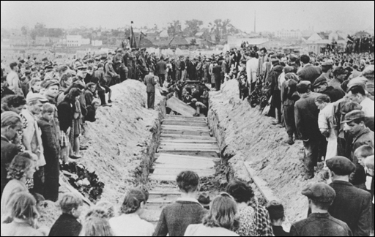
European
Anti-Semitism
Anti-Semitism is hostility toward or prejudice against Jews or Judaism.
In the late 19th and early 20th centuries, anti-Semitism began to spread throughout Europe.
Events in Russia, Austria, and France fueled European anti-Semitism.
In Russia, anti-Jewish mob attacks, called pogroms, began in 1881 and then spread to Central and Eastern Europe.
Russians blamed Jews for the assassination of the tsar, the leader of Russia.

Slide 48
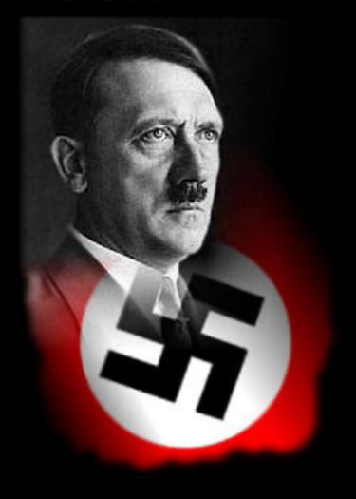
World War II
The events that led to the Holocaust began in 1933.
From the time Adolf Hitler became the chancellor of Germany, the treatment of Jews in Germany, and eventually most of continental Europe, grew worse.
The policies of Hitler’s Nazi Party slowly eroded the rights of Jews.
The government declared that Jews were no longer German citizens and removed them from their jobs, businesses, schools, and homes.

Slide 49
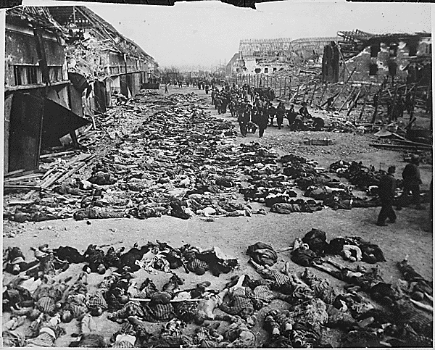
As Germany took over other European countries, including Poland in 1939, Czechoslovakia, the Netherlands, France, much of Russia, and Austria, Jews in those locations were treated similarly or worse.
By the end of the war, Hitler’s “final solution” to rid the earth of Jews resulted in the murder of six million Jews and the deaths of millions of other Europeans.
Often the Jews that could flee Europe moved to Palestine during this time.
The Holocaust ended with Germany’s defeat in World War II in 1945.

Slide 50
The Creation of Israel
The history of the Jews is traced back to the Fertile Crescent along other early civilizations.
In more recent times, Palestine was part of the Ottoman Empire, until World War I.
After World War I and the fall of the Ottoman Empire, Britain ruled Palestine.
As more Jewish people moved into Palestine, tensions with the Arabs increased.
Clashes became violent and more frequent.

Slide 51
In 1937, the British created a plan to divide up the land between the Arabs and Jews, but both groups rejected it.
Although the US was not directly involved at this time, they did believe that Jewish people should be allowed to move to the area.
The United Nations support the creation of a state of Israel after World War II.
Around 1936, one-third of the total population of Palestine was made up of Jewish immigrants.
The conflict between the Arabs and the Jews continued to get worse.
In May of 1948, British rule of Palestine ended and the state of Israel was declared.

Slide 52
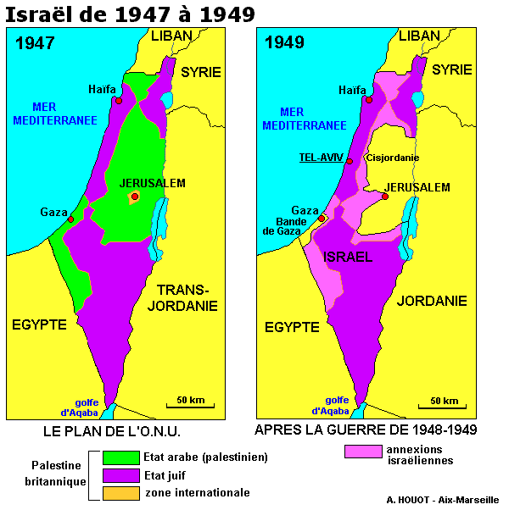
Israeli and Arab
Conflict
May 15, 1948, is known to Arabs as “al-Nakba,” or the catastrophe.
That is the day when the state of Israel was declared and the last of the British troops left.
The very next day, five Arab armies from surrounding countries invaded the new state.
These forces were then defeated by the Israeli army.
Over the next several years, the Arab countries surrounding Israel and Palestine competed to lead Arab forces against the new Israel.

Slide 53
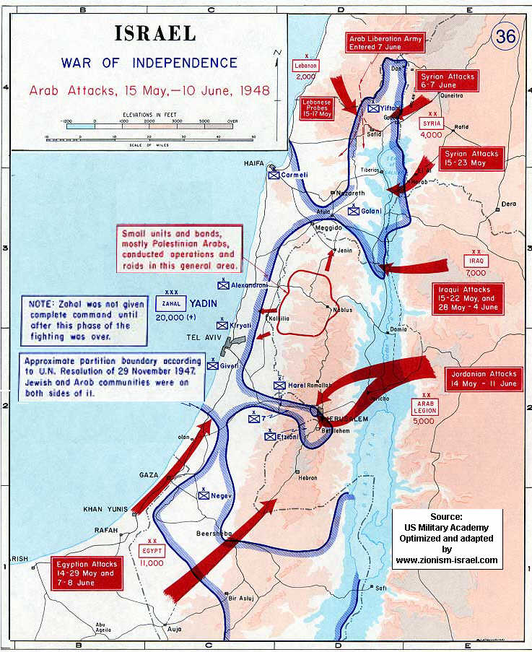
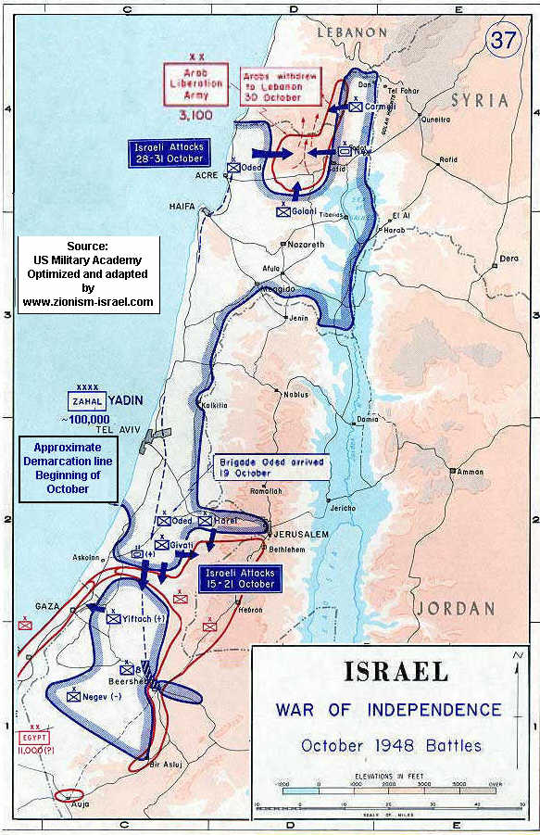

Slide 54
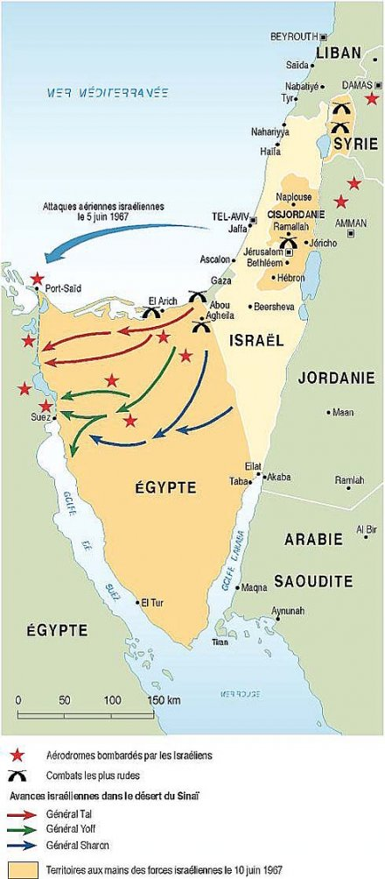
The 1967 Six –Day War occurred in June, and changed the face of the Middle East conflict.
Israel was able to double the amount of land it controlled.
This also helped to spread hope and confidence throughout all of Israel and to its supports.
Another 500,000 Palestinians fled their homes during this conflict, joining the hundreds of thousands already displaced by years of fighting between Jewish and Arab forces.
Many of these people ended up in Egypt, Syria, Lebanon, and Jordan.

Slide 55
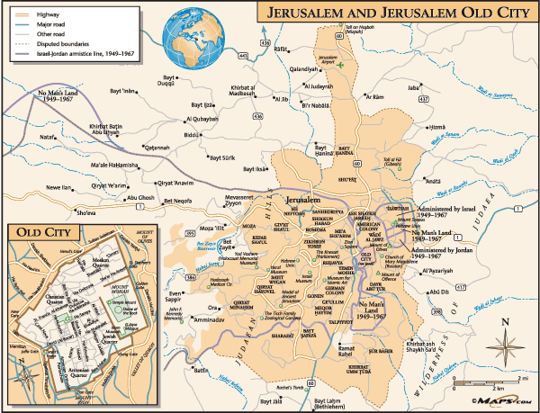

Slide 56
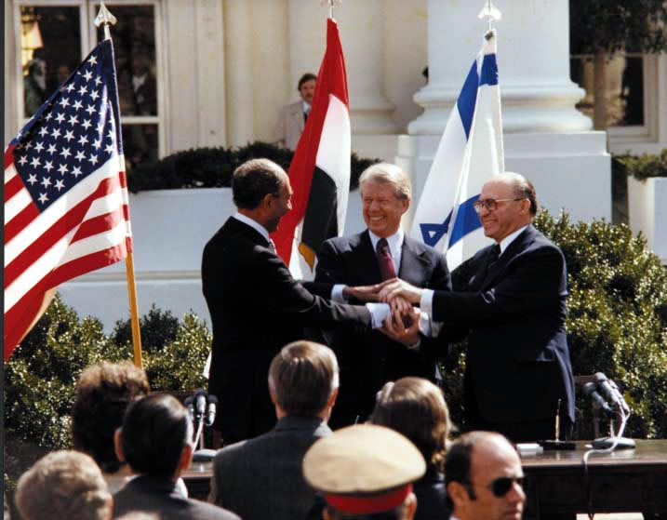
Attempts at Peace
President Carter helped Prime Minster Begin of Israel and Egyptian President Anwar Sadat work out an agreement.
This agreement is called the Camp David Accords.
The three leaders met at Camp David in the US
Begin agreed to remove all Israeli troops from the Sinai Peninsula and return the land to Egypt.
Other Arab countries were not happy about this agreement.
They stopped doing business with Egypt.
In 1981, Sadat was assassinated by troops in the Egyptian army.

Slide 57


Slide 58
Hezbollah and Hamas are two important Arab groups that were founded in the mid-1980’s.
Hezbollah is from Lebanon.
Hamas is based in the Gaza Strip.
Both groups are supported by Syria and Iran and are made up of Muslims.
Over the last 25 years, both groups have each led attacks on Israel.
These attacks have often been very violent and have killed many civilians.
The late 1980’s and the 1990’s saw continued fighting between Israelis and Arabs.
Often civilians were involved, and thousands have been killed.
There have been treaties and agreements that unfortunately, have not led to peace in the region.

Slide 59
Iran – Iraq War
Sec. 5 – US in the Middle East
in 1980, the Iran-Iraq war broke out because the two governments did not like each other, and wanted each others oil supplies
each country suffered a million casualties
the US had to send warships in the area to protect their oil tankers from being attacked by one of the two sides
although Iran was an enemy of the US, we secretly gave them arms during the Reagan years, which later lead to a major investigation here in the US
in 1988, the war ended with a tie

Slide 60


Slide 61
Persian Gulf War
The Persian Gulf War was a war between Iraq and a group of about thirty other nations.
Iraq accused Kuwait of stealing oil by drilling under the border between the two countries.
Iraq invaded Kuwait in August of 1990, under the direction of Iraqi President Saddam Hussein.
The Iraqi army took control of Kuwait in a very short amount of time.

Slide 62

The UN responded to the Iraqi invasion by demanding that Iraq withdraw its troops from Kuwait.
The UN used the Iraqi economy to try to convince the country to withdraw.
They did this by cutting off trade to the country.
Iraq did not withdraw.
The US and other countries began sending troops to Saudi Arabia over the next few months.
The UN set a date for Iraq to leave Kuwait.
The Iraqis remained in Kuwait after the date.
The US and other nations attacked the Iraqi forces in January of 1991. The Iraqi army was defeated in less than two months.

Slide 63




Slide 64





Slide 65


Slide 66


US Invasion of Afghanistan
On September 11, 2001, al-Qaeda attacked two targets in the US.
Al-Qaeda is a group of radical Islamic terrorists based largely in Afghanistan.
They Hijacked four airplanes and crashed two of then into the World Trade Center in New York.
The third airplane crashed into the Pentagon in Virginia, and the fourth crashed in rural Pennsylvania, before reaching its intended target of the White House or US Capital.
These terrorist attacks killed nearly 3,000 people.

Slide 67

Investigations into the attack have named Osama bin Laden as its organizer.
US President Bush called on other countries to help wage war on terrorism.
The first goal of those nations that joined the US was to find bin Laden, whom they believed to be in Afghanistan, even though most of the people carrying out the attacks were from Saudi Arabia or the UAE.
So far bin Laden has not been captured

Slide 68


In October 2001, US and British troops invaded Afghanistan in search of bin Laden.
They bombed places where bin Laden was known to be.
Millions of people from Afghanistan were homeless because of the many wars that have taken place in their country.
After the invasion, more than 3 million refugees returned to their homes.
The US-led forces still struggle to control portions of the country from the Taliban

Slide 69


Slide 70

Operation Iraqi Freedom
In 2003, the US launched an invasion of Iraq, after claiming that the Iraqi government, led by Saddam Hussein, was developing Weapons of Mass Destruction (WMD’s) – nuclear or chemical weapons, and offering aid to groups like al-Qaeda, who were a threat to US interests in the region.
The government of Saddam Hussein collapsed quickly because many of the Iraqis felt he was a cruel leader.
However, problems followed as the US did not have a plan ready to help reorganize the country once the old government was gone.

Slide 71


American forces have remained in Iraq ever since, trying to stop the fighting between the different religious and ethnic groups who are competing with each other for power as they try to organize a new government.
US troops are scheduled to leave by 2011.

