Slide 1
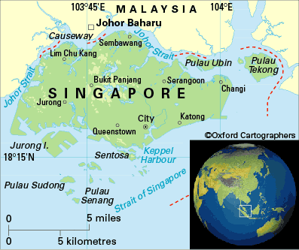
Singapore
By: Ashley Park

Slide 2
What do the colors and symbols represent on the Singapore Flag?
2
3
1
4
# | Symbol/Color | What does it stand for or represent?
1 | Crescent Moon | The crescent moon represents a young nation on the ascendant.
2 | 5 Stars | The 5 stars represent ideals of democracy, peace, progress, justice, and equality.
3 | Red | The red stands for universal brotherhood and equality of all men.
4 | White | The white stands for pervading and everlasting purity and virtue.

Slide 3
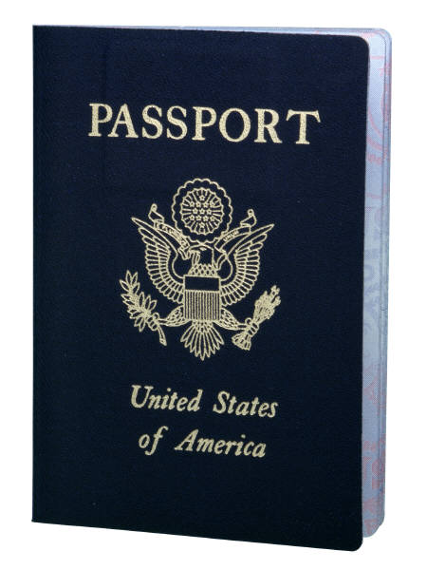
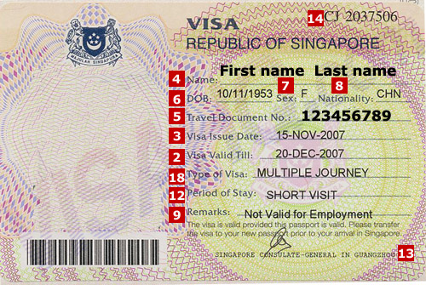
In order for us (U.S. citizens) to enter Singapore, we must have a passport with no less than six months of validity left. A visa is not required if your visit to Singapore is for business or communicative reasons. If your stay is for business, or social reasons, your stay must be for 90 days or less.

Slide 4
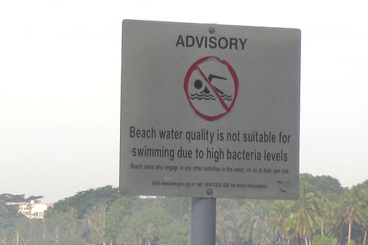
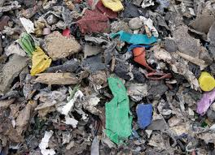
Unsafe Areas of Singapore
Singapore is an overall safe place. The department of state urges the citizens to try and keep their country clean. In this case there are very few unsafe places. Some waterways are unsafe with bacteria or chemicals. Also, there are many industrial problems and waste in different areas. In this case, these areas should be avoided. Overall, Singapore is a safe place with few dangerous places.
Pasir Ris Beach is high in Bacteria causing there to be no swimming allowed.

Slide 5
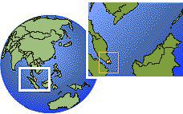
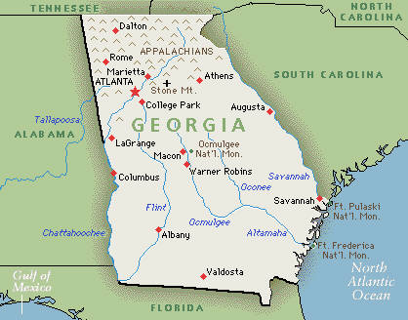
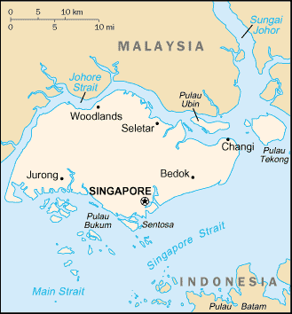
Atlanta To Singapore
9,957 miles

Slide 6
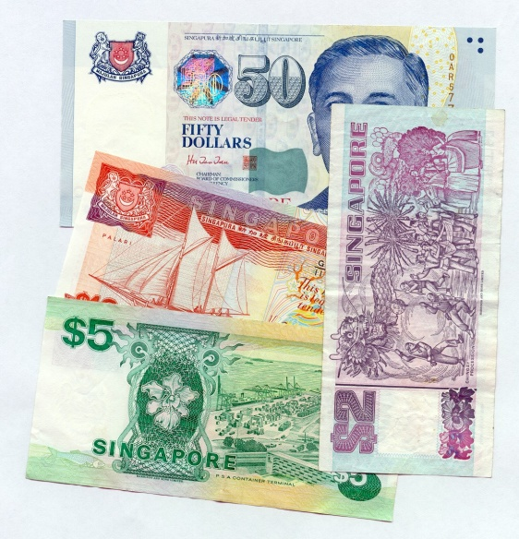
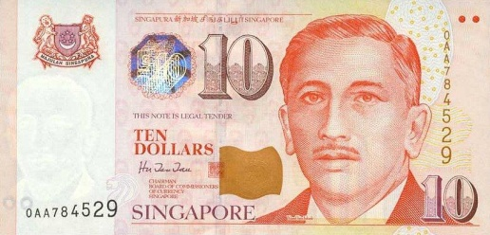
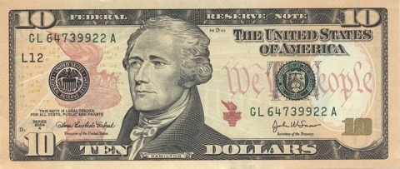
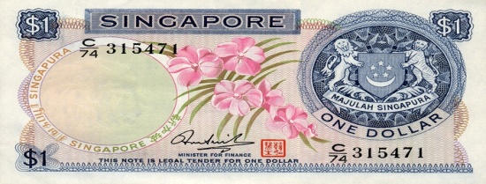
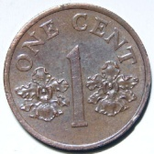
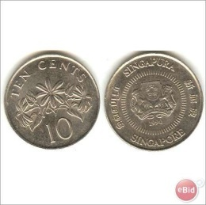
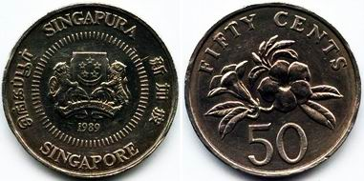
Currency
Called Singapore Dollars
10.00 USD=13.63 SGD
United States Dollars Singapore Dollars

Slide 7
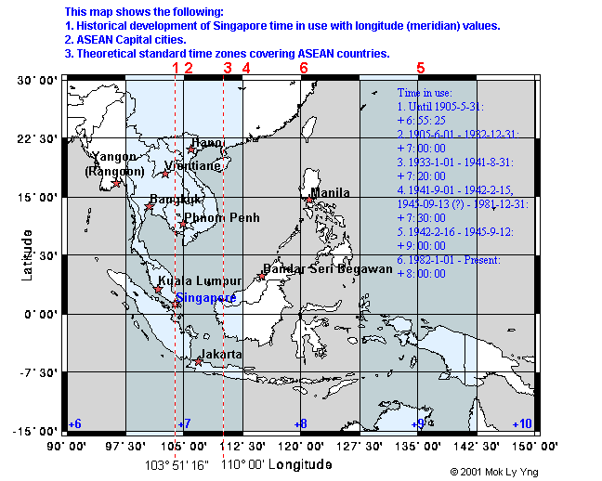
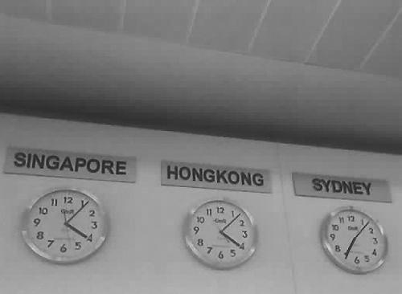
Time Zone
Noon in Atlanta=??? In Singapore
???=Midnight

Slide 8
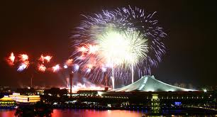
Independence
August 9, 1965
By Malaysian Federation
The mark of the 44th anniversary of Singapore’s independence.
Singapore’s Independence Day with fireworks.

Slide 9
Internet Country Code
.sg

Slide 10
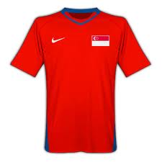
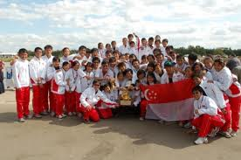
Soccer International Rank
120out of 202

