Slide 1
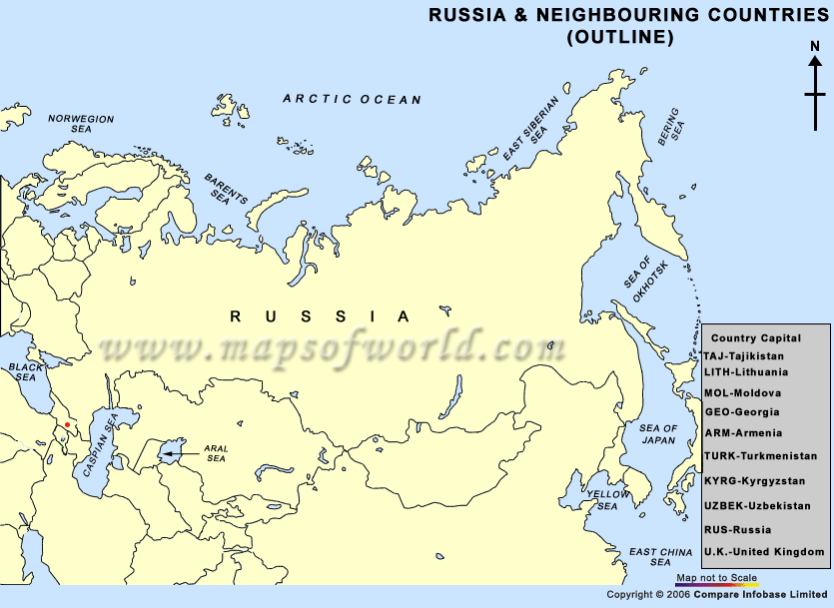

Slide 2
MOLDOVA
COUNTRY

Slide 3
CHISINAU
CAPITAL

Slide 4
RUSSIA
COUNTRY

Slide 5
ESTONIA
COUNTRY

Slide 6
LATVIA
COUNTRY

Slide 7
LITHUANIA
COUNTRY

Slide 8
BELARUS
COUNTRY

Slide 9
UKRAINE
COUNTRY

Slide 10
GEORGIA
COUNTRY

Slide 11
ARMENIA
COUNTRY

Slide 12
AZERBAIJAN
COUNTRY

Slide 13
KHAZAKSTAN
COUNTRY

Slide 14
Kyrgyzstan
COUNTRY

Slide 15
Tajikistan
COUNTRY

Slide 16
Turkmenistan
COUNTRY

Slide 17
UZBEKISTAN
COUNTRY

Slide 18
MOSCOW
CAPITAL

Slide 19
ST. PETERSBURG
CITY

Slide 20
TALLIN
CAPITAL

Slide 21
RIGA
CAPITAL

Slide 22
VILNIUS
CAPITAL

Slide 23
MINSK
CAPITAL

Slide 24
KIEV
CAPITAL

Slide 25
TIBLISI
CAPITAL

Slide 26
YEREVAN
CAPITAL

Slide 27
BAKU
CAPITAL

Slide 28
ASTANA
CAPITAL

Slide 29
BISHKEK
CAPITAL

Slide 30
DUSHANBE
CAPITAL

Slide 31
ASHKABAT
CAPITAL

Slide 32
TASHKENT
CAPITAL

Slide 33
URAL
MOUNTAINS

Slide 34
VOLGA
RIVER

Slide 35
CAUCASUS
MOUNTAINS

Slide 36
ARCTIC OCEAN
BODY OF WATER

Slide 37
BALTIC SEA
BODY OF WATER

Slide 38
BERRING SEA
BODY OF WATER

Slide 39
SEA OF OKHOTSK
BODY OF WATER

Slide 40
BLACK SEA
BODY OF WATER

Slide 41
CASPIAN SEA
BODY OF WATER

Slide 42
SIBERIA
REGION

Slide 43
KAMCHATKA
PENINSULA

Slide 44
LAKE BAIKAL
BODY OF WATER

