Slide 1
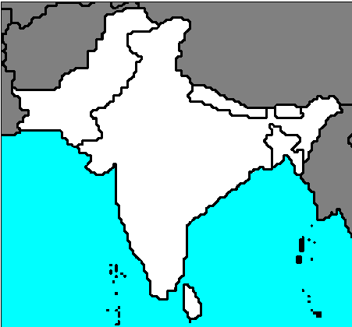
SOUTH ASIA MAP REVIEW

Slide 2
INDIA
COUNTRY

Slide 3
PAKISTAN
COUNTRY

Slide 4
NEPAL
COUNTRY

Slide 5
BHUTAN
COUNTRY

Slide 6
BANGLADESH
COUNTRY

Slide 7
SRI LANKA
COUNTRY

Slide 8
ISLAMABAD
CAPITAL

Slide 9
NEW DELHI
CAPITAL

Slide 10
KATHMANDU
CAPITAL

Slide 11
THIMPU
CAPITAL

Slide 12
DHAKA
CAPITAL

Slide 13
COLOMBO
CAPITAL

Slide 14
AMRITSAR
CITY

Slide 15
LAHORE
CITY

Slide 16
KARACHI
CITY

Slide 17
VARANASI
CITY

Slide 18
CALCUTTA
CITY

Slide 19
MUMBAI
CITY

Slide 20
HYDERABAD
CITY

Slide 21
BANGALORE
CITY

Slide 22
MADRAS
CITY

Slide 23
BRAMAPUTRA
RIVER

Slide 24
INDUS
RIVER

Slide 25
HINDU KUSH
MOUNTAINS

Slide 26
HIMALAYAS
MOUNTAINS

Slide 27
GREAT INDIAN or THAR
DESERT

Slide 28
EVEREST
MOUNTAIN

Slide 29
K2
MOUNTAIN

Slide 30
WESTERN GHATS
MOUNTAINS

Slide 31
EASTERN GHATS
MOUNTAINS

Slide 32
DECCAN
PLATEAU

Slide 33
ARABIAN
SEA

Slide 34
INDIAN
OCEAN

Slide 35
BENGAL
BAY

Slide 36
GANGES or GANGA
RIVER

