Slide 1
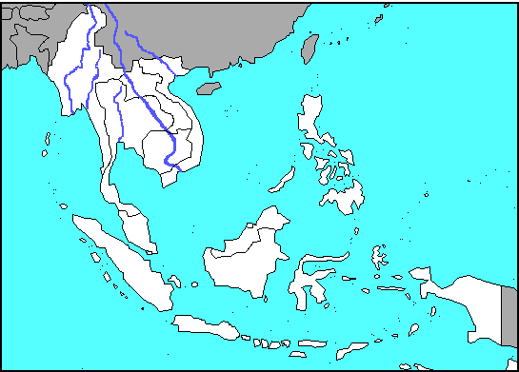
SE Asia Map Review

Slide 2
COUNTRY
Myanmar or Burma

Slide 3
COUNTRY
Thailand

Slide 4
COUNTRY
Laos

Slide 5
COUNTRY
Cambodia

Slide 6
COUNTRY
Vietnam

Slide 7
COUNTRY
Malaysia

Slide 8
COUNTRY
Singapore

Slide 9
COUNTRY
Brunei

Slide 10
COUNTRY
Philippines

Slide 11
COUNTRY
Indonesia

Slide 12
COUNTRY
East Timor

Slide 13
RIVER
Mekong

Slide 14
SEA
South China Sea

Slide 15
Bandar Seri Begawan
Capital

Slide 16
Naypyitaw
Capital

Slide 17
Bangkok
Capital

Slide 18
Vientiane
Capital

Slide 19
Phnom Penh
Capital

Slide 20
Kuala Lumpur
Capital

Slide 21
Manila
Capital

Slide 22
Jakarta
Capital

Slide 23
Dili
Capital

Slide 24
Hanoi
Capital

Slide 25
Ho Chi Minh City (Saigon)
City

Slide 26
Davao
City

Slide 27
Rangoon (Yangon)
City

Slide 28
Irrawaddy
River

Slide 29
Bengal
Bay

Slide 30
Andaman
Sea

Slide 31
Indian
Ocean

Slide 32
Thailand
Gulf

Slide 33
Tonkin
Gulf

Slide 34
Sulu
Sea

Slide 35
Celebes

Slide 36
Philippine Sea
Sea

Slide 37
Java
Sea

Slide 38
Malacca
Strait

Slide 39
Malay
Peninsula

Slide 40
Indochina
Peninsula

Slide 41
Luzon
Island

Slide 42
Mindanao
Island

Slide 43
Sumatra
Island

Slide 44
Borneo
Island

Slide 45
Java
Island

Slide 46
Celebes
Island

Slide 47
Bali
Island

