Slide 1
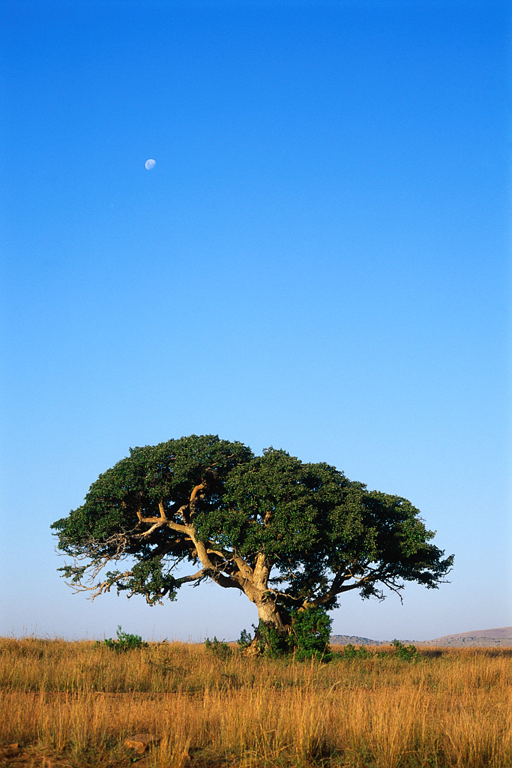
South Africa
Emma Cooper

Slide 2
RELIGION
Traditional:
Many black South Africans still have their traditional beliefs. They believe in one Supreme Being created everything in the world. There are many different names for this Supreme Being. The people do not believe that this Supreme Being controls their everyday lives however. Their ancestors are responsible for this. If one’s ancestors are angry, their crops will fail or illness will come into their families. Therefore, people honor their ancestors with rituals. These ceremonies keep them happy.
Traditions:
Sometimes there are baptisms in seas or rivers for babies, teenagers, and adults
Rites of passage: Girls- must perform the domba, or the python dance
Boys- Elders train them to be men. They learn about history and have survival tests.
Marriage: Wedding take place in churches, mosques, or synagogues.
Men-The groom sometimes gives a lobola, or dowry to the bride’s parents
Women- The bride’s parents sometimes offer a dowry of gifts of useful household objects and clothing to the groom.

Slide 3
RELIGION (Continued)
Modern:
Christianity-
The Dutch Reform Church is the oldest Christian group in South Africa. This church dates back to the 1600s, and one of their main beliefs is that everybody's are already planned before they are born.
The largest Christian group is the African Independent Churches. The largest out of these is the Zion Christian Church. It’s beliefs are derived from traditional rituals and ideas.
Hinduism
Islam
Judaism

Slide 4
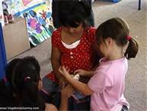
EDUCATION
Education has greatly improved over the years, thanks to the ending of apartied. No child can be denied the right to attend a public school. It is written in the constitution.
They spend 12 years at school. Primary school is 1-7 and high school is 8-12.
Universities or collages are optional.
In 2010, it had 12.3 million learners, 386,000 teachers and around 48,000 schools (8 teachers per school on average) – including 390 special needs schools and 1,000 registered private schools.
Today the literacy rate is 89%.
The department of Higher Education and Training is headed by Dr. Blade Nzimande
The minister of Basic Education is Mrs. Angie Motshekga, and deputy Minister of Basic Education is Mr. Enver Surty.

Slide 5
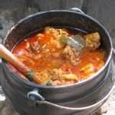
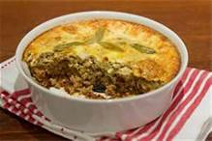
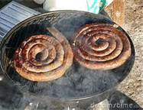
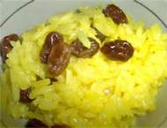
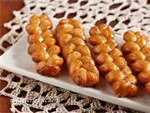
FOOD
A traditional one-pot dish is made of maize that is ground into a thick porridge. Indians introduced curry, which is a mix of meat and vegetable cooked in a spicy sauce.
Cape cuisine: This food originated in the capital of Cape Town. A main dish could include bobotie, a popular dish made from minced beef or lamb with curry and dried fruit, topped with bread or egg custard.
Boerewors are sausages made with a variety of meats and spices. They are sold on streets much like hotdogs. It is a traditional food.
Geelrys is a rice dyed yellow with a spice called turmeric. It has been eaten for many centuries.
Koeksister is a braid shaped donut covered in syrup. It is eaten for dessert.

Slide 6
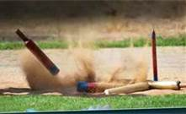
ENTERTAINMENT
Traditional- In traditional tribes, there is more work than play. There is some free time however. Many tribes will dance and sing to pass the time. Some women will talk as they weave baskets or make pottery. Men will go on hunting trips for fun sometimes. Children can make up little games to play with each other like Mbube Mbube. This is a game where a child is an impala and a child is a lion, or mbube. The animals are blindfolded, and then the lion must catch the impala. The other children chant mbube. The louder and faster, the closer the lion is.
Jukskei-a game in which a peg is thrown over a fixed distance at a stake driven into the ground. This is a traditional South African sport.
Modern-
Sports- rugby, cricket, and football (soccer) are the most popular.
Music- singing and dancing is popular, lots of music festivals. Groups such as Iscream and the Chocolate Stix perform.
Port cities have beaches.
International events, like the Absa Cape Epic Cycling Race, or the Cape Town Marathon
Television and radio- see mass media slide

Slide 7
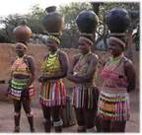
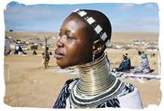
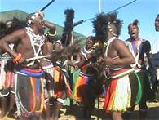
CLOTHING
Most people wear everyday clothes similar to ours in North America.
Some wear traditional costumes every day or on special occasions.
Most outfits are bright and colorful. The include fancy hairstyles and many beads.
Women wear heavy jewelry.
Clothing can help you tell what tribe someone is from. They also show ranks within the tribe. In Zulu culture, only very important figures like the medicine man and chief can wear animal skins.

Slide 8
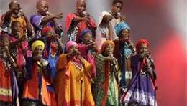
MUSIC
Jazz- South African jazz is very famous. It is called marabi, or improvised jazz. They use pretty much any instrument they can find, and they made up the music as they went. Now there are many types of jazz. It was a symbol of protest for apartheid at one point.
Iscathamiya- This consists of a group of men with different pitched voices that sing together without any instruments. It is almost always sung in isiZulu, because it comes from traditional Zulu singing contests.
Kwaito- This is a lot like hip hop. Gritty lyrics about inequality, city life, and violence are chanted or sung over programmed beats. It is very popular for the youth.
Instruments- There are modern instruments like synthesizers, bass guitars, and saxophones. Traditional instruments include bows, (played by plucking a string) reed flutes (each flute has one note) or mbira ( a box with strips of bamboo or metal that are plucked to make a twangy sound)

Slide 9
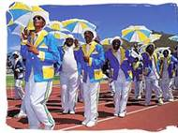
CELEBRATIONS
Each ethnic group has their own special holidays. However, ther are many occasions that everyone celebrates.
Easter- One celebration is when one million followers of the Zion Christian Church make their way to Moria for Easter celebrations. They fast for four days, and spend their time dancing, praying, and singing.
Diwali- People place lit candles or oil lamps, called dipas, everywhere. They hope that Lakshmi will give them a blessing.
Heritage Day- On this day, each ethnic group celebrates its history in their own special day.
The High Holidays- Rosh Hashanah is the Jewish New Year and a period in which people ask forgiveness for their sins. The last day is Yom Kippur. God will give a good year for those who asked for forgiveness. A shofur, which is an instrument made out of a ram’s horn, is blown during this time.
New Years Day- January first is in the summer in South Africa. New Years is often celebrated on beaches and at barbecues called braais. In Cape Town, a second New Year is celebrated known as Tweedenuwejaar. There are many parades.

Slide 10
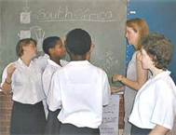
LANGUAGE
South Africa has eleven official languages: English, Afrikaans, isiXhosa, isiZulu, isiNdebele, Sepedi, Sesotho, siSwati, Xitsonga, Setswana, and Tshivenda.
Most South Africans speak three or more languages.
Afrikaans is a mixture of Dutch and other languages in South Africa like Africans, French, English, Malays, and Germans.
Lots of South Africans speak English, but there are some different accents and words. For example, gas is called petrol and an elevator is a lift.
Writing is in all different languages. Translations are made often. It lets people know what life is like in South Africa.
In some languages, certain clicking sounds are made. In isiZulu, the letter ‘q’ is made by pressing your tongue on he roof of your mouth and pulling it straight down.
English | Afrikaans | isiXhosa | Tshivenda | isiZulu
Hello | Hallo | Molo | Nda | Sakubona

Slide 11
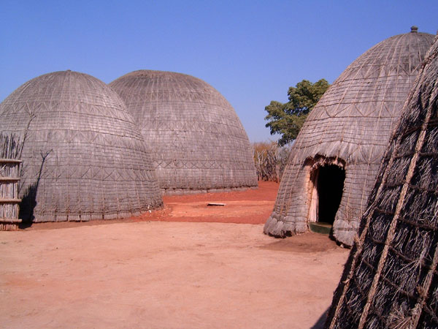
ARCHITECTURE
Zulu- Wicker and reed beehive houses built around a central cattle enclosure
Xhosa- Adobe houses with thatched roofs
Ndebele- Traditional houses were made of adobe with geometric designs. Brick houses and acrylic paints recently.
Venda- Similar to Xhosa houses, only with overhanging roof for shade.
Dutch Colonists- Typical farmstead: single-story, gabled, plastered, and often built in an H shape.
Modern cities have structures similar to ours. The Carlton Centre is the tallest building in Africa. It is 50 stories located in Johannesburg.

Slide 12
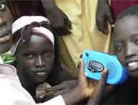
MASS MEDIA
Three national television broadcasters are e.tv, M-Net, and SABC.
The national radio broadcaster is SABC, which operates nine services, including 5FM, Metro FM, and Ukhozi FM.
Movies include Life, Above All, Spud, and White Wedding.
South Africans enjoy shows such as Man van Staal and Interster.
Most of what they watch is American movies and shows, as most do not have the money to film it.

Slide 13
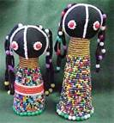
ART
Rock Art- The San and Khoikhoi people who lived in South Africa thousands of years ago, were nomadic hunters and gatherers. They took shelter in caves where the drew paintings on the walls. They were pictures of battles, hunts, rituals, and animals .This 20,000 year old art is being damaged by erosion and fading today.
Dolls- South African dolls are every intricate. They are given as gifts. Some can be life sized while others very small. They are decorated with colorful fabrics, silver rings, and beads. No doll is like another.
Zulu Beadwork- The Zulu are known for their beadwork. It is used to decorate dolls, clothing, and jewelry. Many men work far from home. The women use specific colored beads to send messages of love to their husbands. Red means love, yellow means home, and black means loneliness.
Pottery- Pots of all shapes and sizes are made. On them are intricate designs that may show stories or pictures. They are then used for carrying water or for special traditions.
Weaving- People weave everything. From baskets to fish traps, people can turn grasses, cotton, and even wire into beautiful baskets. Designs are woven into the baskets. A triangle is a man and a diamond is a woman.

