Slide 1
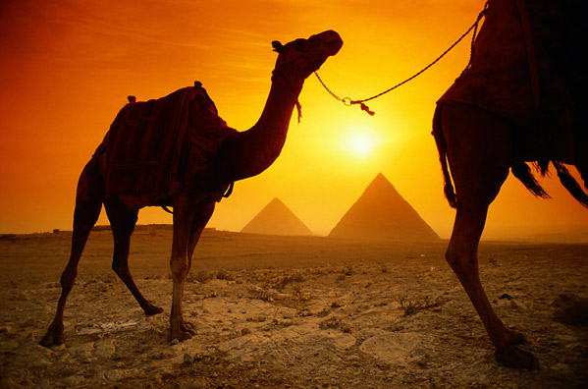
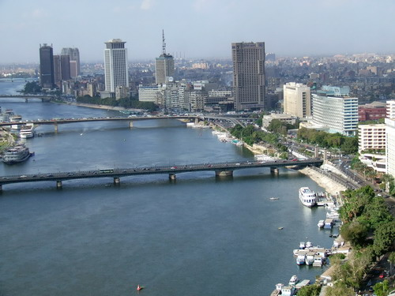
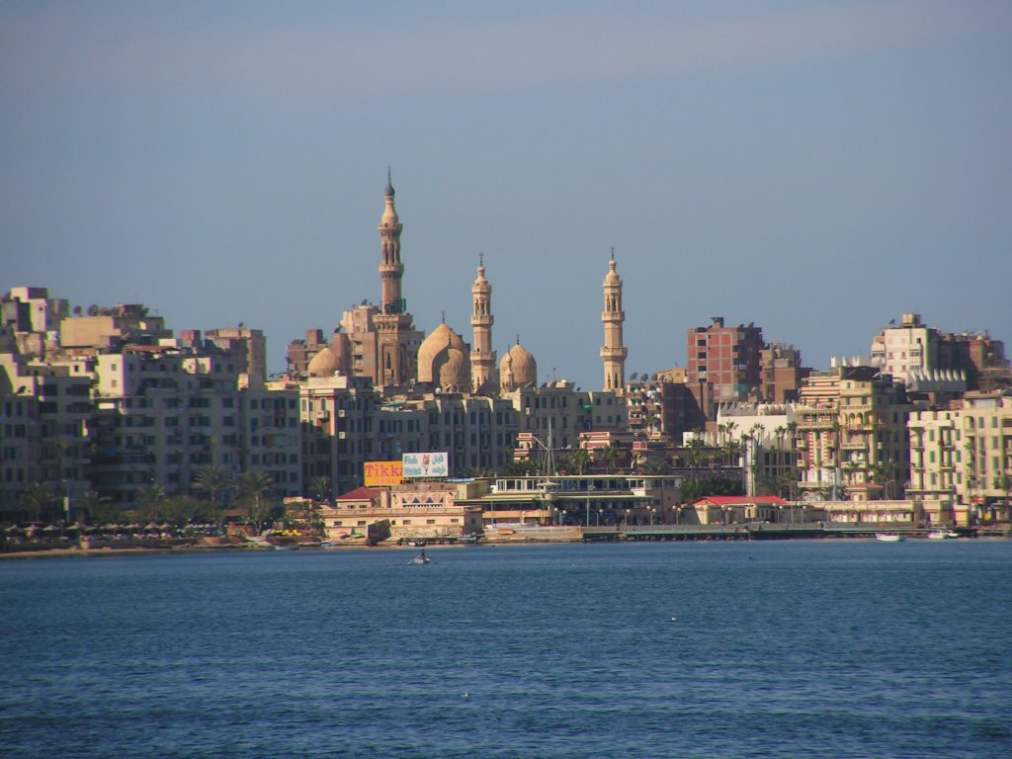
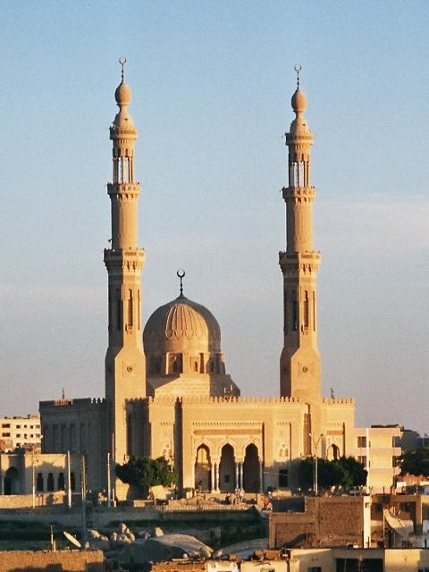
Taking A Trip To Egypt?
Oh, The Places You Can Go In Egypt!
BY: KAILA DIMARZIO

Slide 2
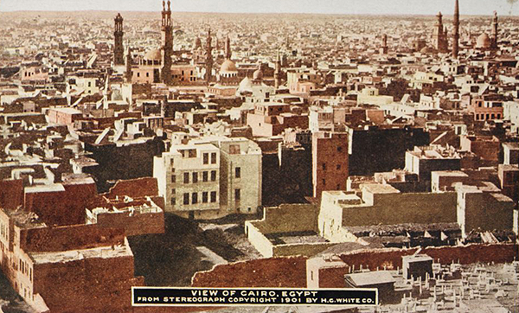
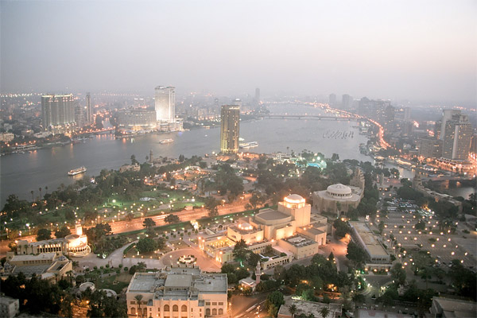
Day 1-3
I will fly from the Atlanta Airport to The Cairo International Airport (flight details on later slide)
From there, I will leave the airport to explore the city, Cairo as my first stop!
Why is Cairo such an amazing and significant city? Well;
1: It is the Capital of all Egypt, and the city itself and closely surrounding areas are considered “The Heart of Egypt”
2: Cairo includes some of the most famous Pharaonic, ancient Christian and Islamic monuments. So I will definitely want to check out the museums.
3: It offers an huge selection of shopping, leisure, culture and nightlife. Shopping ranges from the famous Khan el-Khalili souk, (or bazaar) basically unchanged since the 14th century, to modern air-conditioned centers, leatherwork, glass, displaying the latest fashions. I'm definitely going to all the different stores
4: Some of their most popular buys are spices, perfumes, gold, silver, carpets, brass and copperware ceramics and mashrabiya. I would definitely buy some perfume and silver earrings

Slide 3
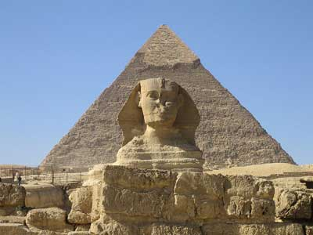
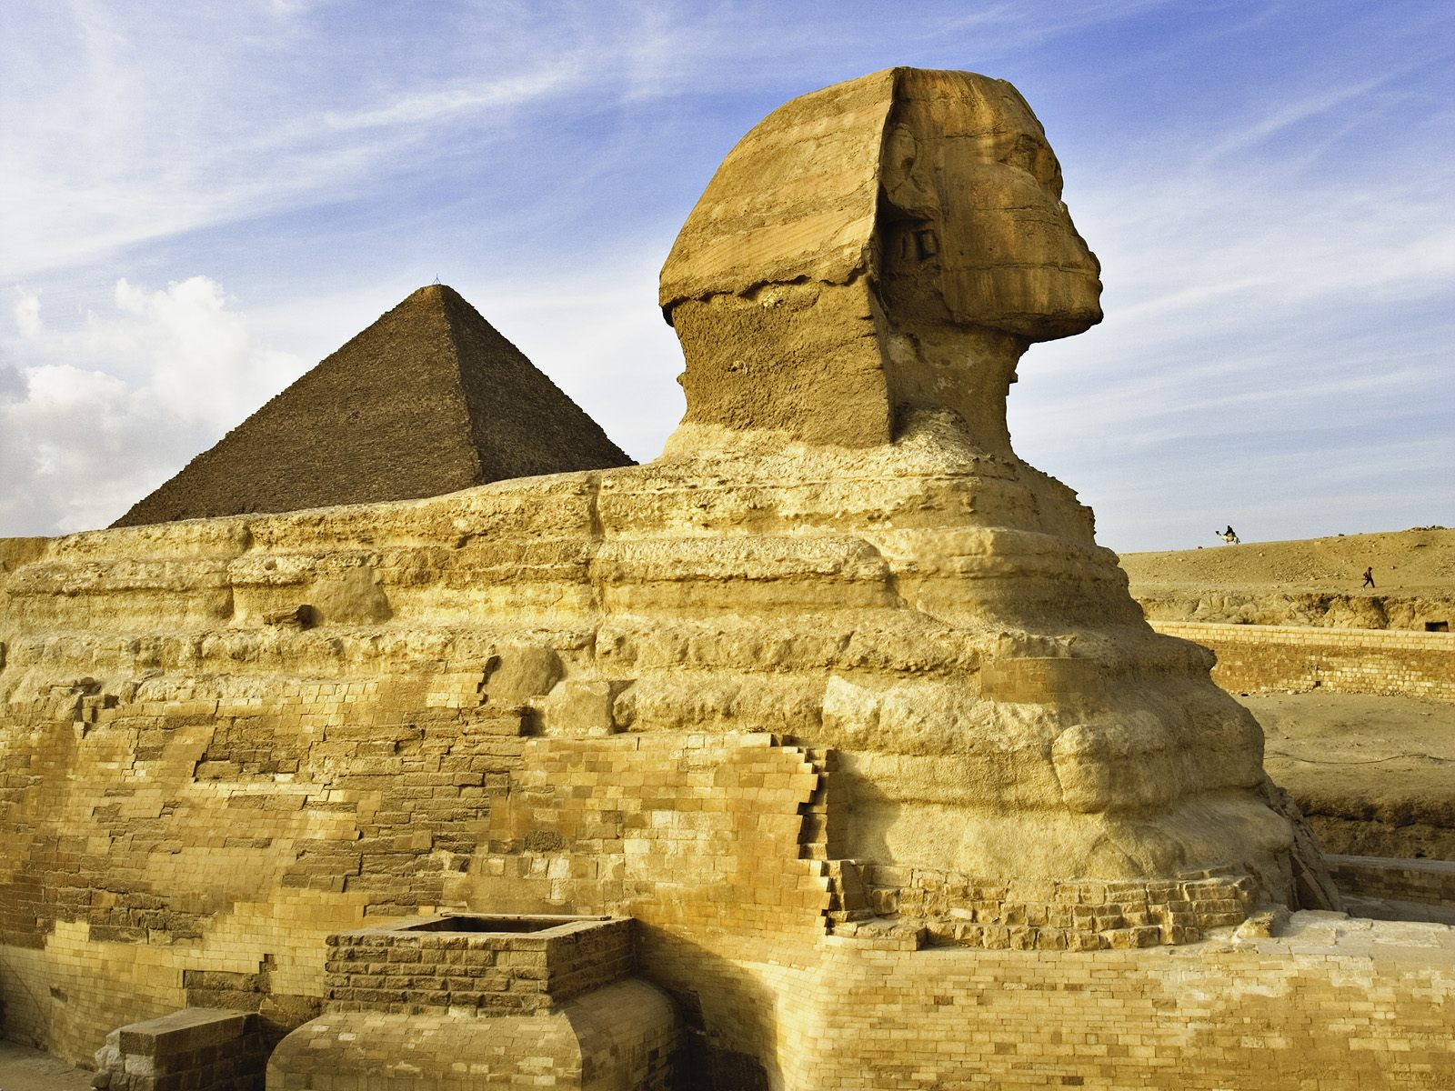
The Sphinx
the Sphinx is carved out of a single ridge of stone 240 feet long and 66 feet high.
The Great Sphinx of Giza has recently undergone a major renevation(To make it more safe for tourists), but its first restoration attempt dates back to 1400 BC
Its important to know that currently only 300 tickets are sold at each of the two entrances to see the Great Sphinx of Giza, so you need to get early in the line. Do not miss the light and sound show in the night.
You can reach the Great Sphinx of Giza by taking a flight to the Cairo International Airport. From their travel to Giza by the Cairo metro system or by taxi.
Best time to go to Giza is between November to February.

Slide 4
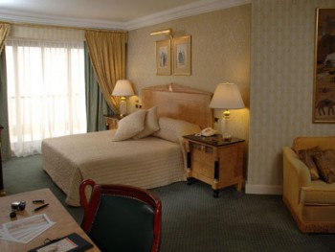
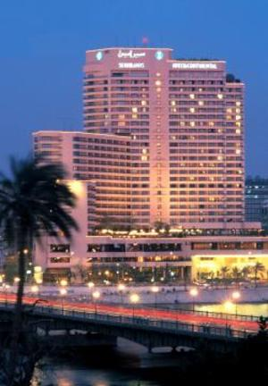
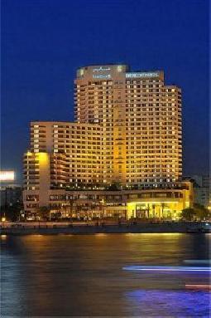
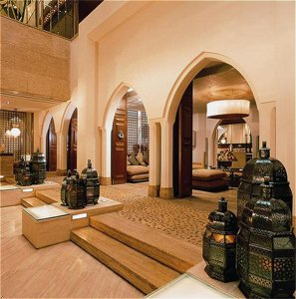
Hotels to stay at in Cairo
Hotel for day 1: Cairo Semiramis. Check In: 3:00 p.m; Check Out: 12:00 p.m; It is located right in the middle of Cairo; Room Service is 24 hours; 24 hour lounge; live entertainment; a spa right in the hotel; daily housekeeping; outdoor pool; about $156 dollars per night
Hotel for Day 2: Cairo City-Stars. Check in: 3:00 p.m; Check out: 12:00 p.m; Pets are not allowed; Renovated in 2009; 12 floors; 311 guest rooms; 12 suites; 24 hour room service; Kids eat free!; 5 restaurants in or right around the hotel. About $197 a night
Hotel for Day 3: Cairo Marriott Hotel. Rated 5 stars; Located in the heart of Cairo; a luxury hotel that combines a 19th century palace with twin towers ; 6 acres of garden too; 24 hour room service; a view of the Nile River; 1090 rooms; part of the Marriott hotel chain; multiple restaurants in the actual hotel; about $180 a night

Slide 5
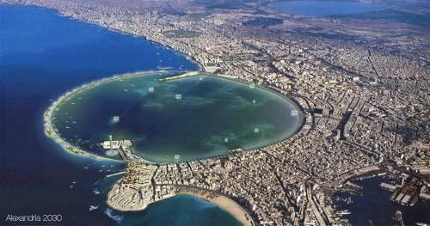
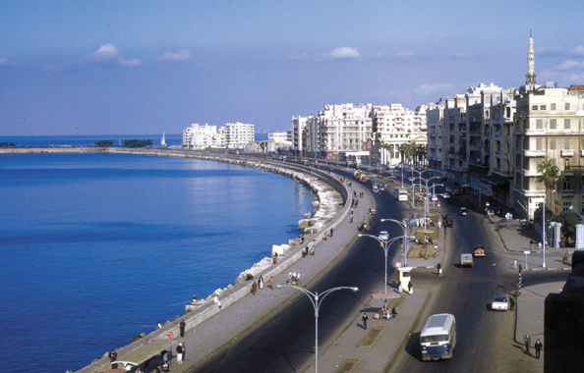
Day 4-6
On the morning of day four I will travel 140 miles from Cairo to the second largest city in Egypt, Alexandria. I will travel by train along side the Nile, then along the Mediterranean coast.
Why is Alexandria such a cool city? Well:
1. Alexandria is an important industrial center because of its natural gas and old pipelines from the Suez.
2. It was actually Egypt’s capital for thousands of years
3. Since Alexandria is located right on the coast of Egypt, its beaches are filled almost year round. Beaches are definitely a place you want to hit.
4. Just as Cairo, it has a wide variety of stores and outdoor malls. The weather is almost always perfect for walking around and shopping with their variety of products that they sell.

Slide 6
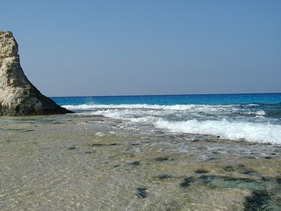
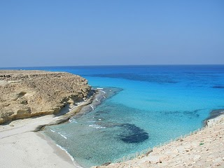
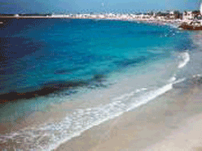
Beaches in Alexandria
Since the beaches in Alexandria are right on the coast of the Mediterranean, the sand is soft and white and the air is fresh and salty.
Many of the beaches of Alexandria are private or attached to communities or hotels , but there are free beaches too.
The Corniche is lined with beaches, with full tourist facilities, from the city centre outwards. In town try the Stanley beach, further east Montazah Beach and Ma'amoura are two of the best.
Despite of miles of white sand beaches and azure sea, Egypt’s Northern coast is still undeveloped and kind of unpopulated. So…that means there are fine beaches all along the coast from Alex to Mersa Matrouh. Unpopulated secluded beaches means pure soft sand, and crystal clear water.
A great place to go to escape from a long day of crowded shops and places.

Slide 7
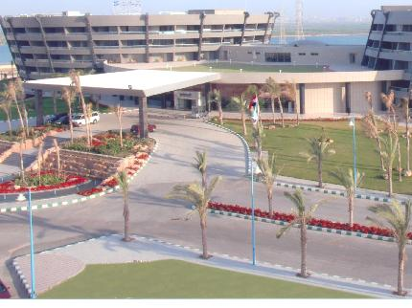
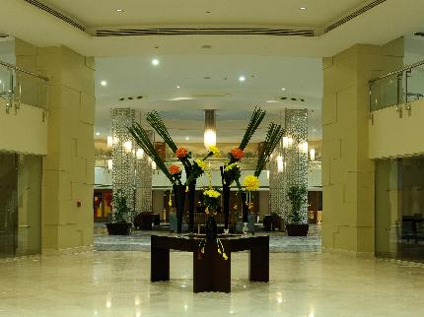
Hotels to stay at in Alexandria
Nights 4 and 5 I will be staying at Radisson Blu Hotel: It features 262 rooms— suites and regular rooms. Out of the mix, it also includes 39 Business Class rooms and 21 Junior Suites along with one Royal Suite.
This hotel also has three restaurants, a health bar, a golf course and a lounge all within the hotels grounds.
It has other places for leisure which include s: Kids' playground, Heated rooftop swimming pool and Health club - located on the roof. About $250 per night
Night 6 I will stay in Sofitel Cecil Alexandria: On the sea shore with a view over the bay and yachting harbor.
The hotel is located in the heart of the business district, 3 miles from the El Nozha airport. Beaches 2 miles away. 83 rooms and 3 suites. Internationalcuisine at the Le Plat d Or brasserie. It features a Coffee shop, Lounge bar, Terrace bar. 2 conference rooms for up to 50 people. Night club.
About $180 per night.

Slide 8
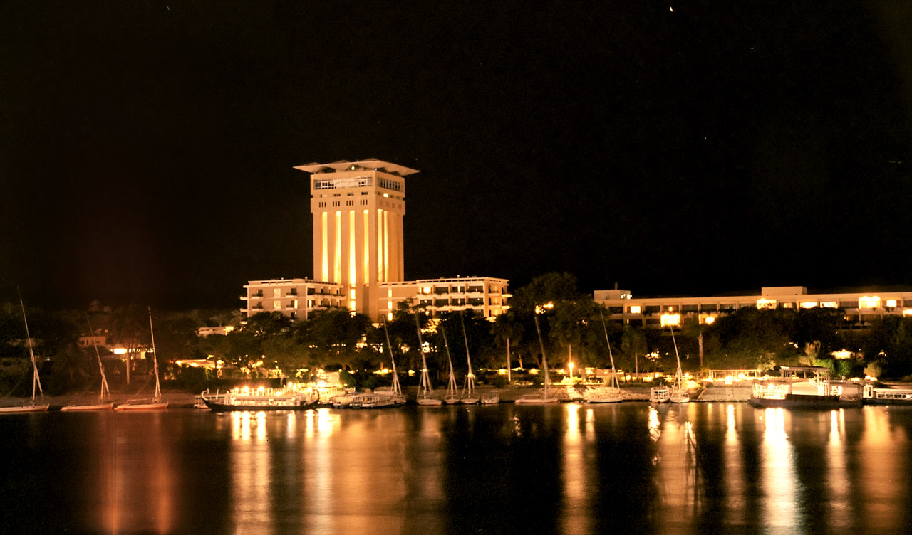
Day 7-9
On the morning of day 7, I will travel by railroad (since it runs all the way down the Nile, stopping right at Aswan)to Egypt's sunniest, Aswan itself. Located about 81 miles south of Luxor, it has a distinctively African atmosphere.
Days can be spent walking up and down the broad Corniche watching the sailboats .
Aswan is famous for its fresh fish— caught directly from the widest part of the Nile — and its cultural music.
Explore the souk, full of the scent and color of spices, perfumes, scarves and baskets. Many of the things the shops offer are hand made by professials. View the spectacular sunsets while having tea on the terrace of the Old Cataract Hotel
Aswan has been a favorite winter get away

Slide 9
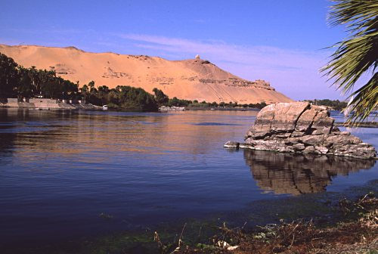
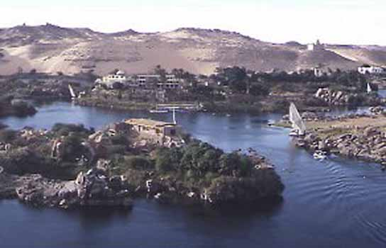
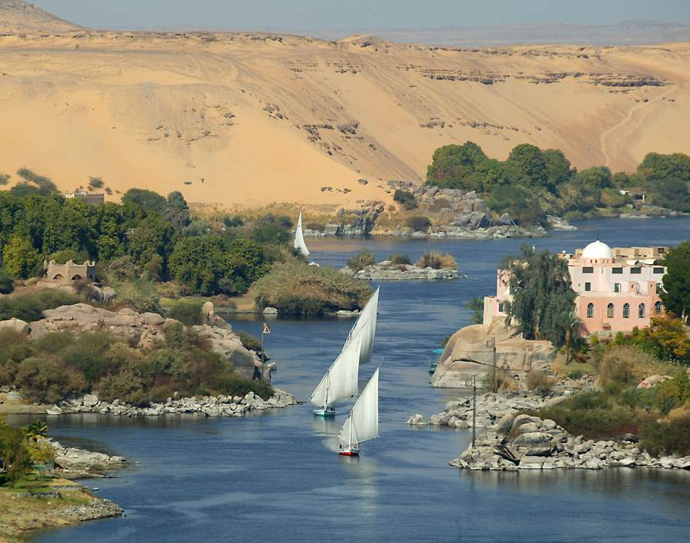
Elephantine Island
Elephantine is an island in the centre of the Nile at Aswan. This was the original ‘border town’ between Egypt and the Nubian lands.
Over the years there has been a great deal of building activity on Elephantine, though most of the ancient structures have now vanished. Excavations and reconstructions have been carried out over the past 100 years.
There is a major museum located right on the island that holds all the ancient artifacts that have been preserved for centuries.

Slide 10
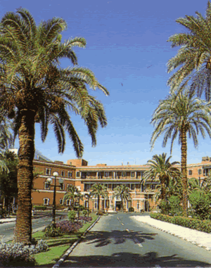
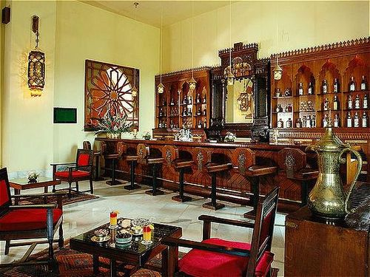
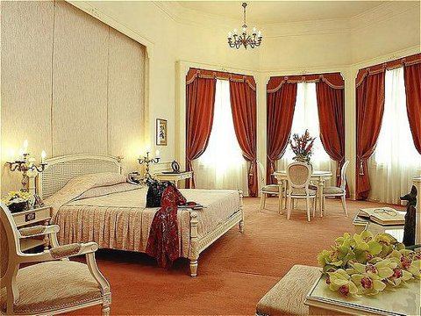
Hotel to stay at Aswan
For all three of the nights, I will stay in the Old Cataract Aswan Hotel. It was built in 1899 and was recently renovated in May, 2008. It over looks the Nile at its most beautiful.
It has an outdoor heated pool along with outdoor tennis courts.
Parking is free at the hotel, it has 24/7 house keeping, and babysitters at the ready (I wouldn’t be needing one though)
The Cataract is a very well kept yet historic luxury hotel that has housed many famous faces throughout recent Egyptian history
Costs for one night are around $180

Slide 11
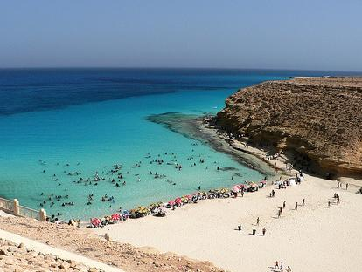
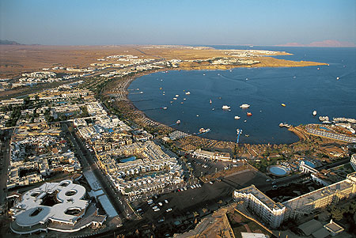
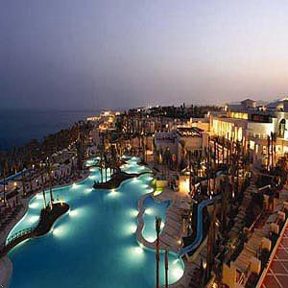
Days 8-10
Sharm el-Sheikh is the fourth city I am going to stay at. I’m going to leave the morning of my eighth day where I will take the railroad back up the Nile river and from the station in Cairo, I will travel by Egypt's main highway to the Sinai peninsula where this coastal city is located
It’s one of the most accessible & developed tourist resort communities on the Sinai peninsula. It’s famous for it’s variety of hotels. Ranging from 5 star luxury hotels to little inns.
With diving and snorkeling, lots of water sports, horses and camel riding, desert safaris, and great nearby antiquities attractions, it is almost impossible for a visitor to get bored!
Na'ama Beach is one of the center of the tourist activities located in Sharm el-Sheikh. With white sand and crystal blue rolling tides, it is a pretty cool beach.
Sharm el-Sheikh mall has shops with foreign and local things to buy, including jewelry, leather things, clothing, pottery and books.

Slide 12
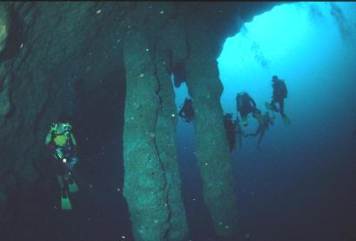
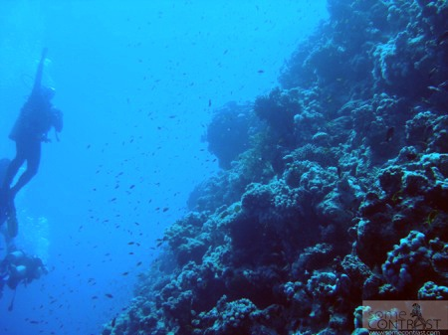
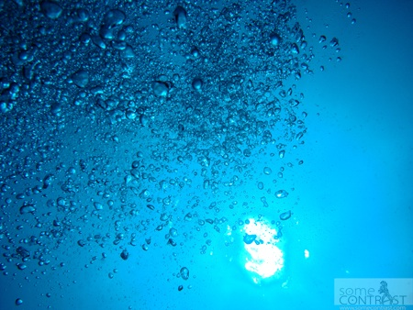
The Blue Hole
A blue hole is a submarine cave or sinkhole . They are also called vertical caves
One particular one, is in Sharm- El Sheikh. Its names is The Bells.
The Bells is a natural small hole at 30m in a sheer wall that drops off to quickly. You descend straight down along side the wall and dive around the hole.
The water is crystal clear and reefs surround the hole.
Some divers are lucky enough to see cool fish.
This Blue Hole attracts thousands of tourists willing to go scuba diving each year.
It would be a great underwater adventure!

Slide 13
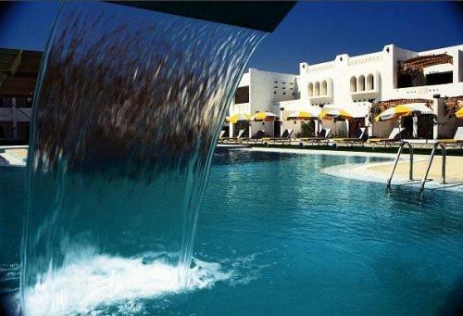
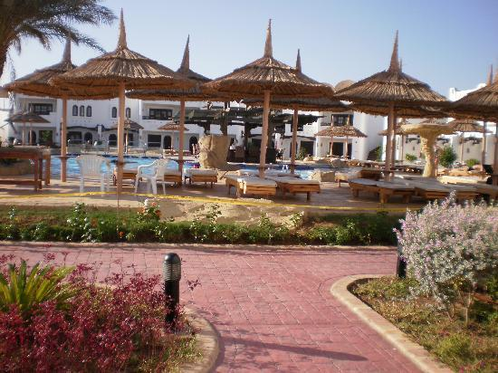
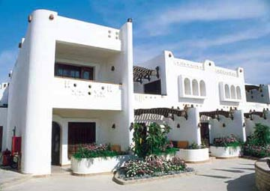
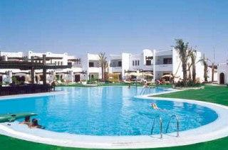
Hotel to stay in at Sharm-El Sheikh
Tropicana Tivoli Hotel in the heart of Sharm-El Sheikh is where I will be staying for my 3 nights in the city.
This hotel has 4 stars, 114 rooms (including suites)
The rooms come with the luxuries: Balcony and mini-fridge plus actual air conditioning for those hot days.
The suites have the luxuries: Master bedroom, another bedroom with a sitting area, pool view and kitchen
The actual hotel has: Large swimming pool (with a kids pool of course), private beach just five minutes away by shuttle bus and mini market
(About $160 a night)

Slide 14
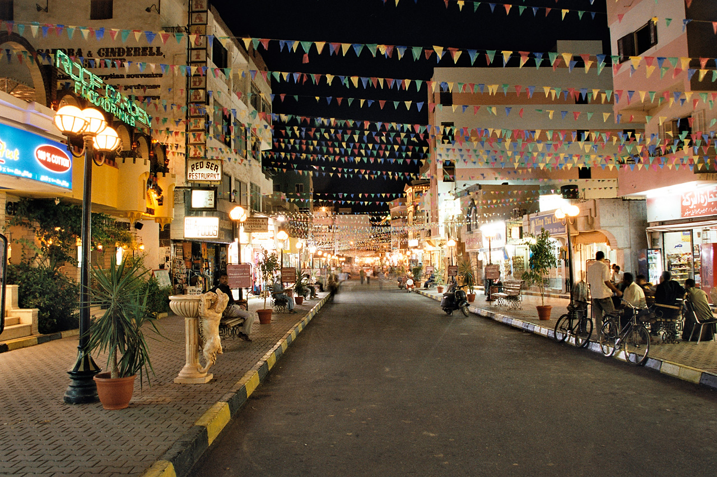
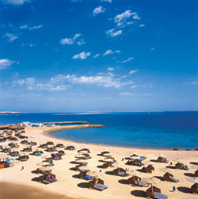
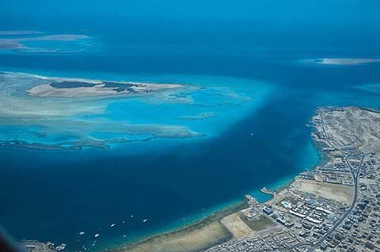
Days 11-13
Just like before, I will leave the morning of my eleventh day and take a boat from Sharm-El Sheikh, across a narrow portion of the Red Sea, to yet another coastal city: Hurghada.
This city was founded in the early 20th century, and until a few years ago, was a small fishing village. But today, it has gone to be one of the biggest tourists resorts of the Red Sea coast and an international center for water sports.
These water sports include: windsurfing, sailing, deep-sea fishing, swimming and snorkeling! This city is famous for its unique underwater gardens that grow just a bit of its coast, as well as rare fish and coral reefs.
On land, this city has a full aquarium and museum. Restaurants are mostly along the main road
A lot of construction is taking place, and we can expect to see some new hotels and restaurants in the near future.

Slide 15
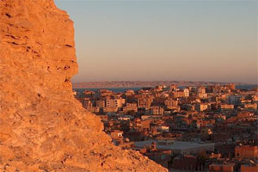
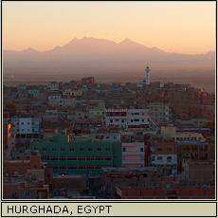
Anfish Mountain
Anfish Mountain, Hurghada is a very famous site in the city. Tourists and travelers are brought to this spot while making a tour round the city of Hurghada.
This is one of the high points in Hurghada which gives you a full view of the whole city ahead.
The best thing about the Anfish Mountain is that it’s not directly visible from any location in Hurghada— so it’s almost secluded like the beaches I talked about preciously.
However a view from the mountain top will give you a full sight of the city ahead of you.
The air must be pretty clear and fresh up there.

Slide 16
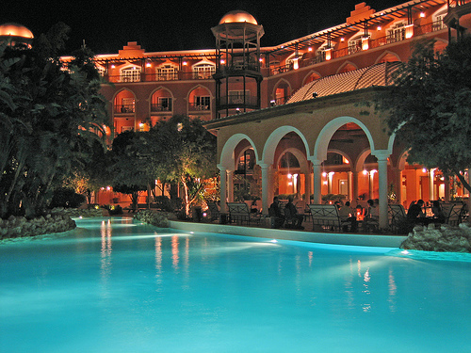
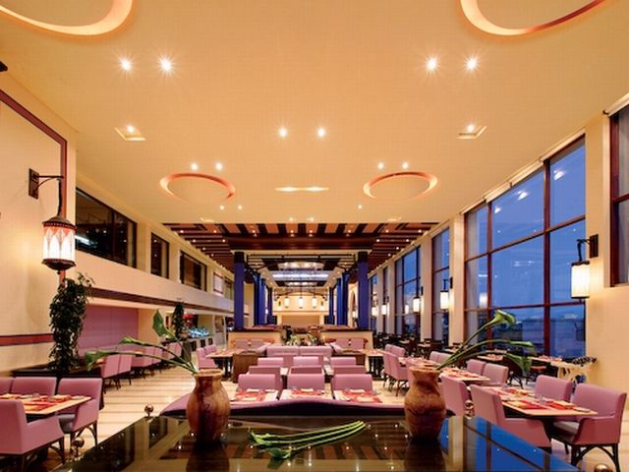
Hotel to stay in at Hurghada
The Grand Hotel is what I will be sleeping at for my three nights in Hurghada
The hotel is situated directly on its own private beach
This hotel comes with two large swimming pools (and two kids polls too of course), waterslide, gardens, buffets, lobby piano, and pool side bar, gift shop, spa/ health club and tennis as well as beach ball.
It is three floors tall with 549 rooms. Some of those rooms are the “superior-deluxe suites” with many luxuries including balcony, ocean view and mini bar

Slide 17
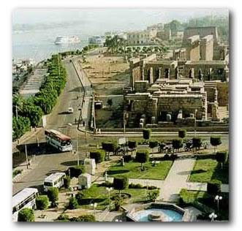
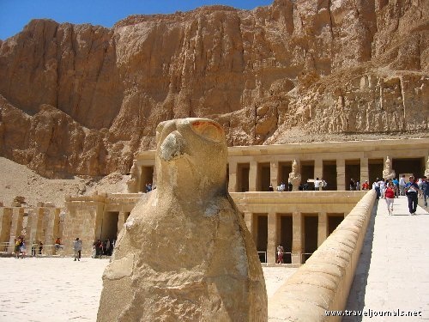
Days 14-15
From Hurghada (On the morning of the 12 day) I will be taking the main highway like before, to Luxor— my final city!
Luxor has been called the worlds greatest open air museum, because it is, and its not just that.
There is so much more to explore. Luxor has the most monuments and preserves in Egypt. And its quite old. Considering that its been s tourist destination for longer than anyone can remember! Even during the Dynasties of the Roman and Greek periods, people would flock to Luxor to see its wonders
There are only three main streets. And they are called: Sharia al-Mahatta, Sharia al-Karnak and the Corniched, next to the Nile.
Along Mahatta street you can find many cafes and bazaars where they sell Egyptian souvenirs
Luxor has always been a pretty populous city and to and today it has about 15o,000 people.
Then, on my last day, I will leave Luxor, travel by railroad and make my way BACK to The Cairo International Airport. Where I will finish my journey to Egypt

Slide 18
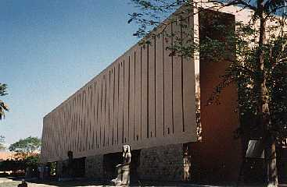
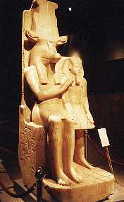
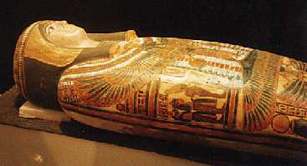
The Luxor Museum
One of the best displays of antiquities in Egypt is located at the Luxor Museum opened in 1975
The admission price is high, but it is worth the visit as a lot of people say
Visiting hours can be kind of restricted so make sure this museum is one of the first things you hit in your stay in Luxor
Spaced out around the main floor are large ancient sculptures and preserved pieces from the ancient times
Then, a ramp leads up to all the antiques like pieces from King Tut’s tomb
Scattered throughout the museum are drawings, painting, old antiques like sandals and ancient clothes, and coffins
This museum can not only teach you things. But you wont get bored while learning— and that’s a fact

Slide 19
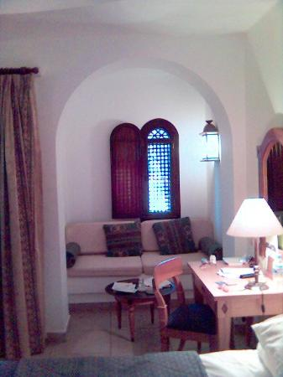
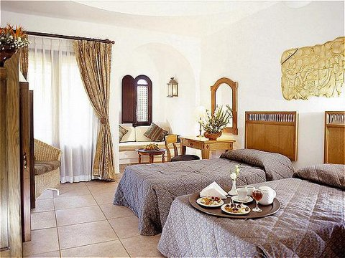
Hotel in Luxor
The name is Hotel Sofitel Karnak Luxor Hotel, located on the East Bank of the Nile. River view of course!
It has a hair salon right in the hotel along with a gift/souvenir shop. An indoor playground and kid’s club.
For leisure there is: A spa with sauna, Jacuzzi, fitness center, massage room, outdoor heated AND unheated pool, tennis court, tennis table, and football.
They have 325 rooms and 22 suites, most with garden views. Suites, even rooms, are equipped with their own mini bar…which means mini fridge too! Room service is 24/7 and they sell hot dishes and cold snacks.
All rooms have a balcony to enjoy the garden views
About $170 per night

Slide 20
Flights TO EGYPT
Atlanta Airport to JFK New York City Airport to Cairo International Airport:
~Departs at 3:20 pm on February 17.
~Flight Number: Delta 32
~Layover: JFK Airport- 5 hours and 2 minutes (Boeing 737-300)
~Lands in Cairo 4:45 pm Egypt time on February 18
~Flight Number: Delta flight 84
~(Boeing 767-300)

Slide 21
Flights FROM EGYPT
Cairo International Airport to Amsterdam to Atlanta Airport
~Departs at 4:10 am Egypt time on March 6
~ Flight number: Delta flight 9428
Layover: Amsterdam- 2 hours 40 minutes
~Lands in Atlanta at 2:55 pm
~ Flight number: Delta 39
~(Boeing 767)

Slide 22
Bibliography
Aswan, the city in Egypt; 2/1/10; http://www.aswanguide.com
Booking.com; 1/13/10; http://www.booking.com
Cairo Restaurants; 1/14/10; http://travel.nytimes.com
Delta; 2/4/10; http://www.delta.com
Kayak; 2/4/10; http://www.kayak.com
Old Cataract Hotel; 2/4/10; http://www.sofitel.com
Radisson Blu Hotel; 1/21/10; http://www.radissonblu.com
Sequoia;1/3/10; http://www.sequoiaonline.net
Sofitel Luxury Hotels; 2/4/10; http://www.sofitel.com
Tropicana Tivoli Hotel; 2/3/10; http://www.tropicanahotels.com
Welcome to Famous Cities of Egypt; 1/13/10; http://www.summittoursegypt.com

