Slide 1
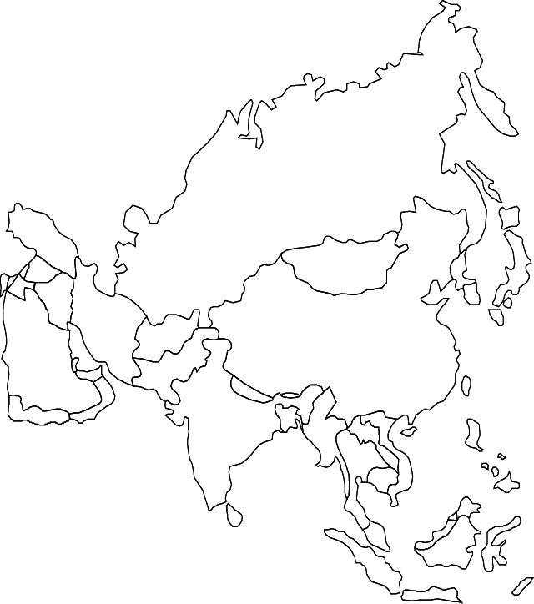
First Nine Weeks-Unit 2 China and India

Slide 2
The Great leap Forward stressed what in China?
Extensive commercial farming & manufacturing

Slide 3
Mao’s attempt to remove all ties to China’s past was known as???
Cultural Revolution

Slide 4
Who was the Communist hero of China who took power in 1949?
Mao Zedong

Slide 5
Who controlled India from the 1700s until after the Seapoy Rebellion?
East India Company

Slide 6
Akbar tried to combine the religions of Islam, Hinduism, & Christianity into what religion?
Divine Faith

Slide 7
What is nationalism?
Loyalty based on
a common history, culture, and/or religion

Slide 8
Who was the Nationalist leader of China?
Chang Kai-shek

Slide 9
Who felt that People should refuse to obey a law they felt was unfair?
Gandhi

Slide 10
Who were the Kuomintang
Chinese Nationalists or democratic government of China

Slide 11
The person with the most power in a parliamentary system is the???
Prime Minister

Slide 12
When India became independent, why were so many people unhappy?
The country was divided along religious lines

Slide 13
Who were the Red Guard?
Mao’s army of young people during the cultural revolution

Slide 14
Who is best remembered for their role in the Indian independence struggle.
Gandhi

Slide 15
Who did Chinese troops either arrest or kill for protesting for more freedom in Tiananmen Square?
CHINESE STUDENTS

Slide 16
First emperor to unite all of China.
Shi Huangdi

Slide 17
What are any material things that are needed to conduct business… Machines, computers, buildings… ?
Capital Goods

Slide 18
In 1997, the United Kingdom returned what to China?
HONG KONG

Slide 19
What happened to the Muslims when India gained its independence?
India was partitioned into East and West Pakistan.

Slide 20
In some countries a single authority decides what is produced. What type of economy is this?
Command Economy

Slide 21
What state has Pakistan and India fought over?
Kashmir

Slide 22
What is an Indian serving in the British military called?
Seapoy

Slide 23
What did Mohandas Gandhi call his program to gain independence from England?
Nonviolent or Passive Resistance

Slide 24
China’s improved wages and standard of living are caused by what?
Economic Growth
Or the opening of the economy to the free market

Slide 25
What does China specialize in today?
Consumer Goods (aka Wal Mart Goods

Slide 26
How did China go from a democratic republic to a Communist dictatorship in the middle of the twentieth century?
The Communist won control from the Nationalist in a violent
civil war.

Slide 27
Entrepreneurs do what in a market economy?
Take on the financial risk in starting a new business

Slide 28
True or False China has a good record when it comes to Human Rights. **GIVE AN EXAMPLE**
FALSE
* Tiananmen Square Massacre*

Slide 29
What natural trade barrier separates China and India?
Himalayan Mountain

Slide 30
What Chinese leader was responsible for its economic growth?
Deng Xiaoping

Slide 31
What program did Mao start to take attention off himself and the government’s failures.
The Cultural Revolution.

Slide 32
The legislator is responsible for what in a parliamentary system of government?
Making and carrying out the laws

Slide 33
Who was China’s Nationalist Leader?
Chiang
Kai-shek

Slide 34
When government does NOT favor a religion. Religion and government are separate.
Secular

Slide 35
What was the outcome of the Chinese civil war of the twentieth century?
The Communist won control from the Nationalist

Slide 36
What are a business’ employees or workers known as ?
Human Resources

Slide 37
What system of government has a central government that controls everything and power is not shared between states, counties or provinces.
Unitary System

Slide 38
What did India call their attempt to improve agriculture?
The
Green Revolution

Slide 39
Communes, mass starvation, and economic failure are all associated with what country?
China

Slide 40
Largest land empire in world history.
Mongol

Slide 41
China has a communist led governments but there modern economies are said to be what type?
Mixed

Slide 42
Group of advisors that helps the leader of a country.
Cabinet

Slide 43
A buyer and user of goods and services is a…?
Consumer

Slide 44
What is the name of the war where the British took Hong Kong from China?
Opium War

Slide 45
What is it called when a state is occupied and controlled by members of another nation?
Colony

Slide 46
Give 4 examples of political trade barriers…
Tariffs
Sanctions
Embargos
Quotas

Slide 47
What system of government is a voluntary association of independent states that agrees to follow a weak central government.
.
Confederation System

Slide 48
What famous building did Shah Jahan build for his wife?
Taj Mahal

Slide 49
What political trade barrier places a tax on the goods or services coming into or leaving a country?
Tariffs

Slide 50
In what system of government is power shared by a powerful central government and states or provinces are given considerable self rule, usually through their own legislatures.
.
Federal System

Slide 51
What year did the communist take over China?
1949

Slide 52
In what type of government does a few people such as a dominant clan or clique have power and the group gets their power from either the military, wealth, or social status. Also, elections may be held but offer only one candidate?
Oligarchy

Slide 53
In what type of government is the government “Ruled by the people” and individual freedom and equality is valued. Where free elections are held and decisions are based on majority rule?
Democracy

Slide 54
India’s government operates as a Federal Republic.
Question-How is power distributed in a Federal Republic?
ANSWER-In a federal republic, power is divided between
the national and state or regional governments.

Slide 55
In what type of government is the power to govern held by one person and where the power to rule is generally inherited or imposed by military force?
Autocracy

Slide 56
A manufacturer of goods and services is a…?
Producer

Slide 57
What is it called when countries trade without any trade restrictions or barriers?
Free Trade

Slide 58
What was the nationalist government of China called?
Kuomintang

Slide 59
Gandhi’s main strategy for dealing with unfair British laws was to have his followers do what?
Non- Violent Protest

Slide 60
What is the Indian movie industry called?
Bollywood

Slide 61
What is anything that improves a countries work force such as education, health care…?
Human Capital

Slide 62
What type of government is ruled by a king or dictator?
Autocratic

Slide 63
What was the name of the largest Islamic Empire in India?
Mughals

Slide 64
What were the Four Modernizations?
China’s attempt to improve their economy during the 1970’s

Slide 65
What is Deng Xiaoping best known for???
Chinese leader was responsible for the economic turnaround in 1979

Slide 66
China’s economic growth has improved what?
Standards of Living and Wages.

Slide 67
To handle its population problem, which countries government instituted a one-child-per-family policy?
CHINA

Slide 68
How is a presidential democracy differ from a parliamentary democracy?
In a presidential democracy the executive branch is separate from the legislative branch.

Slide 69
Most workers in China and India are what?
Farmers

Slide 70
What political trade barrier limits trade with a particular country or specific business BUT DOES NOT stop all trade with the country?
Sanctions

Slide 71
What language is a mixture of Hindi and Persian?
Urdu

Slide 72
Plant that is used to make blue dye?
Indigo

Slide 73
What political trade barrier limits the amount of goods or services coming into or leaving a country?
Quotas

Slide 74
What are two major forms of democratic governments:
Parliamentary
Presidential

Slide 75
What political trade barrier stops all trade with the country?
Embargo

Slide 76
India’s Prime Minister is Narendra Modi
Question-How is the prime minister of India chosen?
ANSWER- prime minister chosen by parliamentary members of the majority party following legislative elections;

Slide 77
What type of government did China have when Mao ruled?
Dictatorship

Slide 78
Millions of people starved to death since they did not know how to farm on communes during what major event?
Great Leap Forward

Slide 79
What was the name of the young people who helped Mao during the Cultural Revolution?
Red Guard

Slide 80
Which jobs did Mao believe would help his country be successful?
Farming & Factory Work

Slide 81
The Chinese attacked pro-democracy demonstrators in what place in 1989?
Tiananmen Square

Slide 82
How would you describe most farms in India today?
Small and family owned

Slide 83
What country has the largest democracy in the world?
INDIA

Slide 84
Leaders from the same family.
Dynasty

Slide 85
What does India specialize in today?
Information Technology (IT)

Slide 86
What determined if a person would live in Pakistan or India when Britain granted freedom to the region?
Their Religion

Slide 87
What is the National People’s Congress?
The elected Chinese legislative assembly

Slide 88
Mao’s retreat into Northern China during the 1930’s was known as the
LONG MARCH

Slide 89
What Buddhist region located in southwest China has been controlled by Chinese, even though it was an independent country before 1950
TIBET

Slide 90
What effect did opening China up to foreign trade have on the country?
Improved the economy

Slide 91
What was the name of Bangladesh between 1947 and 1971?
East Pakistan

Slide 92
Great Soul
Gandhi’s nickname was “Mahatma.” What does this mean?

Slide 93
Market
China’s economy TODAY can best be described as mixed on which side?

