Slide 1
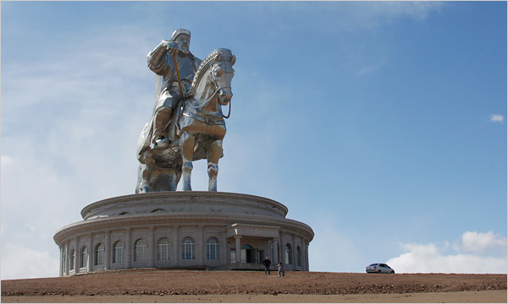
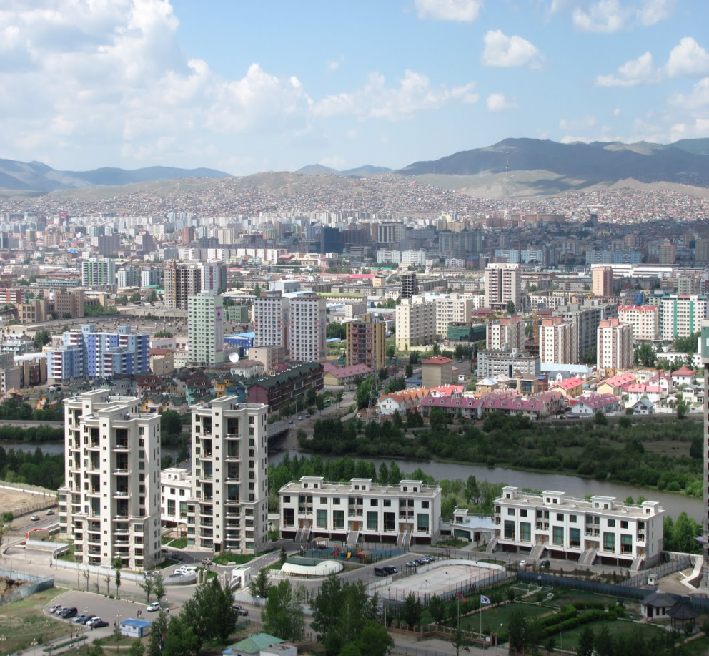
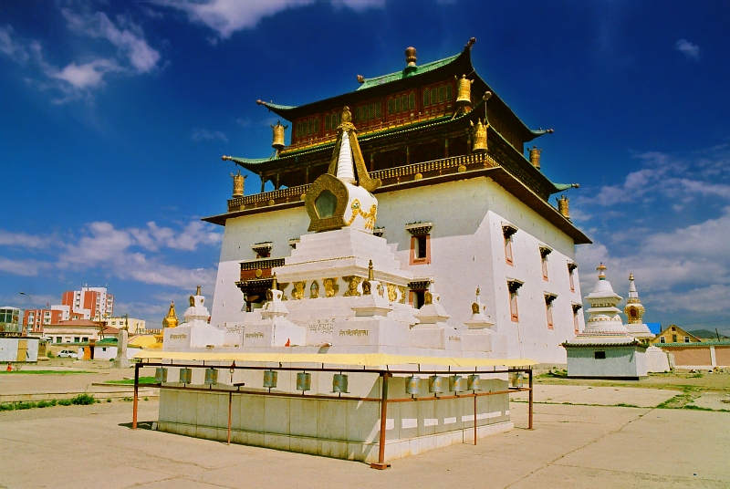
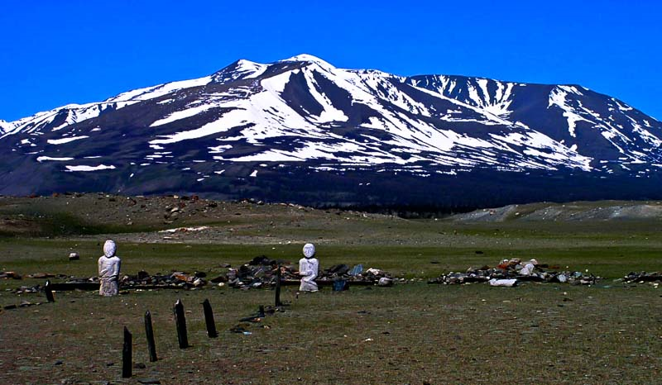
Travel to
Mongolia ☺
Naomi Shin

Slide 2
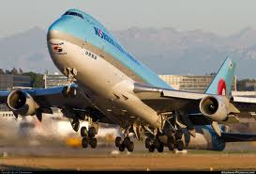
Flight Itinerary
Departure: May 15, 2014
ATL to ULN – 1 stop 22h 10m
Korean Air – Flight 36 15h 00m
Take-off Thu 12:20p ATL Atlanta, GA
Landing Fri 4:20p ICN Seoul, South Korea
Boeing 777-300ER (Wide-body Jet) | 15h 00m
Change planes
ICN Seoul, South Korea 3h 35m
Korean Air – Flight 867 3h 35m
Take-off Fri 7:55p ICN Seoul, South Korea
Landing Fri 10:30p ULN Ulaanbaatar, Mongolia
Airbus A330-300 (Wide-body Jet) | 3h 35m
Return: May 31, 2014
ULN to ATL – 2 stops 52h 05m
Korean Air – Flight 868 3h 00m
Take-off Sat 11:55p ULN Ulaanbaatar, Mongolia
Landing Sun 3:55a ICN Seoul, South Korea
Airbus A330-300 (Wide-body Jet) | 3h 00m
Change planes
ICN Seoul, South Korea 14h 20m
Korean Air – Flight 19 9h 50m
Take-off Sun 6:15p ICN Seoul, South Korea
Landing Sun 12:05p SEA Seattle, WA
Boeing 777-200 (Wide-body Jet) | 9h 50m
Change planes
SEA Seattle, WA 20h 05m
Alaska Airlines – Flight 742 4h 50m
Take-off Mon 8:10a SEA Seattle, WA
Landing Mon 4:00p ATL Atlanta, GA
Boeing 737-900 (Narrow-body Jet) | 4h 50m
Price: $2354
From kayak.com

Slide 3
Cities to visit
Ulaanbaatar- Ulaanbaatar is the capital city of Mongolia. There are many sights and tourist attractions in Ulaanbaatar such as the large statue of Genghis Khan on his horse and the Gandan Monastery.
Daladndzadgad- This city is not one of the largest cities in Mongolia, however near this city are many natural features that captivate Mongolia’s wildlife and nature. One natural feature found near this city is the Gobi desert.
Kharkhorin- This city is the city that used to be the capital of the Mongol empire. Here, there is the Erdene Zuu Khiid Monastery and near the city is the Orkhon River Valley. Here you can experience some of Mongolia’s history and be fascinated by its wonders.
Bayankhongor- This city is one of the largest cities in Mongolia with the Orkhon River flowing nearby. This city is very close to the largest waterfall in the country and is very close to nature as well.
Note: In Mongolia, there are not many restaurants that may have menus for vegans or vegetarians, for the Mongolian diet mainly consists of meat.

Slide 4
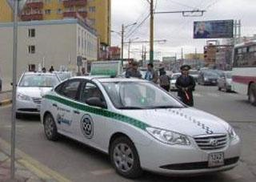
After getting off the plane in Ulaanbaatar…
After the plane ride, you go to the hotel Ramada Ulaanbaatar Citycenter by taxi, for it is too late to travel anywhere. To hail a taxi, you extend your arm with your fingers down. The starting taxi fare charges you about 61 cents per kilometer, but is then changed to 50 cents per kilometer, though you’ll need to check the current rate as this will increase regularly. Also make sure you appear to be confident about where you are going, for taxi drivers will definitely try to take advantage of you if you are new to the city and don’t know your way around. The more confident you appear the better chance you have of getting a fair deal. Be sure to know where you are headed or you could be ‘taken for a ride’. Always remember to have the driver reset the odometer to zero and agree on per kilometer rate before setting off.

Slide 5
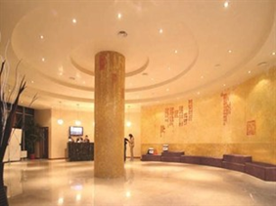
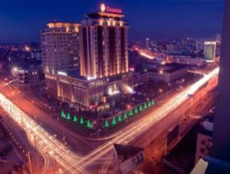
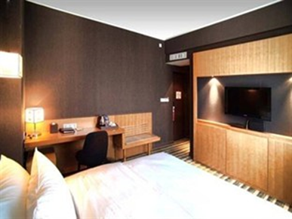
Hotel in Ulaanbaatar
You will be at the Ramada Ulaanbaatar Citycenter hotel for 5 days. This hotel is a 4 star hotel that has many general features such as a 24 hour front desk, ATM on-site, Air-condition, Bar/Lounge, Complimentary breakfast, Express check out, sauna, steam room, Hot tub, Laundry facilities, Non-smoking rooms , Free parking, Restaurant, Room service, Storage , and is Wheelchair accessible. You are able to use the internet with free Wifi and are able to exercise in the fitness room or relax in the spa. The price for a room with a deluxe king bed is $190.91 a night with breakfast included. Not included in room price is hotel tax which is 10%. In the room, there is a private bathroom with a separate shower and bath, air conditioning, bathrobes, a desk, a hair dryer, television with a LCD/plasma screen, shower, satellite/cable TV, coffee/tea maker, and a seating area.

Slide 6
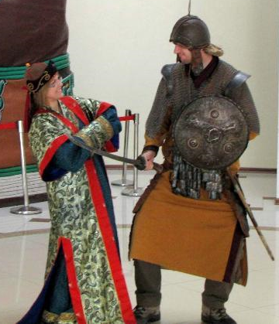
Day 1- 5/17 Ulaanbaatar-statue of Genghis Khan
Statue of Genghis Khan
The next day, you will hail a taxi from the hotel and go to the statue of Genghis Khan. It is 54 kilometers east from Ulaanbaatar and will take about an hour and a half by car. This statue is the largest statue ever built in Mongolia. It depicts Genghis Khan on his horse with his legendary golden whip in hand. It stands on top of the Genghis Khan Statue Complex, which is a visitor center that is 10 meters tall, with 36 columns representing the 36 khans from Genghis to Ligdan Khan. Inside the base of the statue ,which is two-stories, visitors can explore the three museums they have on display, eat from the restaurant, play billiards, or dress up in traditional/authentic Mongolian clothing. Visitors can ascend to the exhibition hall using an elevator at the back of the horse and then walk to the horse’s head passing through its chest and the back of its neck from where they can have an excellent scenic view over the complex area and the scenery beyond where you can take many pictures. The statue is symbolically pointed east towards his birthplace and is currently the largest equestrian statue in the world The best way to get to the statue is by taxi from the hotel and the best way to go back to the city is also by taxi. The same rates should apply for the taxi as it did in the city.

Slide 7
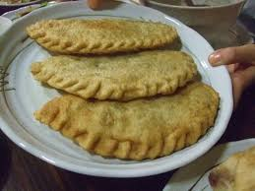
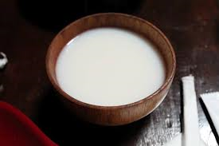
Day 1 continued-Ulaanbaatar- Restaurant
Nomad Legends Mongols Club
After the trip from the Genghis Khan statue you are hungry and need something to fill up your stomach. This restaurant is the perfect place to grab a bite to eat and the perfect place to eat a nice lunch. It is in Ulaanbaatar on Sukhbaatar Street with the Museum of Natural History right across from it. The prices of the meals are from about $3.47 - $4.62. The restaurant hours are from noon to midnight. This tiny restaurant is a good place to try some Mongolian food in a somewhat upscale atmosphere. Their signature foods and drinks to try is Mongolian milk tea or a plate of khuushuur (fried meat pancakes).

Slide 8
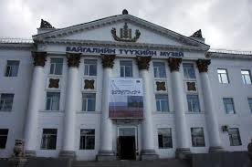
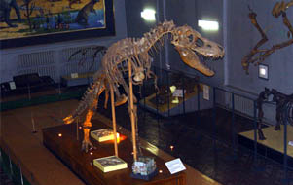
Day 1 continued- Ulaanbaatar- Museum of Natural History
Museum of Natural History
This Museum is just south of the Nomad Legends Mongols Club restaurant which is also on Sukhbaatar Street. After eating, you are able to walk to this museum. With its rambling halls, ancient exhibits, and the smell of formaldehyde and dust, the Museum of Natural History feels trapped in another age of time. There are displays on Mongolia’s geology, flora and fauna, including the requisite section with stuffed and embalmed animals, birds and even fish. Although it is badly in need of renovation, the museum can help you get acquainted with Mongolia’s remarkable biodiversity and diverse landscapes. The most impressive part of the museum is the Paleontology Hall and its display of complete dinosaur skeletons. One complete dinosaur skeleton is a 3m-tall, 5-ton, flesh-eating tarbosaurus. For a bird’s-eye view, you can climb up the stairs outside the hall to a gallery on the 3rd floor. To take pictures of the dinosaur bones you must pay an extra $2.89 to your ticket to get in, which is $1.44 for adults and 58 cents for children. Videos cost an extra $5.78.The opening hours in the museum is from 10 am – 4:30 pm and is closed on Monday and Tuesday.

Slide 9
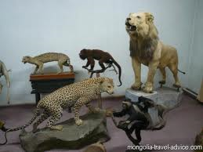
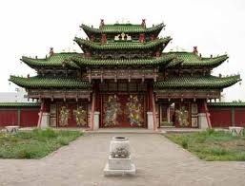
Day 2- 5/18- Ulaanbaatar- Winter Palace of Bogd Khan
Winter Palace of Bogd Khan
From the hotel, you will take a taxi to the Winter Palace of Jebtzun Damba Hutagt VIII , who was referred to as the Bogd Khan, for it is too far to walk. A taxi is the best form of transportation that can not only take you to places but is also cheap.
This was the palace of the last king of Mongolia which was built between the years of 1893-1903. There are six temples in the ground. Inside the palace is a museum that portrays all of what the owned and had. There is an exhibit that shows how penchant he was of unusual wildlife, so there are many stuffed animals which some had been part of his personal zoo. There is also an exhibit of the gifts that the khan received during his rule over Mongolia which is in the white building to the right as you enter. That building is the Winter Palace itself. The admission ticket into the Winter Palace is $1.40, but you have to pay more if you want to take pictures or videos. You have to pay $5.80 for pictures and $8.60 for videos. The opening hours are 9am-5.30pm from May 15 – September 15, and is 9.30am-4.30pm Friday-Tuesday from September 16-May 14. It is located on Chingisiin Örgön Chölöö street.

Slide 10
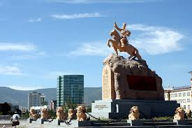
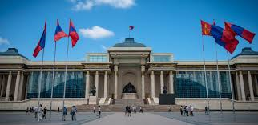
Day 2- Ulaanbaatar- Sukhbaatar square
Sukhbaatar Square
The Winter Palace of Bogd Khan is not very far from Sukhbaatar Square, so it will not take long to get there from the palace. Sukhbaatar Square is dedicated to the ‘hero of the revolution’ in Mongolia named Damdin Sükhbaatar. The square features a statue of Sükhbaatar on top of his horse. The original concrete statue has been replaced by a bronze one. The square today is occasionally used for rallies, ceremonies and even rock concerts. But the square is generally a quiet, serene place where only the photographers or tourists taking pictures are doing anything. Besides the statue of Sukhbaatar, there are some other things to look at in the square. At the northern end of the square there enormous marble construction that was completed in 2006 in time for the 800th anniversary of Chinggis Khan’s (Genghis Khan’s) coronation. At its center is a bronze statue Chinggis Khan seated , lording over his nation. Behind the Chinggis monument is where the Parliament House stands, which is commonly known as Government House. To the northeast of the square is the tall, modern Cultural Palace , a useful landmark containing the Mongolian National Modern Art Gallery and several other cultural buildings. At the southeast corner of the square, the salmon-pinkish building is the State Opera & Ballet Theatre.

Slide 11
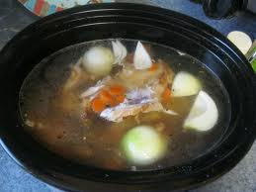
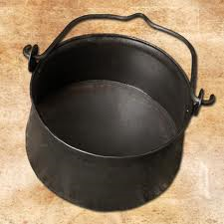
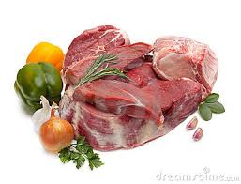
Day 2- Ulaanbaatar- Restaurant
Bull
When you are finished examining the exhibits of the Palace of Bogd Khan and visiting the Sukhbaatar Square, head on down to Bull for some dinner. Of course you will have to go there by taxi for it is too far to walk. This restaurant is the local favorite, located on Seoul Street. You can order an arrangement of raw vegetables and meats, which are brought to your table on platters for you to cook yourself in your personal cauldron of broth. This is a great substitute for the heavy meat menus that other restaurants in the area serve. Bull’s opening hours are from 11:30am-10pm and the price for a meal per person is $8.60.

Slide 12
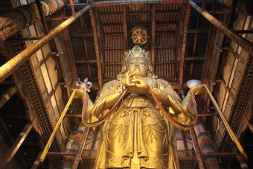
Day 3- 5/19- Ulaanbaatar- Gandan Khiid Monastery
Gandan Khiid (Gandantegchinlen) Monastery
The first stop of the day is the Ganda Khiid Monastery in Ulaanbaatar. From the hotel, get a taxi and go to this monastery that is located on Öndör Gegeen Zanabazaryn Gudamj street. This monastery is not only religiously important, but also important because it is also a tourist attraction. As you enter from the main entrance from the south, a path leads towards the right to a courtyard that contains two temples. At the end of the main path as you enter is the magnificent white Migjid Janraisig Süm, which is the monastery’s main attraction. On the walls of the temple are hundreds of images of Ayush, the Buddha of longevity, which stare through the gloom to the magnificent Migjid Janraisig statue. To the east of the temple are four colleges of Buddhist philosophy, including the yellow building dedicated to Kalachakra, a wrathful Buddhist deity. To the west of the temple is the Öndör Gegeen Zanabazar Buddhist University, which was established in 1970, but the building is usually closed off to foreigners. Opening hours to the monastery is from 8:30am-7pm. Admission to go inside is $2 but if you want to take pictures, then it is an extra $2.90. To take videos, it is an extra $5.80.

Slide 13
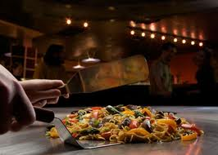
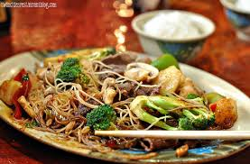
Day 3-Ulaanbaatar- Restaurant
BD’s Mongolian Barbeque
After touring the Gandan Khiid Monastery, it is time for lunch. Ride a taxi from the monastery and go to this restaurant that put a little twist to Mongolian food. If you have ever had Mongolian food in a western country, the food will look familiar. You can fill your bowl with meat, noodles, vegetables, a raw egg, sauces and then give it to the grill master who cooks your meal before your eyes. It is not fully traditional Mongolian food, but it is a popular place for families and hungry travellers. The opening hours for the restaurant is from 11am-11pm. The price for a meal per person is $4 but there is an all you can eat option for $8. This restaurant is located on Seoul Street which is also where the restaurant Bull is.

Slide 14
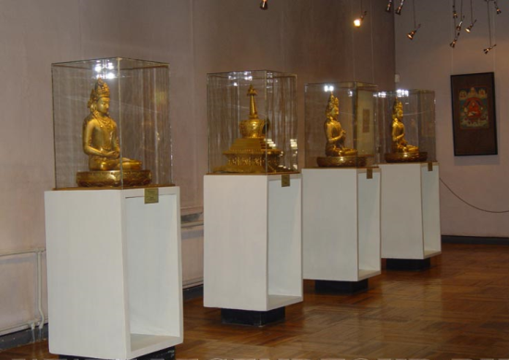
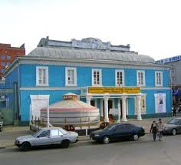
Day 3- Ulaanbaatar- Anabazar Museum of Fine Arts
Zanabazar Museum of Fine Arts
After lunch, you need to visit one more place before going to the hotel to rest. The place you will go is the Zanabazar Museum of Fine Arts. To get there you must hail a taxi for it is the easiest way to get around in the city of Ulaanbaatar. This museum is located on Juulchin Gudamj street. The Zanabazar Museum of Fine Arts museum is a museum with a superb collection of paintings, carvings and sculptures, including many by the revered sculptor and artist, Zanabazar. It also contains other rare, and occasionally old, religious exhibits such as scroll thangka (paintings) and Buddhist statues, representing the best display of its kind in Mongolia. Also worth checking out are the wonderful tsam masks (worn by monks during religious ceremonies) and the intricate paintings, One Day in Mongolia and the Airag Feast, by the renowned artist B Sharav. These paintings depict almost every aspect of nomadic life. The admission price to this museum is $1.40 for adults and is 6 cents for children. There is no extra fee to take pictures or videos. Opening hours are 10am-6pm from May-September, and 10am-5pm from October-April.

Slide 15
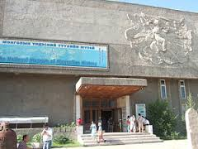
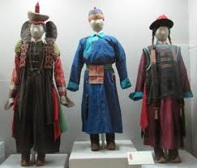
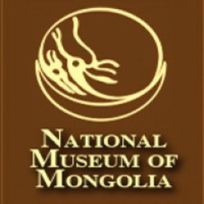
Day 4- 5/20- Ulaanbaatar- National Museum of Mongolia
National Museum of Mongolia
The National Museum of Mongolia is a destination that should not be missed. From the hotel, you need to get a taxi and tell the driver to drive you to this revamped museum. When you go into the museum, you shall see that on the 1st floor there are some fascinating exhibits on Stone Age sites in Mongolia, as well as petroglyphs, deer stones (stone sculptures of reindeer and other animals) and burial sites from the Hun and Uighur eras. When you go up to the 2nd floor, you will see that it houses an outstanding collection of costumes, hats and jewelry, representing most of Mongolia’s ethnic groups. Then take a look at the elaborate silverwork of the Dariganga minority or the barbaric headgear worn by Khalkh Mongols. And there is another floor that you can explore in the museum. On the third floor of the museum, you can see the collection that includes real examples of 12th-century Mongol armor, and correspondence between Pope Innocent IV and Guyuk Khan. There is also a display of traditional Mongolian culture with, among other things, a furnished ger, traditional farming and domestic implements, saddles and musical instruments. This museum is located on the street cnr Juulchin Gudamj & Sükhbaataryn Gudamj which is nearby Sukhbaatar Square. The museum’s opening hours are 9.30am-6pm daily from May 15-August 31, 9.30am-5.30pm from Tuesday-Saturday September 1-May 14. Prices for adults are $1.40 for adults and 70 cents for children. If you want to take pictures, then the price for taking pictures is $5.80.

Slide 16
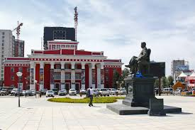
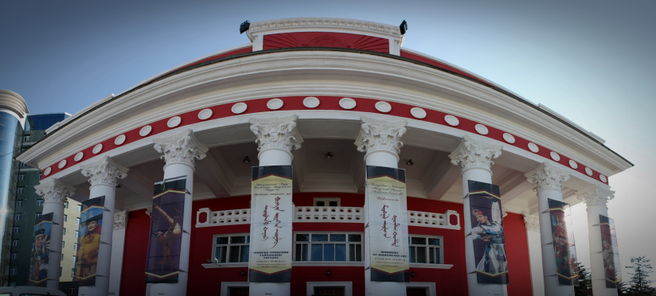
Day 4- Ulaanbaatar-National Academic Drama Theatre
National Academic Drama Theatre
The second visit of the day is at the National Academic Drama Theatre located on Seoul Street. This is the perfect place to spend time , so grab a taxi and go to this large, red theatre shows one of a dozen or so Mongolian language productions by various playwrights from Mongolia, Russia and beyond. You can buy tickets from 10am-7pm, but can also buy tickets in advance at the booking office that is on the right hand side of the theater. Schedules at the theater are sporadic and can change often. The admission price is about $5.80. If you have children, there is a puppet theatre on the left side of the theater as you approach from the road. So the theatre is a great place for adults but also for children.

Slide 17
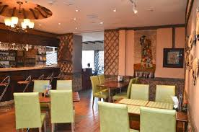
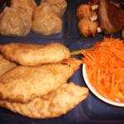
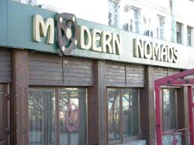
Day 4- Ulaanbaatar- Restaurant
Modern Nomad
From the theater, you need to ride a taxi to this restaurant. Modern Nomad is on Amar Street and is an authentic Mongolian restaurant yet the décor is quite modern. Here, you can try some real Mongolian foods such as buuz ( dumpling shaped as a hershey kiss with meat inside) and khuushuur (fried pancake with meat inside). You can also get the choice of salads and a buffet. The service here is fast and the people serving speak some English. The atmosphere is upbeat and also friendly. The menus are helpful to foreigners who know English for it is written in Mongolian and English. The price of the dishes range from about $1 - $20.

Slide 18
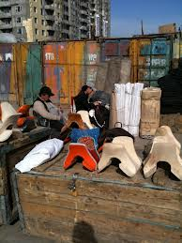
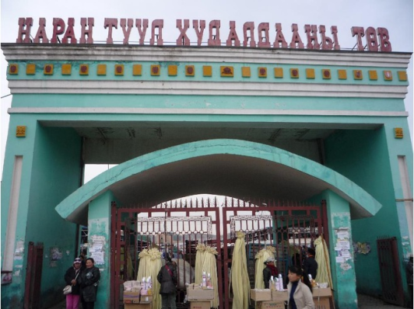
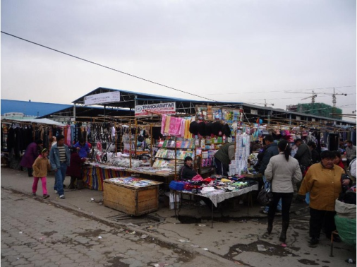
Day 5- Last Day in Ulaanbaatar- Naran Tuul Market
Naran Tuul Market
Today you will visit the Naran Tuul Market and will got there by taxi. This market is one of the cheapest markets in Ulaanbaatar where you can see many unusual items. You can get very cheap dels here for about $17.30 for summer dels and $34.50 for winter dels. Towards the back of the market, you can find horse saddles, riding tacks, and all the material needed to build your own ger. You can also find people selling spices and traditional Mongolian merchandise as well. They also have antique coin dealers but they do not issue official documents. Admission into the market is $0 (50 T) and the opening hours are from 9am-7pm Wednesday to Monday. This market is not the safest area in the city, but it is the ideal market where you can experience Mongolian tradition.

Slide 19
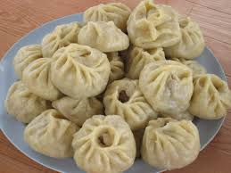
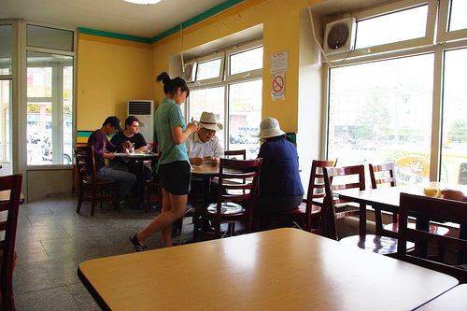
Day 5- Last Day in Ulaanbaatar- Restaurant
Khaan Buuz
The last restaurant of your visit in Mongolia is Khaan Buuz which is located in the center of Ulaanbaatar on Baga Toiruu west Street. The Khaan Buuz is a fast food restaurant with authentic Mongolian food. They serve up industrial-sized buuz (steamed mutton dumplings), plus soups and bifshteks ondogtei (beefsteak with egg). The Khaan Buuz operates for 24 hours a day and meals cost around 5 cents to 9 cents. Fast traditional Mongolia food is available to you for a cheap price at this restaurant.

Slide 20
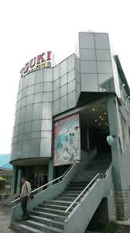
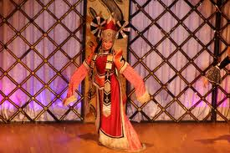
Day 5- 5/21- Last Day in Ulaanbaatar- Tsuki House
Tsuki House
The last stop of the day is at the Tsuki House. Catch a cab and come to see the Moonstone Song & Dance Ensemble where they put on a Mongolian cabaret. You can get an entire performance of contortionists, throat singers, musicians, tsam mask dancers and an electrifying shaman dance done in contemporary fashion. The Tsuki House is open seasonally from May to October. Show times are at 4pm, 6pm, and at 8pm. The admission ticket is $7. Tsuki House is located near Seoul Street and is a modern glass building.

Slide 21
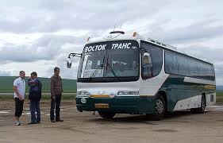
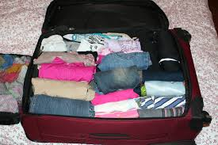
When you get back to the hotel...
Go to your hotel and then start packing to go to another city in Mongolia. You also need to purchase a bus ticket to go to the city called Dalanzadgad. In this city, you are able to explore the Gobi Desert and several other natural features Mongolia has to offer. Also have your alarm on, for you will be leaving early in the morning to go to Dalanzadgad

Slide 22
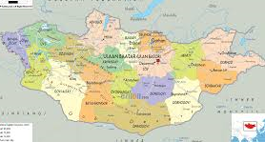
Day 6- 5/22- To the city of Dalandzadgad
Trip to Dalandzadgad
After packing all your stuff , get ready to get on the bus to go to Dalandzadgad. Dalandzadgad is a city in southern Mongolia in the province of Omnogovi. Be sure to wake up early, for the bus leaves at 8:00 am from the Bayanzurkh station in Ulaanbaatar, and the bus ride will take from about 14-18 hours. Since you can’t stay in one place for a long time on the road, you can stop by places for a short period of time. And also be sure to go to the restroom when you can, for it will be a 575 kilometer drive from Ulaanbaatar to Dalandzadgad. The cost for the bus ride is $15.80. You also won’t be lonely for you will have travelling companions on the bus with you.

Slide 23
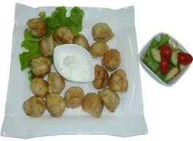
Day 6- On the way to Dalandzadgad- first stop is a restaurant.
Oig Zoog
Oig Zoog is a small restaurant in the small town of Mandalgovi. Look for this local cafe behind the Khan Bank in a yellow building. You may have to trawl through the menu before you find something that is actually available. One of their signature dishes are sharsan bansh (fried dumplings with salad). Meal prices range from $1.40- $2.30 and opening hours are from 9am-10pm.

Slide 24
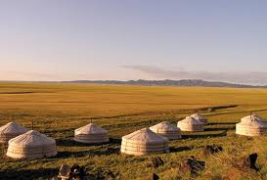
Day 6- On the way to Dalandzadgad- Dundgovi province ger camps
Ger camps
As you drive through the province of Dundgovi, you stop by some ger camps that are in the province. You see that there aren’t many things to see in the province beside desert and wildlife. The bus stops and it stops at a ger camp. The people that live in the gers are friendly and are generous to tourists that visit the area. You can sometimes be invited into their gers and are treated with some milk tea or something to eat.

Slide 25
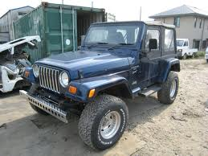
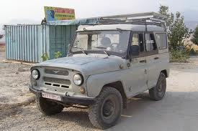
Arrival in Dalandzadgad…
Upon your arrival to Dalandzadgad, you will have to rent a vehicle that is capable of desert travel. The cars that are capable of desert terrain are Japanese jeeps, and Russian jeeps. There are no taxis here in the Gobi and while travelling in the desert it would be best if you traveled with a group of people instead of alone. Car rentals are from about $60-$110 a day.

Slide 26
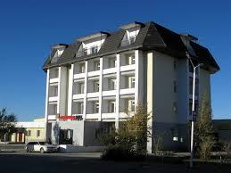
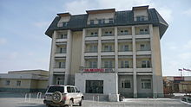
Hotel in Dalandzadgad
A hotel in Dalandzadgad is a rarity, for it is mainly desert and there is not a very developed city around it for miles. The only places to sleep are ger camps in the area. A ger is a Mongolian tent that nomads lived in a long time ago and still live in today. Most tourists who come to this aimag (province), usually do not stay in the city, for all the ger camps are a little beyond the city borders closer to the Gobi Desert. However since it is night and is too late to travel anywhere, the best place to stay for the night is at the Dalanzadgad Hotel. This hotel is the largest hotel in Dalanzadgad and is located in the northeastern part of the city. Although it is the largest hotel in the city, it is pretty small with only 32 beds in the hotel. In the hotel, there is a restaurant, bar, and a sauna. The prices for the hotel is from $25-$50 a night.

Slide 27
Day 7- 5/23- Dalandzadgad- Restaurant
Green Castle Center Restaurant
This small restaurant is located in the small city of Dalandzadgad. Leave your hotel with all your belongings and travel on your jeep that you rented and stop by this restaurant before heading out to the Gobi Desert. The restaurant is known for its ukhriin makhan steik (beef steak) and tsuivan (fried noodles with mutton). Meals cost from about $3.40-$4.90. Opening hours are from 8am-midnight.

Slide 28
Day 7- Gobi- Khongoryn Els
Khongoryn Els
After eating, go to this natural feature that is located in the Gobi Gurvansaikhan National Park which is180 km from Dalanzadgad. Khongoryn Els is also know as the ‘singing sands’. They are the most spectacular sand dunes in Mongolia, and they are called the ‘singing sands’ because of the sounds they make when the wind moves the sand or is collapsed in small avalanches. The larger dunes are found at the northwestern corner of the range. Camel rides are also possible here. The cost to ride a camel is $2.90 an hour and $8.60 a day. The trip to the Khongory Els should take the entire day and you should hire a person to drive your jeep (will cost about $81), or go with an organized tour group and not go alone. You will not have enough time to do anything else for the rest of the day, because the distance from Dalanzadgad to the Khongoryn Els is a lot and touring the place will take a couple hours as well.

Slide 29
Day 8- 5/24- Three Camels Lodge
Three Camels Lodge
Yesterday after the tour, it is too far to go back to the hotel in Dalanzadgad, so you go to the ger camp that is nearby the the Gobi Gurvansaikhan National Park. The Three Camels Lodge is considered one of the best ger camps in the area, but is also the priciest, costing about $200 a night. They have very good service and give you live entertainment. You have a private bathroom with a toilet and a sink, but you have to go to the community shower rooms at the camp. There is a lodge in the middle of the camp where you can relax, eat, and play games. And you can stay at this camp and feel like a traditional Mongol, but also have a nice view of the scenery of the Gobi Desert.

Slide 30
Day 8- Gobi Gurvansaikhan National Park - Restaurant
Three Camels Lodge Restaurant
This restaurant is in the ger camp and you don’t have to leave the comfort of the lodge. (Other restaurants are not able to be found around this area and the only restaurant there is, is at the ger camp.) This restaurant lets you to be able to eat authentic and good tasting Mongolian food with a little bit of a twist to it. You are able to eat at the lodge for breakfast, lunch, or dinner. Not only that, but while eating, you can look out the window and marvel over the scenic views of the Gobi Desert and be able to enjoy your meal even more. Price of the food is included with the price of your stay.

Slide 31
Day 8- Gobi Gurvansaikhan National Park- Yolyn Am
Yolyn Am
When you leave from the lodge, you are to go to the Gobi Gurvansaikhan National Park and visit the Yolyn Am also known as Eagle Valley. The Yolyn Am was originally created to protect the birdlife in the region, but it is now more famous for its dramatic rocky cliffs and narrow, heavily shaded canyons that allow sheets of blue-veined ice to survive well even into the summer months. Yolyn Am is in the Zuun Saikhan Nuruu, 46km west of Dalanzadgad. This trip will take up most of the hours of the day, so there won’t be anytime to do anything else.

Slide 32
Day 9- 5/25- Dalanzadgad to Kharkhorin.
From the ger camp, you drive back to Dalanzadgad and you get ready to go to the city of Kharkhorin in the province of Övörkhangai . It will take 18 hours to get to Kharkhorin by vehicle. The two cities are 970 kilometers apart. You will take a jeep that will be driven by someone and go to the city of Kharkhorin. You can visit some places on the way but not stay too long. Also getting up early in the morning is important for you need to get an early start. This will be more expensive than the bus ride, for you have a driver that is driving the jeep, and it is a farther distance as well.
Kharkhorin
Dalanzadgad

Slide 33
Day 9- On the way to Kharkhorin- Restaurant
Tov Borkigan Ger Camp
On the way to Kharkhorin, you stop by a ger camp for lunch, for that is the only place to eat in a radius of more than fifty miles. This small restaurant within the ger camp, is the perfect place to rest for a while and enjoy your meal. There is electricity here, and also a restroom. The meals are good Mongolian cuisine and are served on very nice plates on cutlery. The restaurant is open from the morning to when the camp is settled down to go to sleep. Meal prices will vary, for the food is included to your stay in the ger camps, but since you are just staying temporarily to eat, you will have to ask what the price of the food is. You will not be staying here for long. It is just a quick meal and you will be back to the road to Kharkhorin.

Slide 34
Day 9- On the way to Kharkhorin- Ulaanbaatar
Still on your way to Kharkhorin, you go through the city of Ulaanbaatar, the city which you stayed for the first 5 days of your journey. In Ulaanbaatar, you will visit the Terelj National Park. You will stay overnight in the ger camps that are in the park, for the sun is going down and you and your driver need a rest from the long drive. The Terelj National Park is a park that is visited by many tourists, because of the strange rock formations and Khentii Mountains located within the park. It is also well know for its Turtle rock and a man who is reading shaped rock. The park is ideal for hiking, horseback/camel back riding, fishing, climbing and photography. This park is 70 kilometers northeast of the capital.

Slide 35
Day 9- Terelj National Park- ger camp
Terelj Lodge
This ger camp is located in the Terelj National Park. You will be staying here for one night and will move on to go to the city of Kharkhorin. The Terelj lodge has three options to choose from: the standard ger, deluxe ger, or wooden house. The standard gers can accommodate 2-4 people and it has 2-3 queen size beds and and one king size bed. The deluxe gers come with a private bathroom with a toilet, sink, and shower. It also has a king size bed and queen size twin beds. The wooden houses are small cabins with large king and queen sized beds and a wide window for a great panoramic view. Prices vary for each type of ger. A standard ger costs $85 a night with a bed and all three meals. A deluxe ger costs $145 a night with a bed and all three meals.

Slide 36
Day 10- 5/26- Kharkhorin- hotel
Dreamland
You leave the ger camp from Ulaanbaatar in the morning, and it takes about 5 hours and 30 minutes to get to Kharkhorin. When you arrive, you stop by look for a hotel and it’s not a hotel. Instead it is a ger camp that is very luxurious and modernized. Dreamland gers have almost everything to make you feel at home. They have ger that have an attached bathroom with flush toilets and a private shower, a king-sized bed, air-conditioning and cable TV. It is owned and operated by a Mongolian sumo champion, so there are some Japanese culture in this ger camp such as a beautiful Japanese-style sauna and bathhouse. It is 360 kilometers away from Ulaanbaatar, and it is located on the banks of the Orkhon River. The prices per night for a single person in a Standard Felt Ger is $40 and is $50 for a Luxury Felt Ger. The price is included with breakfast.

Slide 37
Day 10- Kharkhorin- Erdene Zuu Khiid
Erdene Zuu Khiid
The Erdene Zuu Khiid was a Buddhist monastery, but is now a museum and is not a place of worship anymore. Entrance to the monastery grounds is free. If you want to see inside the temples, however, you’ll have to go to the ticket desk and souvenir shop on your left as you enter the grounds from the south and buy a ticket for $3, which includes a guided tour of the site. But permission to take photos in the temples is an additional $5 and video is $10. The monastery is enclosed in an immense walled compound The three temples in the compound, which were not destroyed in the 1930s, are dedicated to the three stages of Buddha’s life: childhood, adolescence and adulthood. There are many other features to the Erdend Zuu Khiid and is a great place to go for a tour and see Mongolia’s history.

Slide 38
Day 10- Kharkhorin - Stone Turtles
Stone Turtles
If you go outside of the monastery’s walls, you will find two stone turtles. There were once four sculptures that used to mark the boundaries of ancient Karakorum, acting as protectors of the city (turtles were considered symbols of eternity). The turtles originally had an inscribed stone stele mounted vertically on their back. One of them is easy to locate because all you have to do is just walk out of the northern gate of the monastery and follow the path northwest for about 300m. The other one is a little trickier to find, for you will need a guide or directions to find the other one, which is on the hill south of the monastery, about 600m past the phallic rock.

Slide 39
Day 10- Kharkhorin- Restaurant
Morin Jim Café
This restaurant is managed by french people and the food is a mixture of Mongolian and western style foods. The menu includes buuz (steamed mutton dumpling) and goulash. Opening hours are from 8 am-11 pm. Prices range from about $2.30-$3.40. This restaurant is located in the city of Kharkhorin, so you don’t have to go very far to get to this restaurant.

Slide 40
Day 11- 5/27- Kharkhorin- Ancient Karakorum
Ancient Karakorum
The ancient city of Karakorum is just 1 kilometer south and east beyond the location of the stone turtle. The foundations of Karakorum’s buildings are all underground and little of it has been unearthed, so you need to have a great imagination to ponder the grandness of it all. The plain was littered with bricks, ruined walls, and pillars until the mid-16th century, when everything was picked up and used to build the walls and temples of nearby Erdene Zuu Khiid. And next to the stone turtle you can see an area of raised earth surrounded by a wire fence. This was the alleged site of Ögedei Khaan’s palace.

Slide 41
Day 11- Kharkhorin- Phallic Rock
Phallic Rock
Near Kharkhorin, a 60cm-long stone penis attracts steady streams of curiosity-seekers. The ‘phallic rock’, which points ironically to something interestingly called a ‘vaginal slope’, is hidden up in small valley about 2kilometers southeast of Erdene Zuu Khiid (look for the sign from the main road).
Legend has it that the rock was placed here in an attempt to stop frisky monks, filled with lust by the shapely slope, from fraternizing with the local women. On the hill next to the historic stone penis is a newer penis, chiseled smooth and standing erect.

Slide 42
Day 11- Kharkhorin- Tsagaan Lavai
Tsagaan Lavai
After your visit to the phallic rock and and the site of the ancient city of Karokorum, go back to the city of Kharkhorin and go to this restaurant. Unlike many other restaurants in Mongolia, this restaurant serves dishes for vegetarians and vegans. This café is nearby the Morin Jim Café. Prices of the dishes are about $1.10 and the opening hours are from 9am- 8pm Monday-Saturday.

Slide 43
Day 12- 5/28 – Kharkhorin- Great Imperial Map Monument
Great Imperial Map Monument
Drive from the ger camp to this new and large monument that was built in 2004. It is atop a hill overlooking Kharkhorin to the southwest. The three sides honor various empires established on the Orkhon Gol, including the Hunnu period (300–200 BC), the Turkic period (AD 600–800) and the Mongol period (13th century). You can get an excellent panoramic view from here. There is no charge to come to this monument and can visit it whenever you like.

Slide 44
Day 12- Kharkhorin- Kharkorin Museum
Kharkhorin Museum
This new Kharkhorin museum,was opened in 2009. In this museum, there are displays of the history of the city and the archaeological discoveries made ​​in the north of Erdene Zuu Khiid by several archaeological teams. This small museum has three rooms with the largest room having about 4 or 5 sections. It contains history of Mongolia from the stone ages to the middle ages. It also displays a 3D map of Kharkhorin. There are also captions in English that allow you to read the descriptions.

Slide 45
Day 12- Kharkhorin- Restaurant
Dreamland
After touring the Great Imperial Map Monument and Kharkhorin Museum, you go eat at a restaurant in Kharkhorin. This restaurant is a European restaurant with western food. At this restaurant, you can eat some of the best meals in this area. The meals cost from about $4.60-$8.60 and opening hours are from 9 am- 8 pm everyday.

Slide 46
Day 13- 5/29- Kharkhorin- Orkhon Waterfall
Orkhon Waterfall (UlaanTsutgalan)
From Kharkhorin, you will drive to Bat-Ulzii, which is the city where the Orkhon Waterfall is located in. The Orkhon Waterfall (UlaanTsutgalan) is the largest waterfall in Mongolia and was formed from volcanic eruptions about 20,000 years ago. It cascades from the height of 22 metres and is 10m wide. This waterfall is the halfway marker of the Orkhon River which runs about 1120 kilometers before meeting the Selenge River. It can be slightly chilly, but it is possible to swim in the plunge pool where the water falls into.

Slide 47
Day 13- Kharkhorin- Orkhon River
Orkhon River
After your visit to the Ulaan Tsutgalan waterfall, you will then travel up the Orkhon River and hike along the Orkhon River Valley and visit the nomads in the countryside and be able to have a taste of airag (fermented horse milk that is put in some liquors). You can take in the wonderful scenery of Mongolia and be able to marvel at the beautiful blue sky that Mongolia is known for. Be sure to wear your comfortable shoes, or you won’t be able to walk very much.

Slide 48
Day 13- Kharkhorin- Restaurant
Dreamland ger camp
Since you have visited all the restaurants in the Kharkhorin city area, you will have to eat at your ger camp. At the ger camp you will have Mongolian cuisine that may be mixed with western cuisine. The price is included with your stay at the ger camp, and the hours are from when guests start waking up to when everyone is in bed.

Slide 49
Day 14- 5/30- Kharkhorin to Bayankhongor
In the morning, you will leave the ger camp and go to the city of Bayankhongor by jeep. Bayankhongor is southwest of Kharkhorin and will take approximately 6 hours and 17 minutes to get there. It is about 100 kilometers from Kharkhorin. You can visit places along the way, but can’t stay for long, for you have to get to the city quickly. Note: this will be the last city you visit before leaving Mongolia.
Kharkhorin
Bayankhongor

Slide 50
Day 14- Bayankhongor Lamyn Gegeenii Gon Gandan Dedlin Khiid
Lamyn Gegeenii Gon Gandan Dedlin Khiid
Upon arrival to Bayankhongor, you will visit the Lamyn Gegeenii Gon Gandan Dedlin Khiid. This monastery used to be 20 kilometers east from Bayankhongor. This monastery used to be the largest in Mongolia, but it was destroyed by the communists in 1937. The current monastery is home to only 15 monks and foundations have been laid for the new prayer temple that was completed in 2011. Daily services at the monastery start at 10am in the ‘brick ger’ temple which features a statue of Sakyamuni (the historical Buddha) surrounded by a green-and-white Tara.

Slide 51
Day 14- Bayankhongor-Aimag Museum
Aimag Museum
After visiting the monastery, go visit the Aimag Museum which is also in the city of Baynkhongor. The Aimag Museum is located inside a sports stadium, but is well laid out and worth a visit. There is a good display on Buddhist art, featuring two lovely statues of Tara, some old scroll paintings, and tsam (lama dance) masks and costumes. The admission ticket is $1.10, but to take pictures you must pay an extra amount of $2.90. Opening hours to the museum are 9am-1pm & 2-6pm Monday-Friday.

Slide 52
Day 14- Bayankhongor- Restaurant
Soyombo
Soyombo is a Asian restaurant that can be found in the city of Bayankhongor. This restaurant serves traditional Mongolian food such as buuz, but you can also get fried chicken if you are lucky enough. The meal prices are from about $2.00-$3.40. Opening hours are from 10 am- 11 pm.
Lucky Day ☺

Slide 53
Day 14- Bayankhongor- Place to sleep
Khongor Hotel
This hotel is the hotel you will be staying for one night before you leave Mongolia. This hotel is located in Bayankhongor but is not the most luxurious of all hotels, but it is clean and functional with some having showers. To have secure parking, it costs an additional $1.70 to your stay here.

Slide 54
Day 15- 5/31- Bayankhongor- Dinosaur Park
Dinosaur Park
Before leaving for Ulaanbaatar to the airport, you can visit a couple places very quickly. The first stop of the day is a Dinosaur Park. This park has several life-sized concrete dinosaurs including a family of Velociraptors, some kind of sauropod and a T-Rex. The cost into the Dinosaur Park is free with no cost at all. The park is still being constructed and each dinosaur is being carefully constructed with Bayankhongor's wisest welders, magnificent mud molders and positively praiseworthy painters. Some of these statues rise 10 meters off the ground.

Slide 55
Day 15- Bayankhongor- Natural History Museum
Natural History Museum
This museum is found in the city of Bayankhongor. At the museum you can see animals that can be found in Bayankhongor that have been stuffed, a replica of aTarbosaurus skeleton and some fossils, including a 130-million-year-old fossilised turtle. This will be the last place that you visit ,besides a restaurant, before you leave for home.

Slide 56
Day 15- Bayankhongor- Restaurant
Uran Khairkhan
This restaurant is the last restaurant you will eat at before you leave the city of Bayankhonger and go to the airport to leave for home. This Central Asian restaurant with its cheery yellow tablecloths and cosy booth dining, jovial Uran Khairkhan is reminiscent of a Norman Rockwell painting c 1950. Their signature iced cakes in the cabinet are 6 cents a slice. Meal prices are from 9 cents- $3.40. Opening hours are from 9am-10pm.

Slide 57
Day 15- To the airport
You have stayed in Mongolia for 15 days and have visited 4 cities. Take a jeep from Bayankhongor and go to Ulaanbaatar to take the flight to go back home. It take about 9 hours and 16 minutes to get to Ulaanbaatar by vehicle and your airplane will take off at 11:55 pm. After that, good bye Mongolia.

Slide 58
Total money spent in Mongolia
Including the airplane ticket, you have spent over 4,000 dollars in Mongolia. Although everything seemed cheap, that totals up and ends up being a lot of money. But a trip to Mongolia is pretty cheap compared to other vacations. Hope that you will enjoy Mongolia when you visit for vacation one day! ☺

Slide 59
Bibliography Photographs
Airag. 2011. Photograph. Mongolia Expeditions. Blogger, 2011. Web. 13 Feb. 2014. <http://altai-expeditions.blogspot.com/2011/02/airag-fermented-mares-milk.html>.
PhotographCommentsLinkTagsParentheticalEditDelete
Animals from the Bogd Khan's Private Zoo. 2014. Photograph. Bogd Khan Palace Museum, Ulaanbaatar. Bogd Khan Palace Museum. 2014. Web. 12 Feb. 2014. <http://www.mongolia-travel-advice.com/bogd-khan-palace.html>.
PhotographCommentsLinkTagsParentheticalEditDelete
Barthelemy, Jane. Broth. N.d. Photograph. Jane's Healthy Kitchen. Jane Barthelemy, 2014. Web. 12 Feb. 2014. <http://janeshealthykitchen.com/paleo-bone-broth/#.Uv1E5u0o7IU>.
PhotographCommentsLinkTagsParentheticalEditDelete
Croner, Don. Winter Palace of Bogd Khan. 2011. Photograph. Ulaanbaatar. Don Croner’s World Wide Wanders. 21 June 2011. Web. 12 Feb. 2014. <http://www.doncronerblog.com/2011/06/mongolia-bogd-khan-winter-palace-museum.html>.
PhotographCommentsLinkTagsParentheticalEditDelete
Croner, Don. Zanzbazar Museum of Fine Arts. 2006. Photograph. Ulaanbaatar. Mongolia Web. 6 May 2006. Web. 13 Feb. 2014. <http://www.mongolia-web.com/476-zanabazar-museum-fine-arts>.
PhotographCommentsLinkTagsParentheticalEditDelete
Cultural Show at Tsuki House Ulaanbaatar. 2011. Photograph. Ulaanbaatar. Picasa Web Albums. Picasa, 2011. Web. 13 Feb. 2014. <http://picasaweb.google.com/lh/photo/4DDTqAiJkextN_wtQBaI7A>.
PhotographCommentsLinkTagsParentheticalEditDelete
Davis, Ben. The Parliament Building, Sukhbaatar Square, Ulaanbaatar. 2012. Photograph. Sukhbaatar Square, Ulaanbaatar. Ben Davis Photography. Blogger, 13 July 2012. Web. 12 Feb. 2014. <http://bendavisphotography.blogspot.com/2012/07/arriving-in-mongolia.html>.
PhotographCommentsLinkTagsParentheticalEditDelete
Deluxe King Bed. 2014. Photograph. Mongolia, Ulaanbaatar. Agoda. Agoda, 2014. Web. 12 Feb. 2014. <http://www.agoda.com/ramada-ulaanbaatar-citycenter-hotel/hotel/ulaanbaatar-mn.html>.
PhotographCommentsLinkTagsParentheticalEditDelete
Erdene Zuu Khiid. N.d. Photograph. Conservation Ink. Conservation Ink, 2010. Web. 13 Feb. 2014. <http://conservationink.org/pancardgallery.htm>.
PhotographCommentsLinkTagsParentheticalEditDelete
Glamping in Mongolia. 2011. Photograph. Glamping in Mongolia. Theguardian, 16 Aug. 2011. Web. 13 Feb. 2014. <http://www.theguardian.com/travel/2011/aug/16/glamping-mongolia-yurt-ger>.
PhotographCommentsLinkTagsParentheticalEditDelete
Great Imperial Monument. 2013. Photograph. Panoramio. Panoramio, 2013. Web. 13 Feb. 2014. <http://www.panoramio.com/user/114525>.
PhotographCommentsLinkTagsParentheticalEditDelete
J, Chris. Gandantegchinlen Khiid Monastery. 2012. Photograph. Ulaanbaatar, Ulaanbaatar. TrekEarth. TrekEarth, 2012. Web. 26 Jan. 2014. <http://www.trekearth.com/gallery/Asia/Mongolia/East/Ulaanbaatar/Ulan_Bator/>.
PhotographCommentsLinkTagsParenthetical

Slide 60
Bibliography Photographs
Khuushuur. 2014. Photograph. Mongolia, Ulaanbaatar. Explore Mongolia. Blogger, 2014. Web. 13 Feb. 2014. <http://exploremongolia.blogspot.com/2011/05/mongolian-food.html>.
Kim, Miru. Khongoryn Els. 2013. Photograph. Khongoryn Els. Artsy. Artsy, 2013. Web. 13 Feb. 2014. <https://artsy.net/artwork/miru-kim-khongoryn-els-mongolia-gobi-1>.
Korean Air. 2014. Photograph. Airplane Pictures. Airplane Pictures, 2014. Web. 12 Feb. 2014. <https://encrypted-tbn1.gstatic.com/images?q=tbn:ANd9GcR7qXvWKps_Aaj-v_u66IzQ8FihslZJ-ZCkVnw09U8FXZaLuQDr>
Levin, Dan. A 131-foot-tall Statue of Genghis Khan and His Horse. 2009. Photograph. Mongolia. New York Times. New York Times, 2 Aug. 2009. Web. 26 Jan. 2014. <http://www.nytimes.com/2009/08/03/world/asia/03genghis.html?_r=0>.
Lobby of Ramada Ulaanbaatar Citycenter. 2014. Photograph. Mongolia, Ulaanbaatar. Ramada Ulaanbaatar Citycenter. Agoda, 2014. Web. 12 Feb. 2014. <http://www.agoda.com/ramada-ulaanbaatar-citycenter-hotel/hotel/ulaanbaatar-mn.html>.
Migjid Janraisig Statue. 2014. Photograph. Ulaanbaatar. Buddhism and Religion. Mongolia Travel and Tours, 2014. Web. 12 Feb. 2014. <http://www.mongolia-travel-and-tours.com/buddhism-mongolia.html>.
Mongolian Food. 2014. Photograph. Mongolian Food. Blue Silk Travel, 2014. Web. 16 Feb. 2014. <http://www.bluesilktravel.com/Mongolia-Travel-Mongolian-Food.htm>.
Mongolian Milk Tea. 2014. Photograph. Mongolia, Ulaanbaatar. Mongolian Milk Tea Anyone? JMO Brain Dump, 2014. Web. 13 Feb. 2014. <http://jmobraindump.wordpress.com/2012/08/17/mongolian-milk-tea-anyone/>
Mongolian Stir Fry. 2014. Photograph. King Khan Lunch Menu. King Khan Crazy Mongolian Stir Fry and Sushi Bar, 2014. Web. 12 Feb. 2014. <http://kingkhanmongolian.com/our-menu/>.
Mongolian Stir Fry. 2014. Photograph. Sandy. HuHut Mongolian Grill. HuHut Mongolian Grill, 2014. Web. 12 Feb. 2014. <https://www.huhot.com/locations/utah/sandy>.
Mongolian Traditional Clothing. 2013. Photograph. Ulaanbaatar. Take a Glimpse of Mongolian History. 2013. Web. 13 Feb. 2014. <http://www.mytripblog.org/pg/blog/mongolia-social-manager/read/71348/take-a-glimpse-of-mongolian-history-in-ulaanbaatar>.
Naran Tuul Market. 2014. Photograph. Ulaanbaatar. Virtual Tourist. Virtual Tourist, 2014. Web. 13 Feb. 2014. <http://www.virtualtourist.com/travel/Asia/Mongolia/Shopping-Mongolia-TG-C-1.html>.
N.d. Photograph. Museum of Natural History, Ulaanbaatar. Mongolia Tourism. To Promote Responsible Tourism in Mongolia, 2011. Web. 13 Feb. 2014. <http://www.mongoliatourism.org/travel-services/mongolian-museums.html>.
Ramada. 2014. Photograph. Mongolia, Ulaanbaatar. Agoda. Agoda, 2014. Web. 12 Feb. 2014. <http://www.agoda.com/ramada-ulaanbaatar-citycenter-hotel/hotel/ulaanbaatar-mn.html>.
Raw Meat with Vegetable. N.d. Photograph. Dreamstime. Dreamstime, 2014. Web. 12 Feb. 2014. <http://www.dreamstime.com/stock-image-raw-meat-vegetables-image21848901>.
Roof of Mongolia Trek. 2014. Photograph. Mongolia. Discover Mongolia. Discover Mongolia, 2014. Web. 26 Jan. 2014. <http://www.discovermongolia.mn/tours/Adventure_travel/Mongolia_trekking_Altai_mountains.html>.
Stone Turle. 2013. Photograph. World Adventurer. World Adventurer, 2013. Web. 13 Feb. 2014. <http://world-adventurer.com/>
Sukhbaatar. 2014. Photograph. Ulaanbaatar. 14 Day Mongolia, Gobi, and Beijing. Discovery Tours By Gate 1, 2014. Web. 12 Feb. 2014. <http://www.discovery-tours.com/STW//stwproduct.aspx?theme=DISCOVER&productcode=DSCV-MN-CN-14DPSGDB-14&print=Y&skipbody=Y>.
Taxis in Ulaanbaatar 2011. 2010. Photograph. Ulaanbaatar. 612 New Taxis in Ulaanbaatar in 2011. New Agency, 2010. Web. 12 Feb. 2014. <http://english.news.mn/content/91604.shtml>.
Three Camels Lodge. 2014. Photograph. Gobi Gurvansaikhan National Park. Wilderness Travel. Wilderness Travel, 2014. Web. 13 Feb. 2014. <http://www.wildernesstravel.com/lodging/mongolia/three-camel-lodge>.
Tsuivan. 2013. Photograph. Photobucket. Photobucket, 2013. Web. 13 Feb. 2014. <http://s1195.photobucket.com/user/Joes-Corner/media/JC%20Daily%20Special/100_3701.jpg.html>.
Ulaanbaatar. N.d. Photograph. Ulaanbaatar, Mongolia. Ulaanbaatar Travel Guide. Vacation Advice 101, 2013. Web. 26 Jan. 2014. <http://vacationadvice101.com/category/mongolia/>.

Slide 61
Bibliography information
Dream Land Khar Khorin and Erdenezuu–Dream Land Ger Camp Uvurkhangai." Camp Information. Mongolian Ger Camps, 2013. Web. 16 Feb. 2014. <http://www.mongoliagercamps.net/home/campview/dream_land_ger_camp>.
"Dream Mongolia." Dream Mongolia. Dream Mongolia, 2014. Web. 13 Feb. 2014. <http://www.dreammongolia.com/index.php/template/adventure-tours/kharkhorin-and-gobi-tour>.
"Enormous Statue of Genghis Khan in Mongolia | Amusing Planet." Enormous Statue of Genghis Khan in Mongolia | Amusing Planet. Amusing Planet, 2014. Web. 12 Feb. 2014. <http://www.amusingplanet.com/2013/09/enormous-statue-of-genghis-khan-in.html>.
"Erdene Zuu Khiid." Lonely Planet. Lonely Planet, 2014. Web. 13 Feb. 2014. <http://www.lonelyplanet.com/mongolia/central-mongolia/kharkhorin-karakorum/sights/religious/erdene-zuu-khiid>.
"Gandan Khiid." Lonely Planet. Lonely Planet, 2014. Web. 15 Feb. 2014. <http://www.lonelyplanet.com/mongolia/sights/religious/gandan-khiid>.
"Genghis Khan Statue Complex, Ulaanbaatar." Genghis Khan Statue Complex. Trip Advisor, 2014. Web. 13 Feb. 2014. <http://www.tripadvisor.com/Attraction_Review-g293956-d3243907-Reviews-Genghis_Khan_Statue_Complex-Ulaanbaatar.html>.
"Green Castle Center Restaurant." Lonely Planet. Lonely Planet, 2014. Web. 15 Feb. 2014. <http://www.lonelyplanet.com/mongolia/the-gobi/dalanzadgad/restaurants/central-asian/green-castle-center-restaurant>.
"Kharakhorin Museum." Gogobot. Gogobot, 2013. Web. 13 Feb. 2014. <http://www.gogobot.com/kharakhorin-museum-kharkhorin-attraction>.
"Khongoryn Els." Lonely Planet. Lonely Planet, 2014. Web. 13 Feb. 2014. <http://www.lonelyplanet.com/mongolia/sights/natural-landmarks/khongoryn-els>.
"MONGOLIA GER CAMP, MONGOLIA ACCOMMODATIONS, MONGOLIA LODGES, LEISURE IN MONGOLIA." MONGOLIA GER CAMP, MONGOLIA ACCOMMODATIONS, MONGOLIA LODGES, LEISURE IN MONGOLIA. Look Mongolia, 2014. Web. 13 Feb. 2014. <http://www.tereljlodge.com/reservation.html>.
"Mongolia 2nd." Google Books. N.p., 2010. Web. 13 Feb. 2014. <http://books.google.com/books?id=u1Y-51tTJ78C&pg=PA290&lpg=PA290&dq=ger+camp+prices+dalanzadgad&source=bl&ots=ZgO9NkRlZ0&sig=qwqYwj9mlgOhu__CBCjdU0YjFa4&hl=en&sa=X&ei=V_3_UsaxFsu-kQfPo4GoAQ&ved=0CEoQ6AEwBQ#v=onepage&q=ger%20camp%20prices%20dalanzadgad&f=false>.
"Mongolian Tugrik (MNT) and United States Dollar (USD) Currency Exchange Rate Conversion Calculator." Convert Mongolian Tugriks (MNT) and United States Dollars (USD): Currency Exchange Rate Conversion Calculator. N.p., 2014. Web. 12 Feb. 2014. <http://coinmill.com/MNT_USD.html#MNT=300>.

Slide 62
Bibliography information
"Museum of Natural History." Lonely Planet. Lonely Planet, 2013. Web. 13 Feb. 2014. <http://www.lonelyplanet.com/mongolia/sights/museums-galleries/museum-natural-history>.
"National Museum of Mongolia." Lonely Planet. Lonely Planet, 2014. Web. 13 Feb. 2014. <http://www.lonelyplanet.com/mongolia/sights/museums-galleries/national-museum-mongolia>.
"Ramada Ulaanbaatar Citycenter." KAYAK. KAYAK, 2014. Web. 12 Feb. 2014. <http://www.kayak.com/hotels/Ramada-Ulaanbaatar-Citycenter%2CUlaanbaatar%2CMongolia-c5134-h603089-details/2014-05-16/2014-05-20/expanded/#overview>.
"Restaurants in Mongolia." Lonely Planet. Lonely Planet, 2014. Web. 12 Feb. 2014. <http://www.lonelyplanet.com/mongolia/restaurants>.
"SÃ¼khbaatar Square." Lonely Planet. Lonely Planet, 2014. Web. 13 Feb. 2014. <http://www.lonelyplanet.com/mongolia/sights/squares-plazas/sukhbaatar-square>.
"Taxi Fares in Ulaanbaatar, Mongolia." Taxi Fare in Ulaanbaatar, Mongolia. Taxi Prices Calculator for Ulaanbaatar. Numbeo, 2014. Web. 13 Feb. 2014. <http://www.numbeo.com/taxi-fare/city_result.jsp?country=Mongolia&city=Ulaanbaatar>.
"Things to Do in Mongolia." Lonely Planet. Lonely Planet, 2014. Web. 13 Feb. 2014. <http://www.lonelyplanet.com/mongolia/things-to-do>.
"Three Camels Lodge Campground, Dalandzadgad." Three Camels Lodge (Dalandzadgad, Mongolia). Trip Advisor, 2014. Web. 13 Feb. 2014. <http://www.tripadvisor.com/Hotel_Review-g940744-d606052-Reviews-or10-Three_Camels_Lodge-Dalandzadgad_Omnogovi_Province.html#REVIEWS>.
"Travel Closer to Nature. Best Opportunities for Horse Riding and Hiking." Gorkhi Terelj National Park Welcomes You. Grand Altai Mountain LLC, 2014. Web. 13 Feb. 2014. <http://www.explore-mongolia.com/destination/explore_gorkhi_terelj_national_park>.
"Ulaanbaatar." Transport in Mongolia. Lonely Planet, 2014. Web. 12 Feb. 2014. <http://www.lonelyplanet.com/mongolia/ulaanbaatar/transport/getting-around>.
"Winter Palace of the Bogd Khan." Lonely Planet. Lonely Planet, 2013. Web. 13 Feb. 2014. <http://www.lonelyplanet.com/mongolia/sights/museums-galleries/winter-palace-bogd-khan>.
"Zanabazar Museum of Fine Arts." Lonely Planet. Lonely Planet, 2014. Web. 13 Feb. 2014. <http://www.lonelyplanet.com/mongolia/sights/museums-galleries/zanabazar-museum-fine-arts>.

