Slide 1
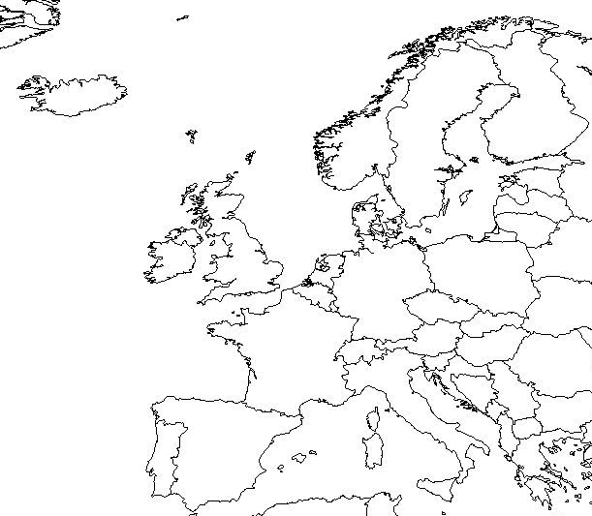
WEST EUROPE MAP REVIEW

Slide 2
GERMANY
COUNTRY

Slide 3
ICELAND
COUNTRY

Slide 4
IRELAND
COUNTRY

Slide 5
UNITED KINGDOM
COUNTRY

Slide 6
NORWAY
COUNTRY

Slide 7
SWEDEN
COUNTRY

Slide 8
FINLAND
COUNTRY

Slide 9
DENMARK
COUNTRY

Slide 10
AUSTRIA
COUNTRY

Slide 11
SWITZERLAND
COUNTRY

Slide 12
ITALY
COUNTRY

Slide 13
SPAIN
COUNTRY

Slide 14
PORTUGAL
COUNTRY

Slide 15
FRANCE
COUNTRY

Slide 16
LUXEMBOURG
COUNTRY

Slide 17
BELGIUM
COUNTRY

Slide 18
NETHERLANDS
Or
HOLLAND
COUNTRY

Slide 19
GREECE
COUNTRY

Slide 20
PARIS
CAPITAL

Slide 21
REYKJAVIK
CAPITAL

Slide 22
DUBLIN
CAPITAL

Slide 23
LONDON
CAPITAL

Slide 24
OSLO
CAPITAL

Slide 25
STOCKHOLM
CAPITAL

Slide 26
HELSINKI
CAPITAL

Slide 27
COPENHAGEN
CAPITAL

Slide 28
BERLIN
CAPITAL

Slide 29
VIENNA
CAPITAL

Slide 30
BERN
CAPITAL

Slide 31
ROME
CAPITAL

Slide 32
MADRID
CAPITAL

Slide 33
LISBON
CAPITAL

Slide 34
LUXEMBERG CITY
CAPITAL

Slide 35
BRUSSLES
CAPITAL

Slide 36
AMSTERDAM
CAPITAL

Slide 37
ATHENS
CAPITAL

Slide 38
CORSICA
ISLAND

Slide 39
SARDINIA
ISLAND

Slide 40
SICILY
ISLAND

Slide 41
CRETE
ISLAND

Slide 42
MUNICH
CITY

Slide 43
BARCELONA
CITY

